Slide 1
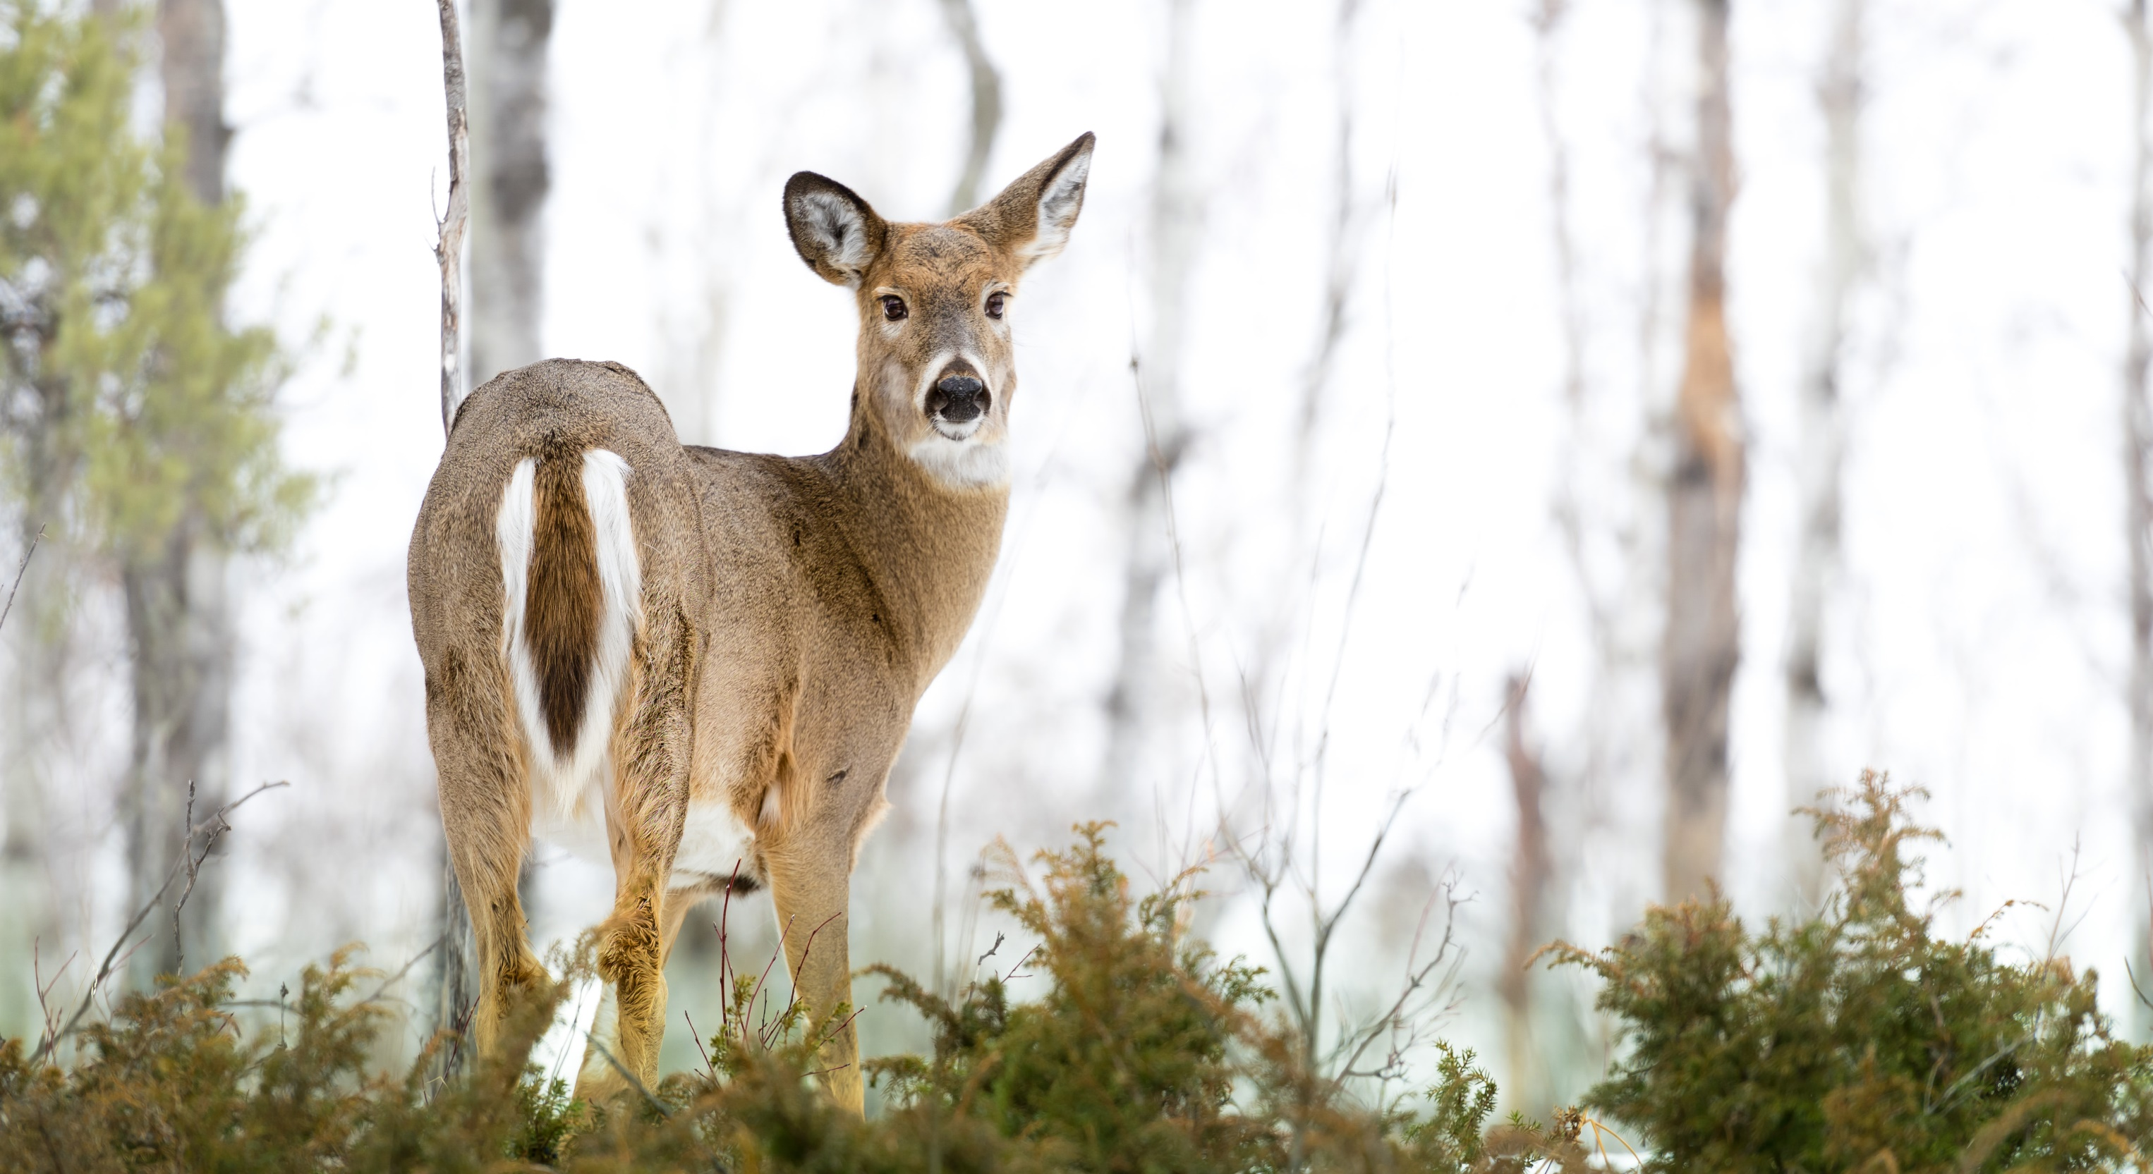
Chronic Wasting Disease Surveillance Infrastructure for North America
Grant #: 145892-22060
^{Krysten Schuler, PhD}
^{ks833@cornell.edu}
^{Cornell Wildlife Health Lab}

Slide 2
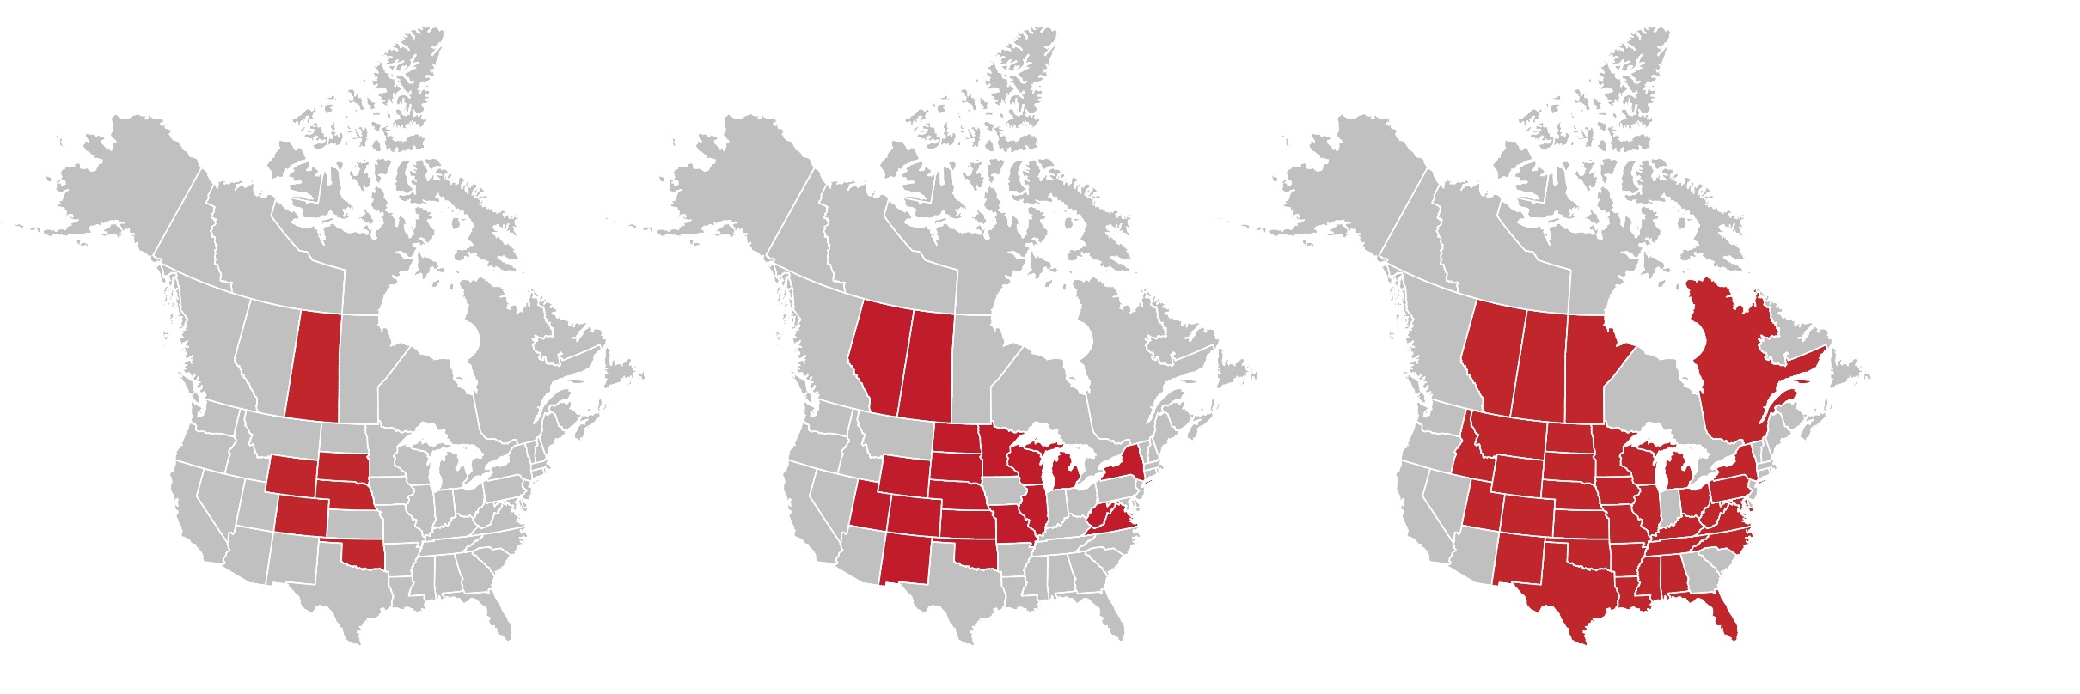
CWD Surveillance: The Next Frontier
Aligning Efforts for Improved Intelligence
CWD is spreading fast – Will it eventually be everywhere?
CWD surveillance is expensive: personnel and testing
2000
6 states/provinces
2010
19 states/provinces
2023
36 states/provinces
(of which 3 captive only)
Notes:
Every state and province was doing things a little bit differently. Don’t have to recreate the wheel.
Scott Chiavacci (USGS) estimated state natural resource agencies spent over $25.5M spend in FY2020 on CWD. Ag agencies spent $2.9M.

Slide 3
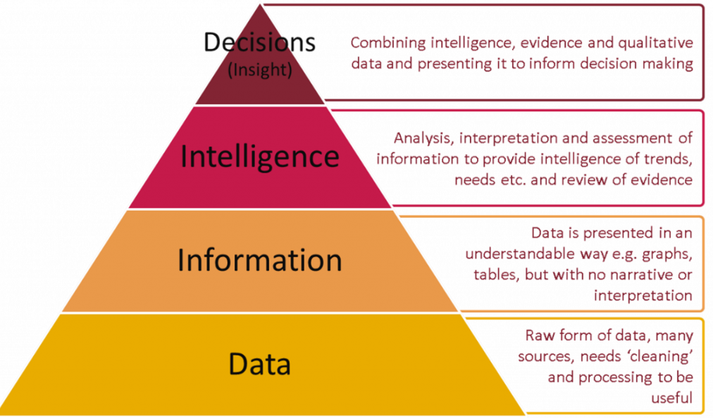
Data to Action Pyramid
Synthesizing Data across Landscapes
Data-to-Action Pyramid
Surveillance
Notes:
To get there, we need to ensure that the base of our pyramid – the “data” is solid before we start working our way up the scale so we will focus on that part today…

Slide 4
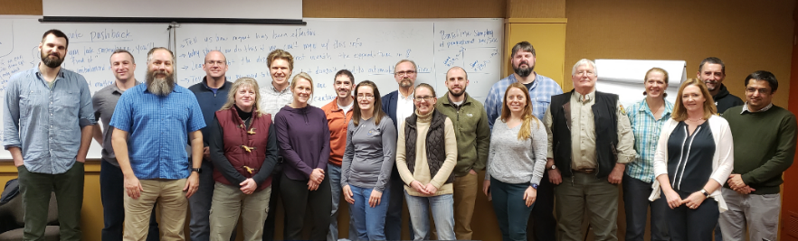

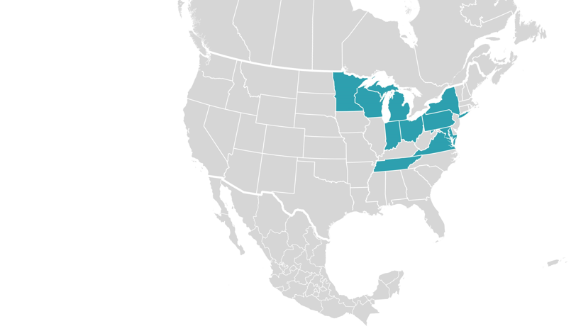
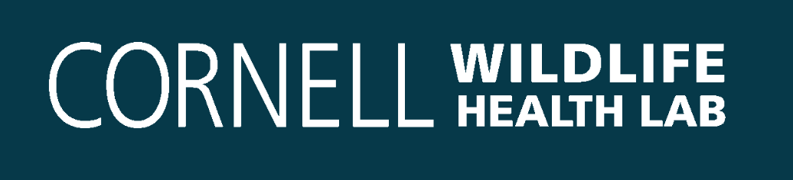




CWD Surveillance Brainstorming: 2020
Surveillance Optimization Project (SOP4CWD)
Participation by federal agencies does not imply endorsement by the U.S. Government.
Notes:
A small group of us decided to do just that. Specifically, we set out to develop a novel approach to CWD surveillance in free-ranging wildlife across North America. We called this network the surveillance optimization project for chronic wasting disease, or shorthand, SOP4CWD. We kicked off the project in early 2020, just before the world shut down due to COVID-19. We convened an in-person meeting of wildlife managers, modelers, and veterinarians to discuss the ideal wildlife disease surveillance system.

Slide 5
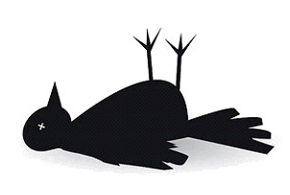





Goals for Wildlife Health Data
Surveillance Systems 2.0
MANAGE
SHARE
COLLECT
DATA
PIPELINE
Geospatial Data
Real-Time
Decision-Support
Notes:
So let’s breakdown the elements of wildlife health data at the bottom of the pyramid. We want to be able to collect information on sick and dead animals or through a designed study [CLICK], we want to be able to manage that information so it is useful [CLICK], and finally, we want to be able to share that information with interested parties [CLICK] But how could we do better with our disease surveillance by changing our collection procedures to be the most efficient and effective?
There are criticisms now of wildlife surveillance as “just putting dots on a map” and not really leading toward any actual information. Can we say that we are “free from disease?” or that our management activities have made a difference? Not given the non-random and unstructured methods in which we collect the majority of our samples.
Wildlife health data systems should be set up considering specific pre-defined objectives, design strategies, reporting systems, implementation methods, and long-term system maintenance. The collection, organization, and analysis of appropriate data is considered before implementation, along with the type and format of data to be gathered.
standards for data storage and quality. We also want to ensure proper data entry, storage, and structuring so data integrate readily with existing and future systems. We need s standards to guarantee data quality, as well as training and entry guidelines. On top of all that, we need guidelines to address accessibility to data users, while meeting requirements necessary for sensitive data.

Slide 6
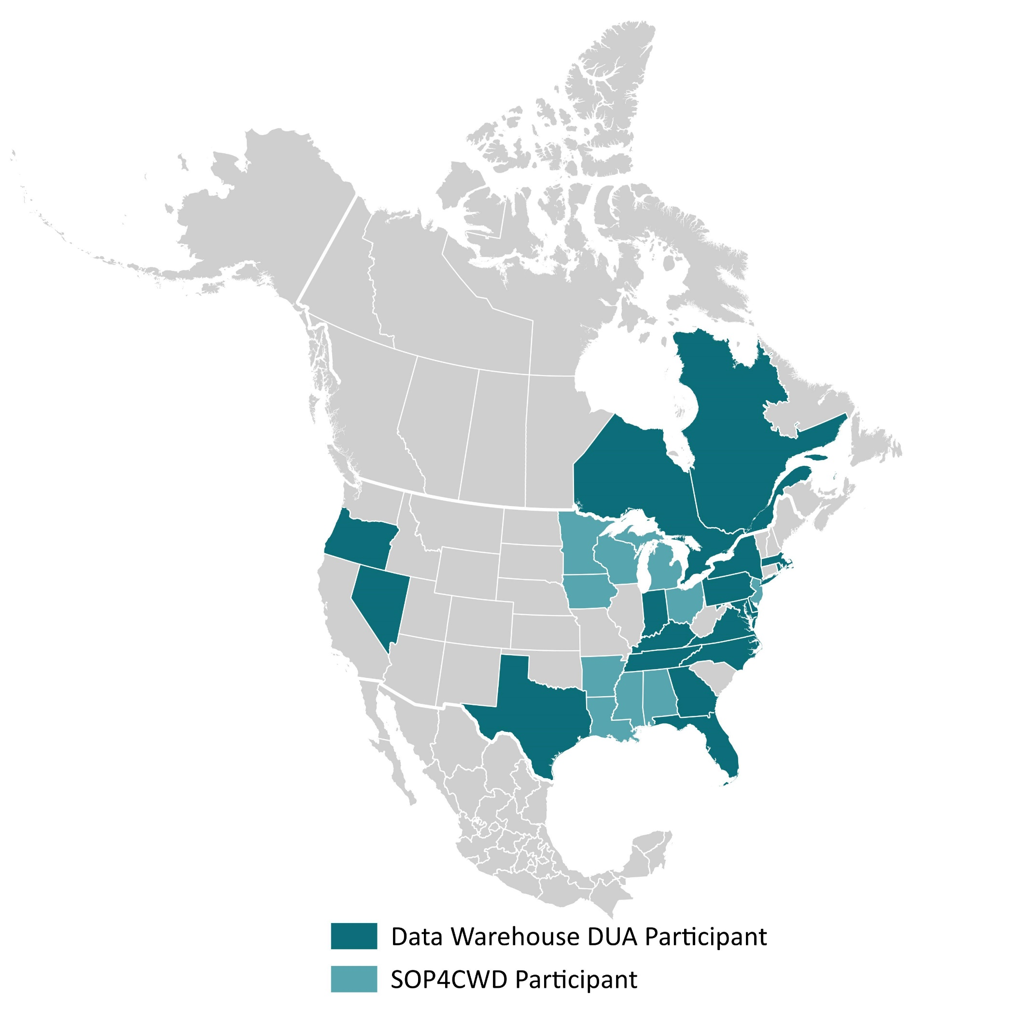
CWD Data Warehouse
Shared CWD Surveillance Infrastructure
Free software to all wildlife agencies!
18 State agencies
2 Provincial agencies
1 Tribal nation
Data Use Agreement:
Data ownership/sharing
Data access
Security and technology
Research approval process
800,000 Data Points
> 80 agency users
Notes:
So far, we have 18 state, 2 provincial wildlife agencies and 1 tribal nation, the Seneca Nation, that have started using the CWD Data Warehouse. Not all SOP4CWD have transitioned to using the CWD Data Warehouse, however, all have expressed their intent to migrate to this system and we are going to be working with them to do so.
The system is available at no cost to wildlife agencies. So far, we have been able to completely support the development of the system with grants and internal funding, as well as contributions from wildlife agencies for developing specific aspects of the system. I would welcome a discussion on long term funding options, but in any case, we are expecting to be in this for the long run and have the support of our agency for that.
To join the CWD Data Warehouse, we require all wildlife agencies approve of a data use agreement which defines how data may be used and who may access it, security measures and technology used. It also defines a process by which research partners may request data. Any use of the data by research partners requires explicit written approval by the wildlife agencies from which the data are being requested. Our role in this Is to facilitate and help streamline the process for both the researcher and the agencies.
I mention the DUA because I believe it is an important element of our success so far. We used a data use agreement for SOP4CWD and have written a new version for the CWD Data Warehouse. Data use agreements create clear guidelines and guardrails and are the basis for a good working relationship. We want to make sure that agencies can trust us with safeguarding their data and so we take the data use agreement very seriously.
NEXT

Slide 7

Data Security & Privacy
Only for Wildlife Management Agencies
No public access
Agencies see their individual data
Other jurisdictions see summarized data by county
Models can run with all data
No hunter personally identifiable information (PII)
Data User Agreement
No distribution of data without approval
Researcher Agreement
States must approve release of data
Integration into agency systems = best
adoption
Notes:
Let’s talk a bit more about data security and privacy. This system is only intended to be used by wildlife management agencies. There no public access. Agencies decide who they give access to within their organization and how to use maps or outputs from this system for their own purposes. Agencies can see their own data. All other data displayed is summarized by county. The models can run with all the data, but you don’t see the inputs for that.
The Warehouse does not require or ask an agency to provide any Personally identifiable information (PII) that would which would be considered sensitive, such as hunter name and contact info. The Data Warehouse uses standard security measures for any modern database application. The only place we have names and addresses is for the businesses: taxidermists, meat processors, and captive cervids.
We also created a data user agreement to make sure agencies and Cornell understand the rules of using this data. We will not distribute any data without written approval of the agency. One purpose of the project is to make data more available for research efforts that will benefit the state wildlife agencies. To that end, we have developed a Research Data Request process that will make data sharing easier for both the researcher and the agency. Note that no agency data will be shared with anyone without the agency approval.

Slide 8
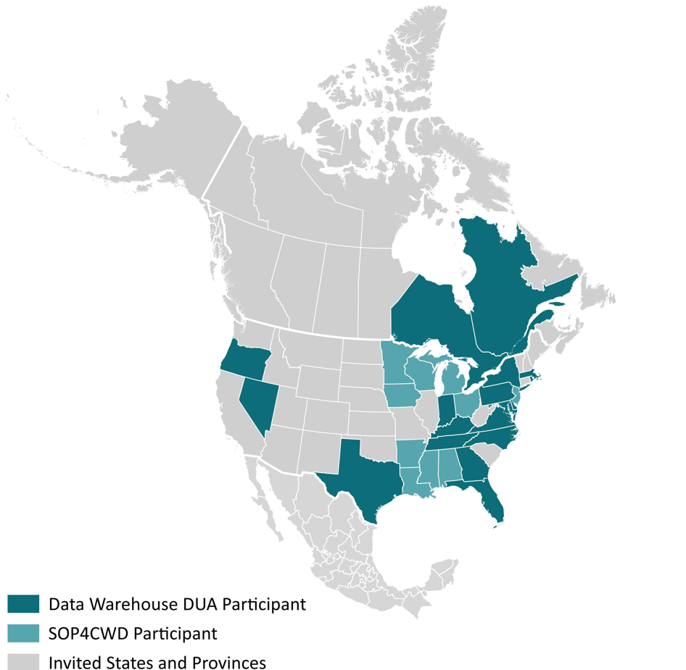

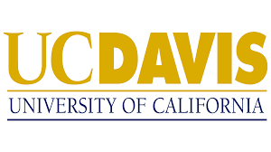

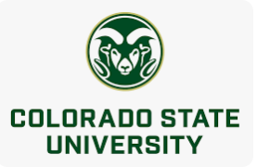
CWD Data Warehouse
Research Progress
8 Research Institutions
>100 People get Monthly Updates
Participation by federal agencies does not imply endorsement by the U.S. Government.
Notes:
This effort seems to be working. We are gaining more users and researchers that want to be involved. We now have partners at 8 academic research institutions, coast-to-coast. We have sent out over 50 monthly updates to our contact list.

Slide 9
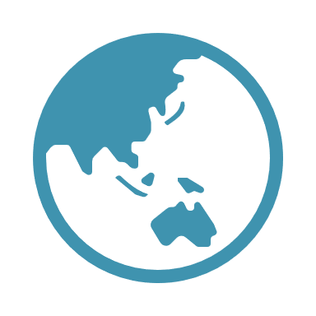
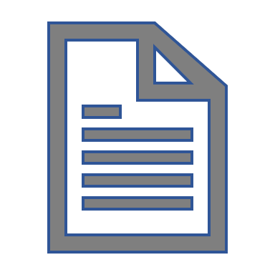



CWD Data Warehouse
User Benefits
Data
Data Management
Models
Data Analysis
Visualizations
Data
Interaction
$$f$$
$$(x)$$
Lead Developer
Notes:
So what is the Warehouse? Conceptually, the system has three components: data, models, and visualizations. Wildlife agencies can upload their data or connect their agency databases to the system, manage and analyze their data via built in models, and can generate a variety of visualizations and reports that can be shared with their own staff or regionally.

Slide 10
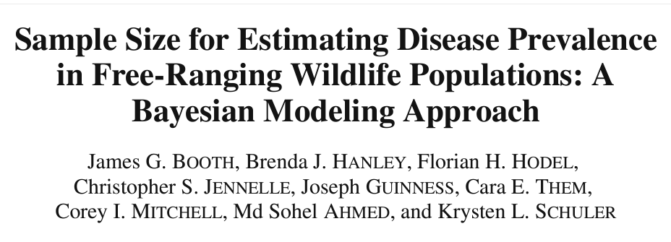
Accomplishments & Products
2023 Multistate Conservation Needs Grant
Invitations sent to all 50 states, 13 provinces, and Native American Fish and Wildlife Society
Publications: 1 completed, 5 in peer-review, 5 in preparation
Software: 1 production + 1 sandbox version
- Platform being expanded to all species/disease issues
Datasets: 17 individual; summarized: 2 in revision
Models: 7 embedded in Warehouse, 2 data download (external use)
Presentations: 4 + 1 Workshop (2023 CWD Conference)
Notes:
We are grateful for the funding received through the Multistate grant and are proud of what we’ve been able to accomplish in the last year. We have invited every US state and Canadian province. We are still working on inviting Mexican states and Native American nations.
We are working on a variety of publications and have already published one paper looking at sample sizes for estimating disease prevalence in free-ranging wildlife. For the CWD Data Warehouse, we have both a production version for users and a sandbox version as a testing environment. We are currently working on expanding the Warehouse platform to be useful for all species and disease issues. We have published 17 state/province datasets in the Cornell eCommons and have 2 summarized datasets that we are currently revising. We have 7 models already in the warehouse, one of which is the Hazard model that we used to detect the very 1st cases of CWD in TN, AL, and FL; and 2 external products where we have structured a data download for easier usage. We’ve also given 4 presentations and 1 workshop.

Slide 11
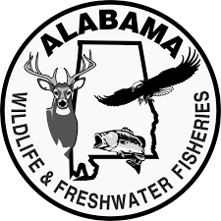
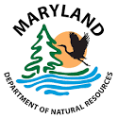


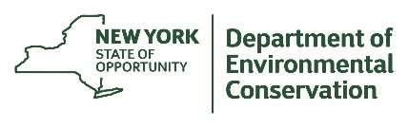



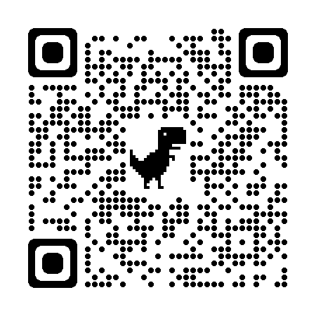

Funding & Support
This Project was funded by a Multistate Conservation Grant
#F23AP00488-00, a program funded from the Wildlife and Sport
Fish Restoration Program, and jointly managed by the U.S. Fish
and Wildlife Service and the Association of Fish and Wildlife Agencies.
https://cwhl.vet.cornell.edu/project/sop4cwd
Notes:
We have a website for SOP4CWD that you can scan the QR code there. We’d also like to thank the state wildlife agencies that have specifically contributed to the CWD Data Warehouse and of course the Multistate Conservation Grant. Unfortunately, we submitted a number of proposals in 2023 and were not successful with acquiring funding from USDA or NSF.

Slide 12
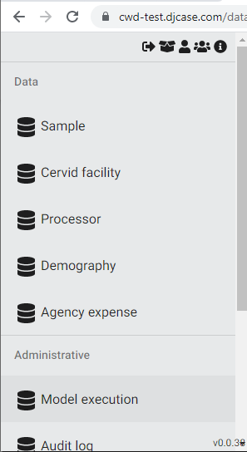
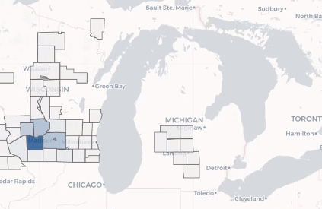
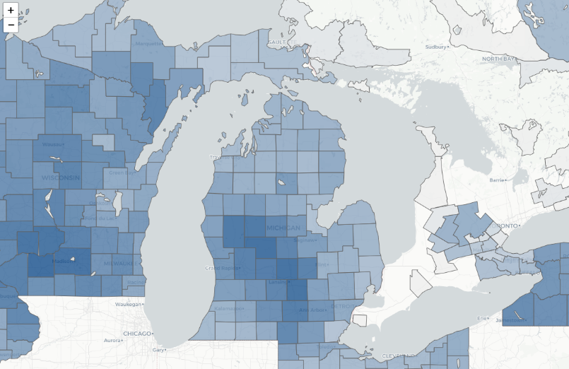
CWD Data Warehouse
Descriptive Data: Individual States
!
Confirmed CWD+ Cases
Sampling Intensity
Maps are for the illustrative purpose of this presentation and should not be used, copied, or distributed.
Citation: Mitchell, Hanley, Abbott, Hollingshead, Kelly, Miller, & Schuler. 2021. Wildlife disease positives software. Cornell University Library eCommons Repository. https://doi.org/10.7298/sf7q-8q61.
Notes:
Here is an example of the kind of data we store in the Warehouse. In addition to the expected CWD cases, sampling intensity, apparent prevalence, we also can house data on cervid facilities, meat processors and taxidermists, demographic data, and agencies expenses.

Slide 13
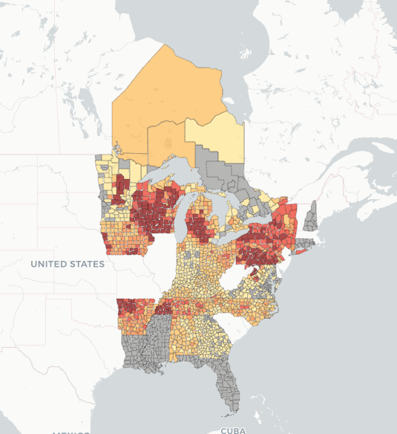
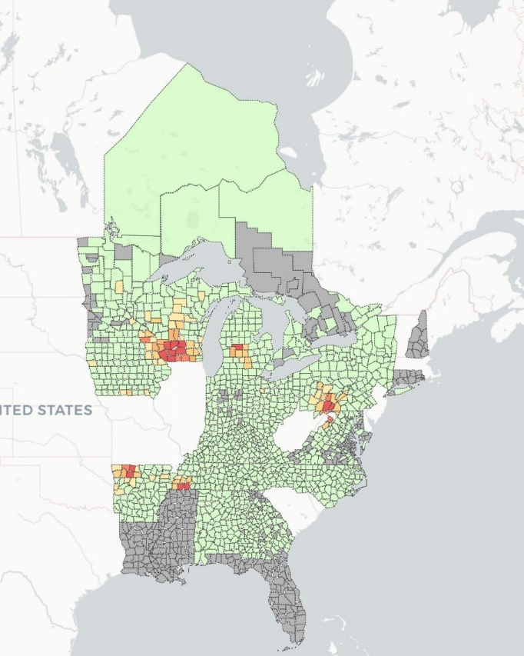
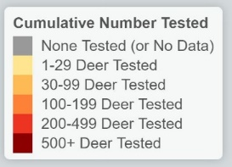
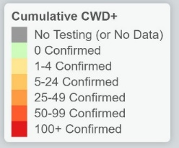
CWD Data Warehouse
Summarized Data: All Users
Maps are for the illustrative purpose of this presentation and should not be used, copied, or distributed.
Citation: Mitchell, Hanley, Abbott, Hollingshead, Kelly, Miller, & Schuler. 2021. Regional wildlife disease positives software. Cornell University Library eCommons Repository. https://doi.org/10.7298/mchw-3e31.
Notes:
Zooming out, we can see the region’s best-available information pertaining to the status and distribution of disease across local, state, regional, or even international boundaries.

Slide 14
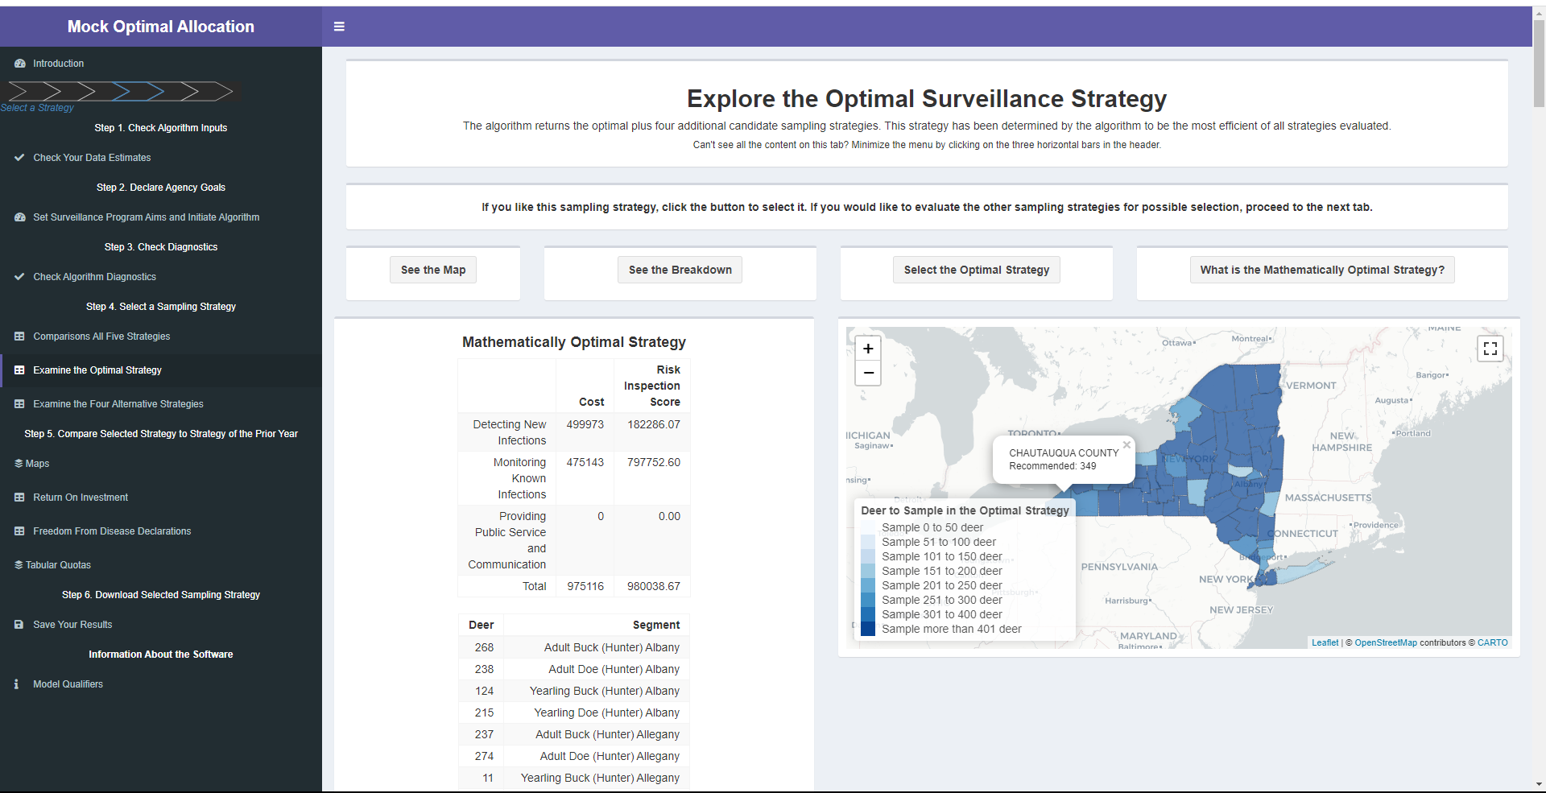
Making the Data Useful…
Modeling for Decision Support
Notes:
One of the major priorities was making complicated models accessible to your non-technical users, like an agency biologist. We worked very hard to make these models as much point-and-click as possible. Th idea behind these models is that they can be used as decision-support tools to explore different options for surveillance and management.

Slide 15
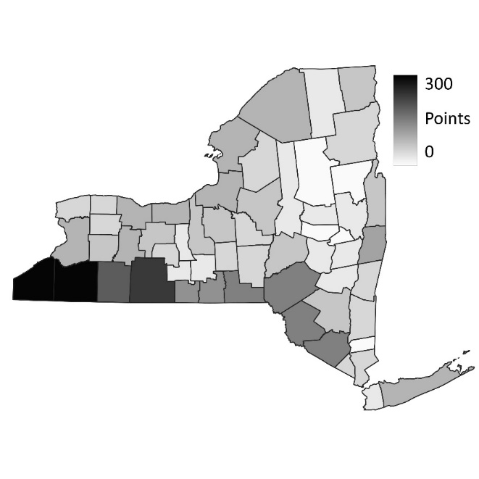
CWD Data Warehouse
Models – Hazard Model
Overview
Quantifies risk of CWD introduction based on agency perceptions and spatial distribution of hazards; aimed at maximizing early detection
Inputs
Hazard locations
Population demographic metrics
Agency risk perception survey
Output
Sampling recommendations
by management unit
Schuler, K., Hollingshead, N., Heerkens, S., Kelly, J., Hurst, J., Abbott, R., Collins, E., Lewis, J., & Hynes, K. Novel Detection of Chronic Wasting Disease Using Risk-Weighted Surveillance. in prep.
Notes:
For instance, the hazard model is used to quantify the risk of CWD introduction. Known hazards or potential sources of CWD, are scored based on agency knowledge to come up with an overall measure of risk for each management unit. The model then distributes a statewide sampling quota proportionately across the state based on introduction risk and deer densities.

Slide 16
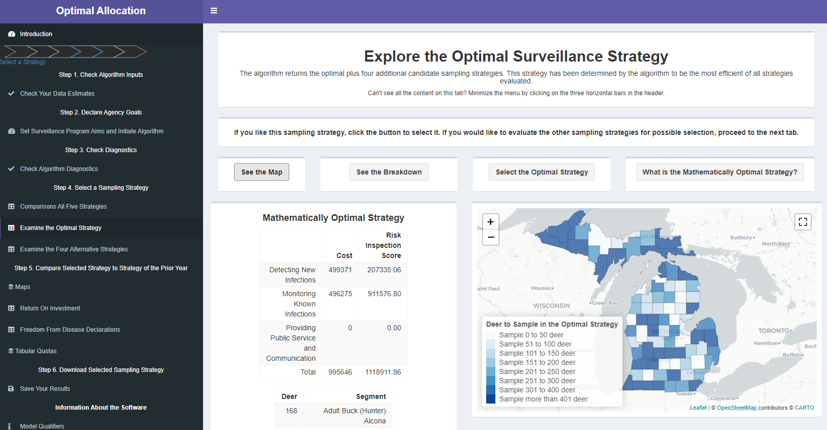
CWD Data Warehouse
Models – Sampling Optimization Model
Overview
A combinatorial optimization algorithm that maximizes benefits and minimize costs given a set program budget
Inputs
Benefit of early detection
Benefit of detecting change in prevalence
Benefit of informed agency/public
Risks (new infection, spread)
Prevalence
Surveillance related costs
Total program budget
Output
Sampling recommendations by management unit
Hanley, B., Them, C., Mitchell, C. I., Walter, W. D., Walsh, D., Jennelle, C., Hollingshead, N., Abbott, R. C., Kelly, J., Grove, D., Williams, D., Ahmed, S., Miller, L., & Schuler, K. A tool to allocate surveillance resources of chronic wasting disease in white-tailed deer. in prep.
Notes:
The Sampling Optimization model, which is a combinatorial optimization algorithm that accounts for costs and benefits of sampling across a state, given a program budget, surveillance costs, desired benefits, and risks of introduction and spread. The output is a set of sampling quotas by management unit that tell the user where they can get the most benefit of sampling for the least cost or a fixed cost.

Slide 17
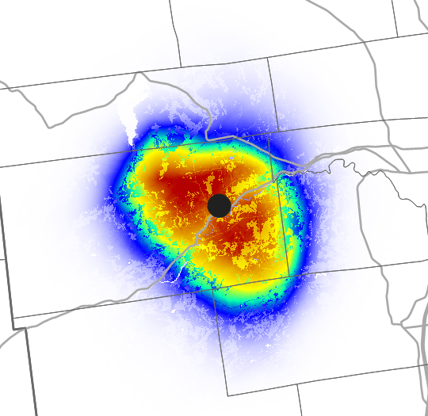
CWD Data Warehouse
Models – Outbreak Response
Overview
Considers resource use and contact probability to describe an area where a CWD-positive animal would likely come in contact with another deer
Inputs
Location of a CWD positive deer
Resource selection function
Contact probability function
Landscape characteristics
Output
Contact Probability
Surface
Quinn AD, D Williams, W Porter, M Smith, F DeSantis, and S McNulty.2009. Risk Assessment of a Chronic Wasting Disease Outbreak in New York: Final Report. 50 pp.
Notes:
The outbreak response model uses a resource selection function and contact probability function based on collar data to determine the likelihood that an infected animal would have come in contact with another deer on the landscape. It generates a probability surface that can be used to determine where to set a containment zone.
NEXT

Slide 18
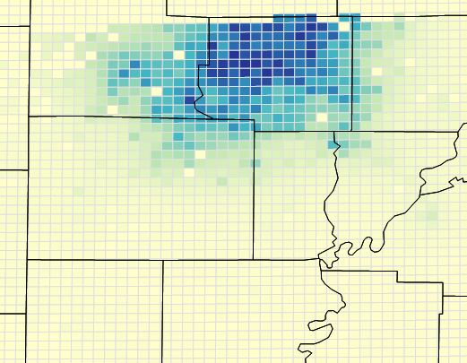
CWD Data Warehouse
Models – Habitat Risk
Overview
A Bayesian hierarchical model that predict risk of CWD infection per population segment at relatively fine spatial scales (1-10 km²)
Inputs
Spatial landscape data
land cover, soils, topography
Surveillance data
Output
CWD risk per age/sex
segment per grid cell
Walter, W. D., Them, C., Hanley, B., Mitchell, C. I., Kelly, J., Grove, D., Christensen, C., Hollingshead, N., Abbott, R. C., Ahmed, S., & Schuler, K. Predicting the odds of chronic wasting disease with the HabitatRisk Software. Submitted.
Notes:
The habitat risk model uses Bayesian hierarchical modeling to predict risk of CWD occurrence by age/sex segment. This provides agencies with a more fine scale look at the potential risk of CWD spread which can inform agencies where to focus management activities after CWD has been detected in their state.

Slide 19
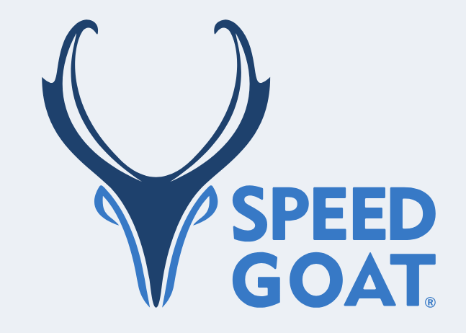
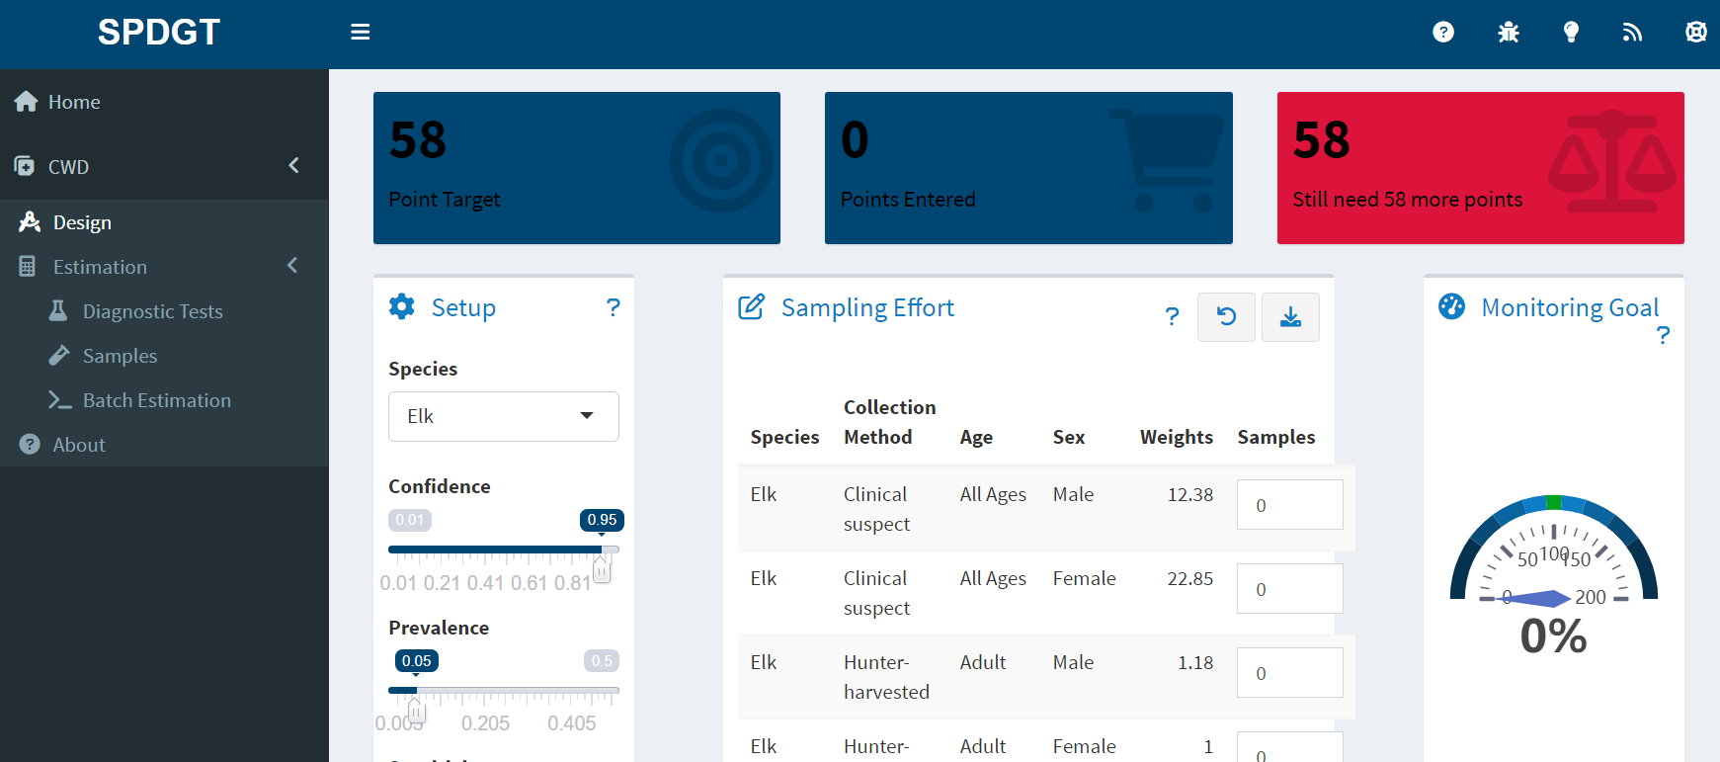
CWD Data Warehouse
Models – Speed Goat Sampling Weights
Overview
Generates models for export/import into Speed Goat weighted surveillance planning web application
Notes:
The Speed Goat Sampling Weights model is not actually in the Warehouse, but instead the Warehouse generates the necessary files to use as inputs to derive sample weights that reflect the different statistical probabilities that different age-sex segments will test positive for CWD.

Slide 20
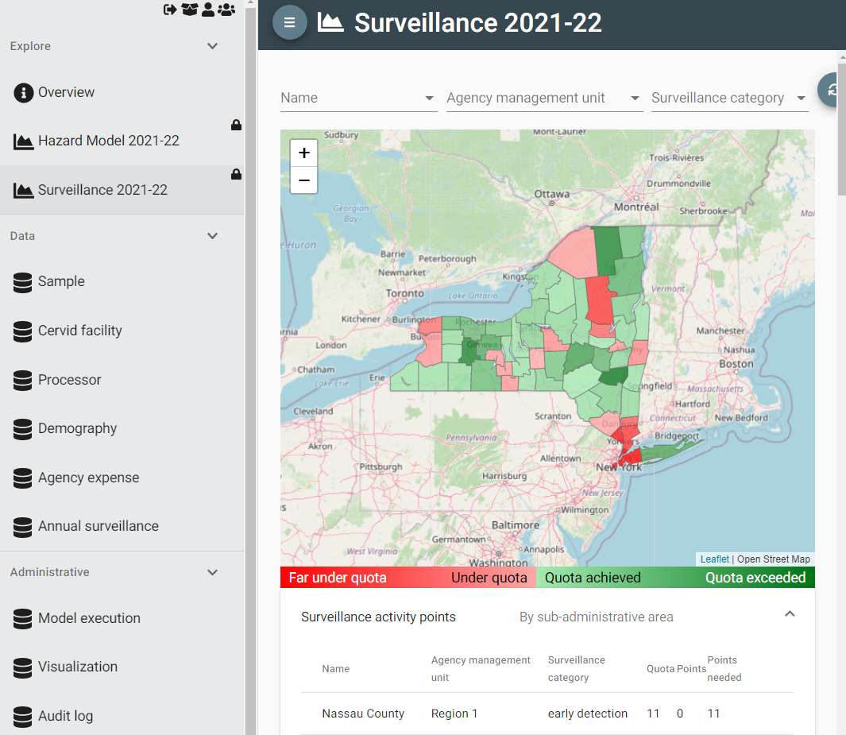
CWD Data Warehouse
Visualizations
Notes:
Agencies can use model outputs to set surveillance quotas, then track progress towards those quotas through a data visualization like this.
NEXT

Slide 21
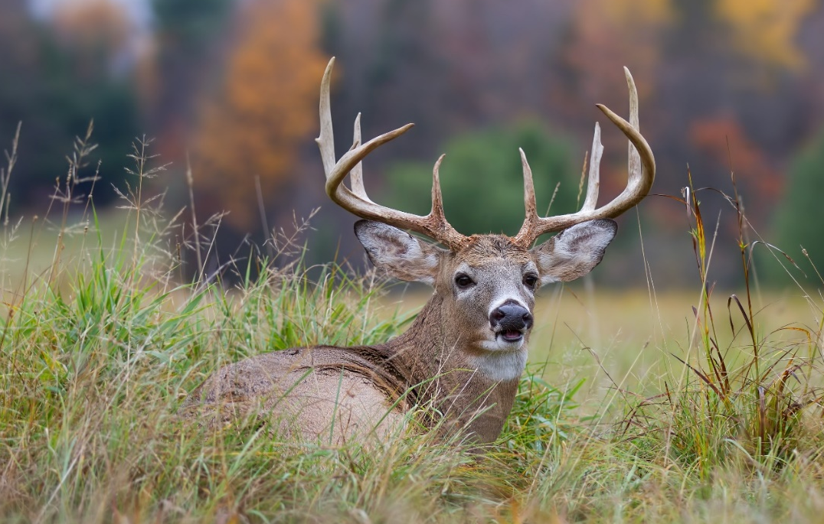
Next Steps for SOP4CWD
Maximizing Benefits to Wildlife Agencies
Encourage agency use of the CWD Data Warehouse
Build in workflow improvements
USDA CWD results messaging service connection
Link with more models
Invite more tribes, Mexican states
Intersect with other efforts:
CWD Alliance
CWD Research Consortium
USGS CWD Tissue Repository
USGS WHISPers?
Agriculture agencies?
Models
Notes:
What are we doing next? We are always thinking of how to maximize the benefits to wildlife agencies to encourage them to use the Warehouse. We see better adoption if we can build workflow improvements in for each individual state. We are working on linking the USDA messaging service to deliver CWD results to the Data Warehouse for the agencies that want to use that service. We’re are getting the new models in. We continue to invite and support all U.S. states, Canadian provinces, Mexican states, and tribes to use this system if they want.
We have had discussions with the folks in USGS about their CWD tissue repository to see if we could serve as the data hub for that project.
Lastly, we’re trying to think about the long-term planning of this system. Can this be a new paradigm in how we do wildlife health surveillance?

Slide 22

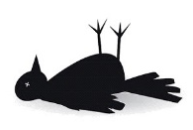
Disease Surveillance Workflow
Data Pipeline
Field
Notes:
e’ve worked with a number of wildlife agencies to help them transition to using more robust digital data collection processes. We always recommend moving to using barcodes. That’s pretty critical for sample tracking and data quality control.
We also transitioned agencies from using paper forms to ESRI Survey123. It seems every wildlife agency is already familiar with ESRI Survey 123 and is comfortable using itf for data collection and sample processing.
NEXT

Slide 23
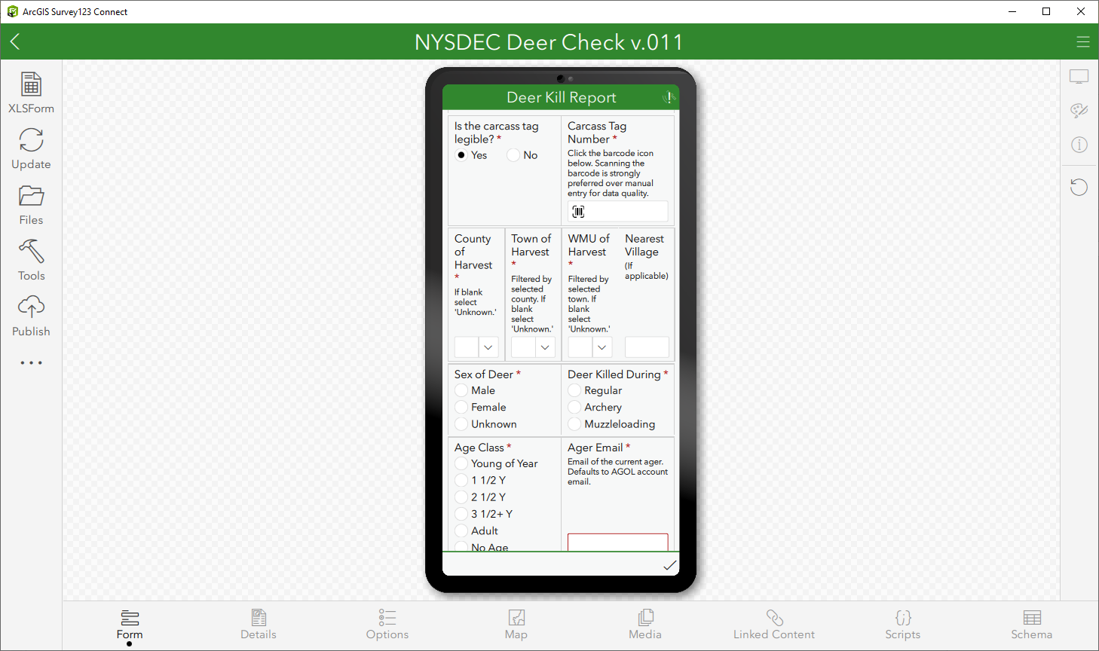


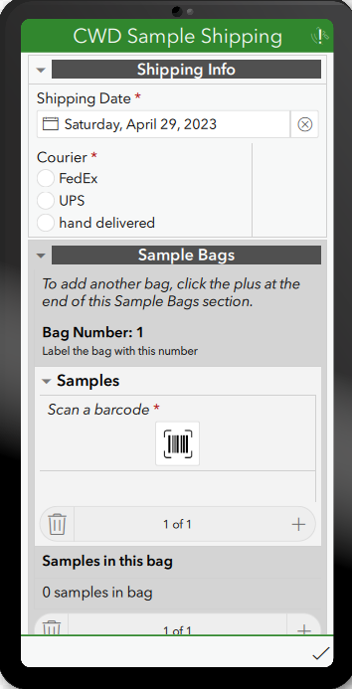
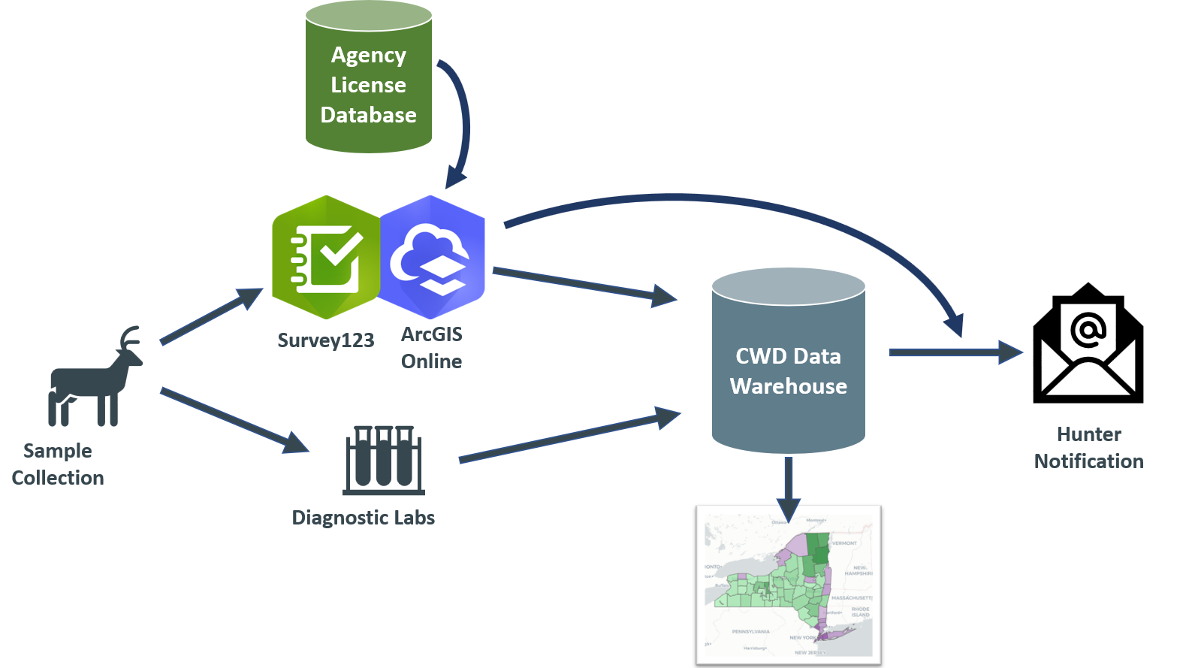
Disease Surveillance Workflow
Data Pipeline
Field
Data
Collection
Sample
Diagnostic Testing
Notes:
So we’ve worked with a number of wildlife agencies to help them transition to using more robust digital data collection processes. We always recommend moving to using barcodes. That’s pretty critical for sample tracking and data quality control.
We also transitioned agencies from using paper forms to ESRI Survey123. It seems every wildlife agency is already familiar with ESRI Survey 123 and is comfortable using itf for data collection and sample processing.
NEXT

Slide 24
Disease Surveillance Workflow
Data Pipeline
Field
Data
Management
Wildlife Health Warehouse
Data
Collection
Sample
Diagnostic Testing
Notes:
So we’ve worked with a number of wildlife agencies to help them transition to using more robust digital data collection processes. We always recommend moving to using barcodes. That’s pretty critical for sample tracking and data quality control.
We also transitioned agencies from using paper forms to ESRI Survey123. It seems every wildlife agency is already familiar with ESRI Survey 123 and is comfortable using itf for data collection and sample processing.
NEXT

Slide 25
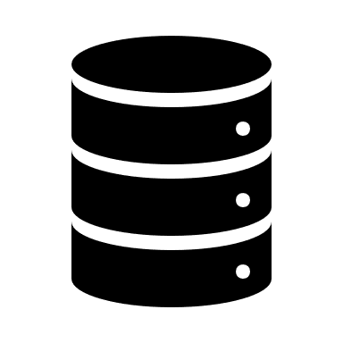

Disease Surveillance Workflow
Data Pipeline
Field
Data
Management
Wildlife Health Warehouse
Data
Collection
Share Results
Sample
Diagnostic Testing
Notes:
So we’ve worked with a number of wildlife agencies to help them transition to using more robust digital data collection processes. We always recommend moving to using barcodes. That’s pretty critical for sample tracking and data quality control.
We also transitioned agencies from using paper forms to ESRI Survey123. It seems every wildlife agency is already familiar with ESRI Survey 123 and is comfortable using itf for data collection and sample processing.
NEXT

Slide 26
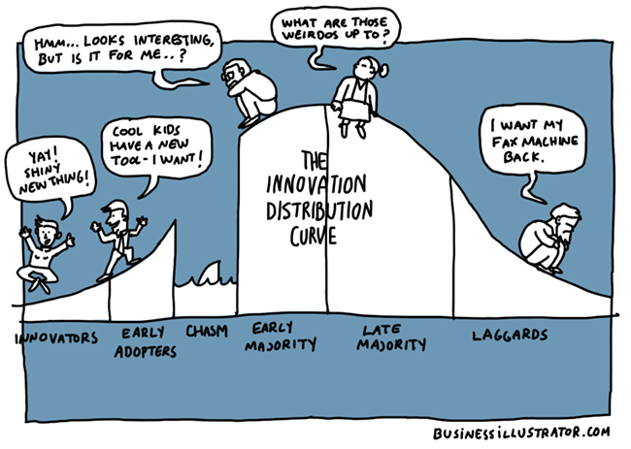
The Conservation Dilemma
Prioritize Collaboration
Notes:
So humor me for a minute and I will assume that everyone in the room is on board with this idea because you all are willing to adopt new ideas, trends, and technologies. You would fall on the left side of the curve with the innovators and early adopters. You see how more integration across fields will make meaningful changes. So how do we bring this to the rest of the wildlife society? Those people that might still say that wildlife health is just the absence of disease? You may have picked up on the fact that there are a lot of people in our profession that like to do things the same way they’ve always done them…
Start gathering people together on these issues. Focus on up and comers. Younger people need to be exposed to it. Young people want to make a change and come in to just document demise. More integration across fields to make meaningful changes.
I suspect that many here today are on the B-side.
The innovators and early adopters.
There are a lot of folks in our professions who are clearly on the A side.
How do we, or do we, bring them along?
CLICK
We also refer to different groups as green dots and grey dots
The green ones are on the left, embracing the new.
And there are shades of grey up on the hill and on the right tail.

Slide 27
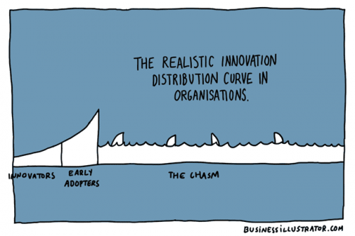
The Conservation Dilemma
Long-Term Funding
Notes:
Often that chasm feels like it’s miles long to get new ideas to be adopted…but don’t give up hope!

Slide 28
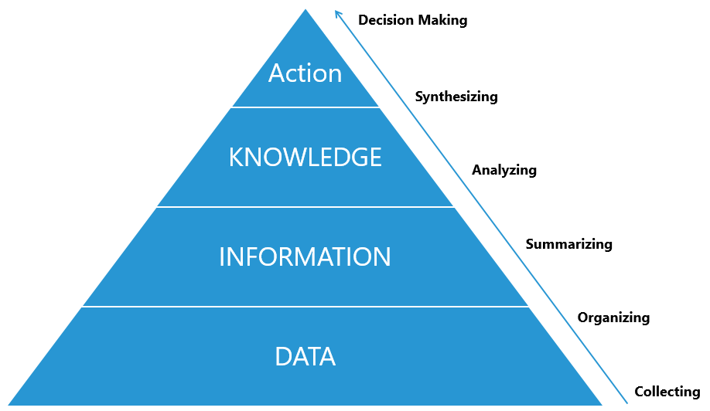
Wildlife Health 2.0
Better Data Leads to Action!
Collect statistically valid data from which you can derive information
Technical tools exist for better data collection & analysis
Use new analytical methods to increase understanding
Link systems to improve One Health
Timely intelligence for decision makers to take action!
Notes:
t the end of the day, this is a talk about how the science gets done and could be done better, not necessarily the scientific results. BUT…
As we see that the significance of wildlife health to human health is now obvious, new approaches to studying wildlife health are critical to make much needed changes.
Going back to our pyramid moving from data to action, here are a few of the lessons we’ve learned at the Cornell Wildlife Health Lab that might be useful to other wildlife health professionals. 1) We’ve seen a number of new outbreaks over the past 3 years, the more we can plan now for how to work cooperatively on data collection and desired outputs – the further ahead we will be when “the next big thing” hits. 2) My statisticians begged me to remind everyone to work with a trained statistician in planning your study to ensure that you have the best data possible to derive inferences. 3) We now have cheap, easy to use technical solutions for a lot of the data collection that we do. 4) We need to think about how to modernize data collection and link systems together so that we don’t have to enter data in a million different places. 5) There’s a lot of data out there that we don’t always think about like the costs, effort, or other economic data; risk data, and more that can help get to that knowledge part of the pyramid. 6) And the last one before I get off my soap box, is that we can start looking to new analytical methods using data science to help us increase our understanding.

Slide 29
Modern World: Health Evolution
Wildlife Health 1.0 Wildlife Health 2.0
Health is the absence of certain contagious disease
Diseases are relatively minor contributor to species declines
No economic and social impacts
Data is collected by individual researchers/agencies
Not easily aggregated
Does not align with human/veterinary terminology
Health is the capacity to deal with all life throws at you
It is coherence between evolved capacities, social expectations, and lived reality
Aligns with how health is conceived in human and livestock sectors
‘One Data’ integrated across platforms = ‘One Health’
Samples are collected via statistically valid methods
Determine freedom-from-disease

