Slide 1
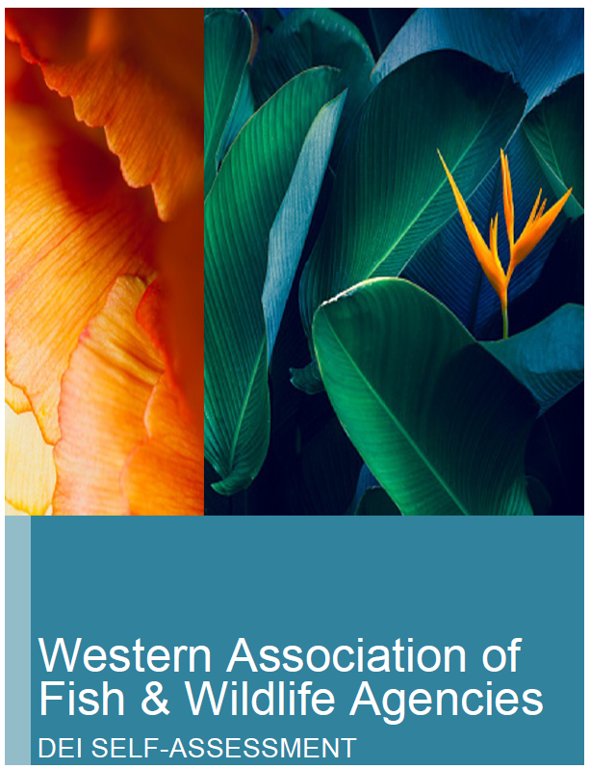
Western Association of
Fish & Wildlife Agencies
DEI SELF-ASSESSMENT 2022
Prepared by James L. Mason, Ph.D.
Organizational Cultural Competence Assessment and Training
Portland, Oregon
Presented by Susan Steffen

Slide 2
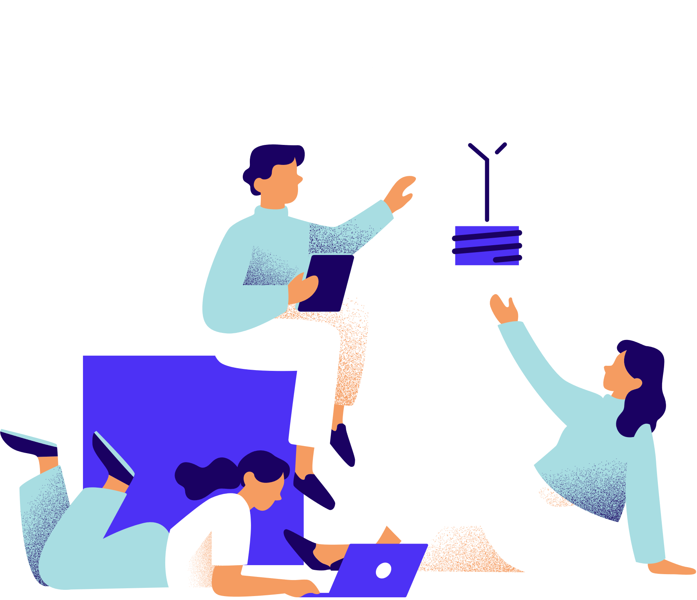
2022
Multi-State Conservation Grant
Grant F22AP00687

Slide 3
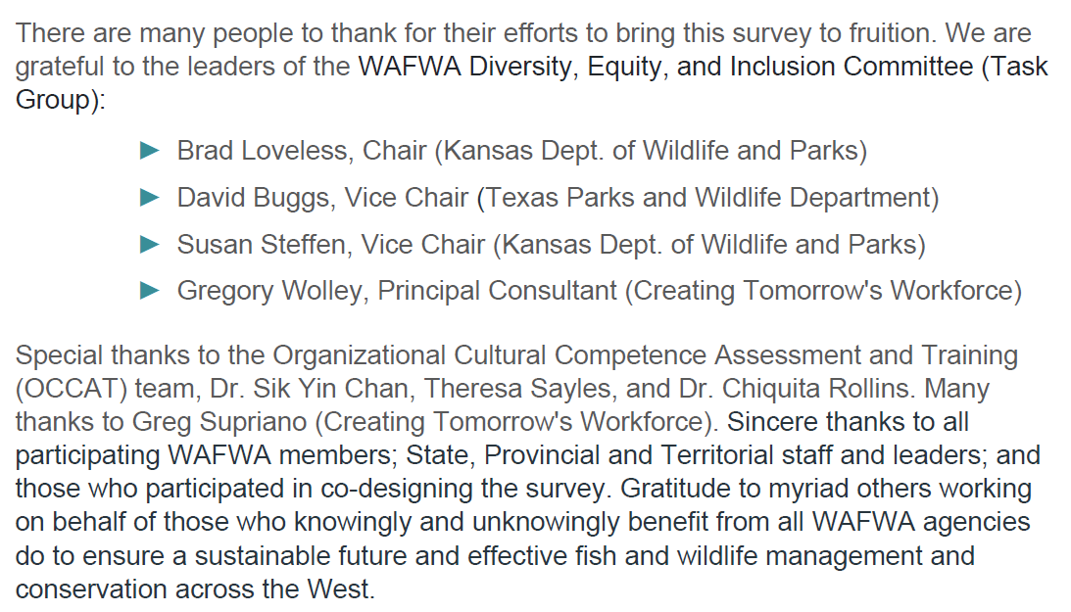
Acknowledgments

Slide 4
Goals
The intent of this assessment is to provide reliable data that will help WAFWA organizations:
• Prep for current and projected demographics
• Uncover culturally diverse community beliefs and practices regarding fish and
wildlife, conservation, and outdoor-related programs and services
• Identify challenges and potential resources and strategies
• Reveal resources for increasing diversity on policy, decision-making, and organizational leadership structures
• And more!

Slide 5
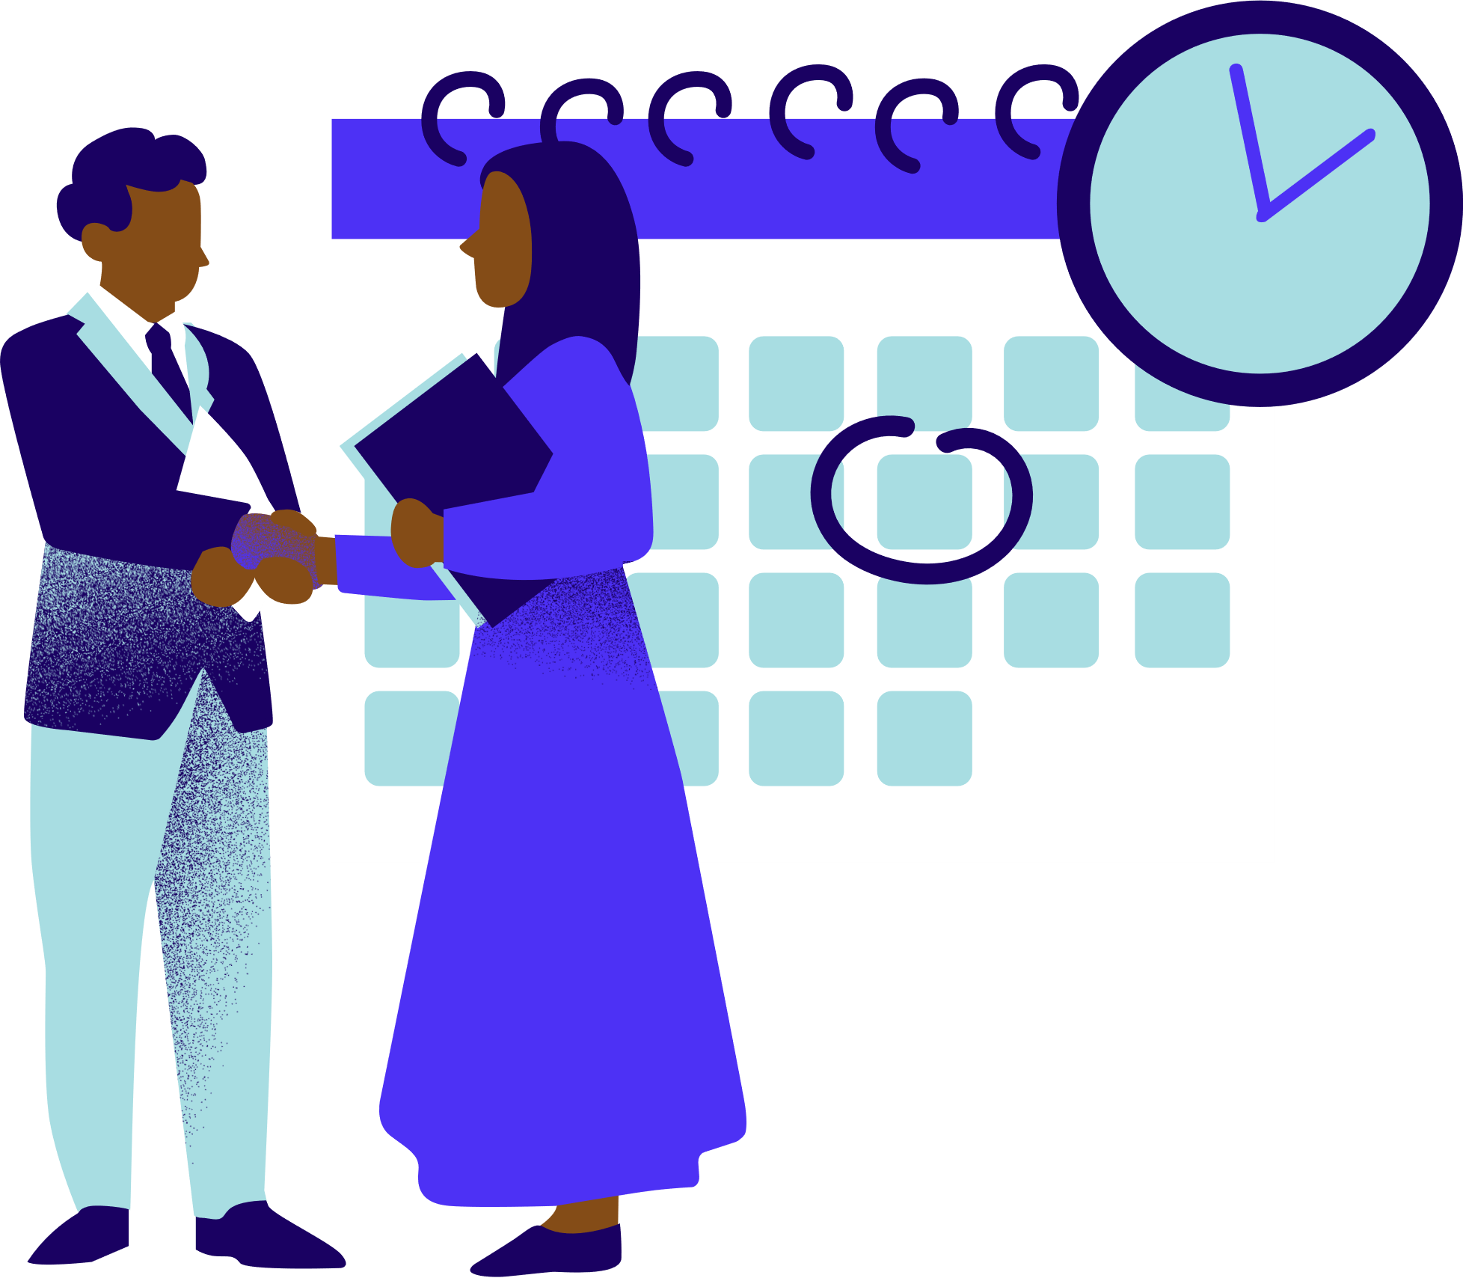
Methods
November 2022
  Letter from Brad Loveless with a link to the DEISAQ
  survey was sent to all WAFWA member State Directors
3 reminder emails (December 3, 6 and 9) to State Directors
All survey responses were sent directly to OCCAT for analysis.
Dr. Mason and team received responses from SurveyMonkey.
We used SPSS version 29 to run the quantitative results.
States with 50 or more responses receive an infographic with subscale scores.

Slide 6
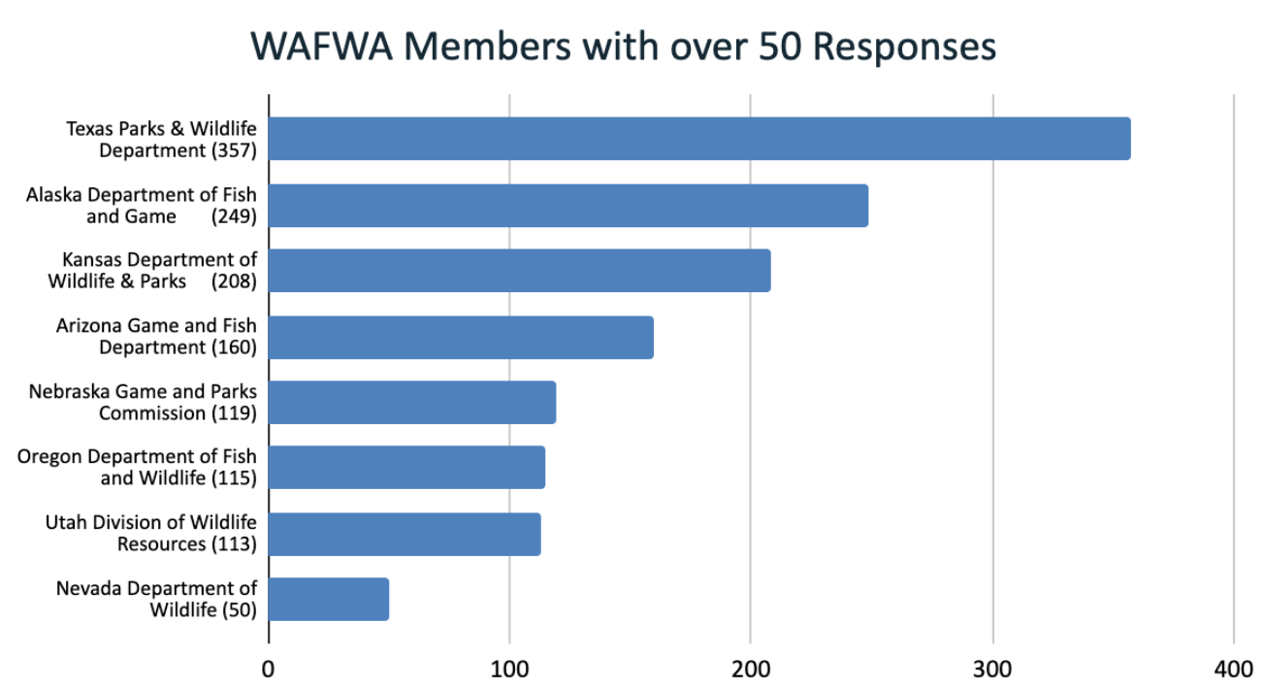
Results | Demographics

Slide 7
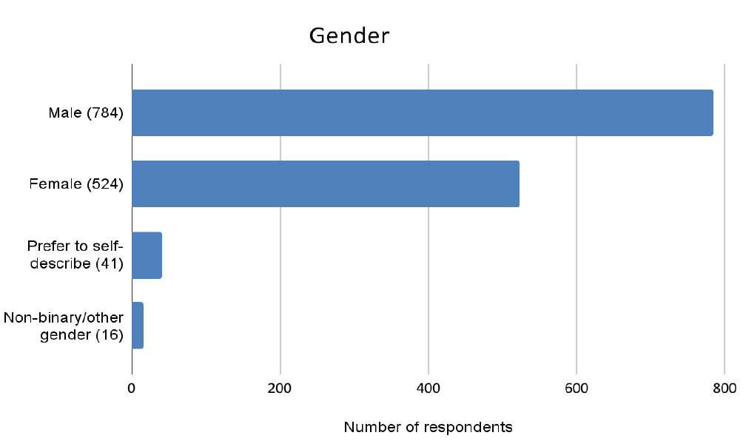
Results | Demographics

Slide 8
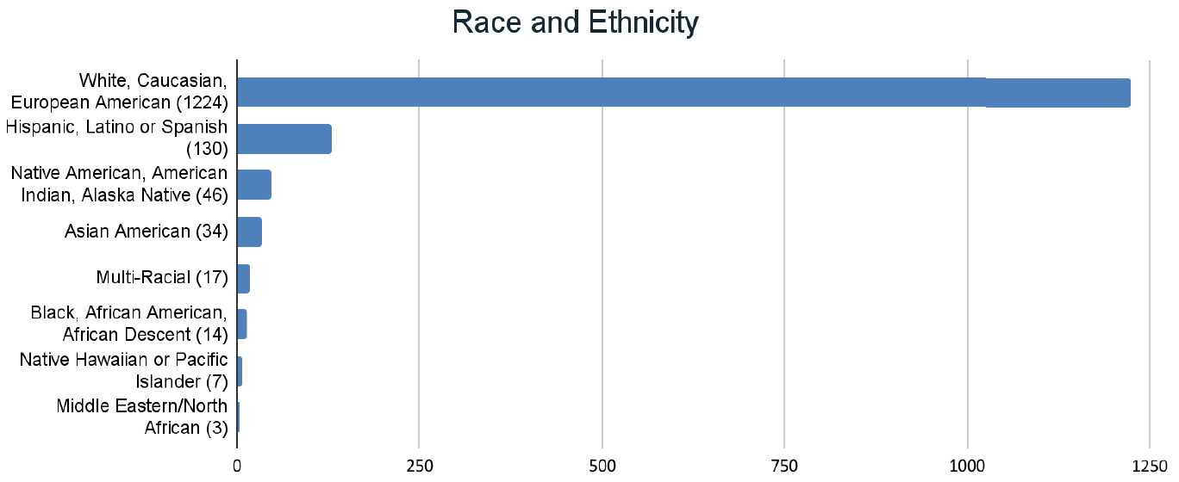
Results | Demographics

Slide 9
Results | 5 DEI Domains
Community Awareness
Community Engagement
Community Resources and Linkages
Staff Development and Policy
Community Outreach

Slide 10
Results | 5 DEI Domains
Community Awareness
Community Engagement
Community Resources and Linkages
Staff Development and Policy
Community Outreach
Ability to understand demographics, lived experiences, beliefs, and practices of culturally diverse and underrepresented constituents. Allows professionals to engage communities without bias to achieve mission and goals while reducing conflict.

Slide 11
Results | 5 DEI Domains
Community Awareness
Community Engagement
Community Resources and Linkages
Staff Development and Policy
Community Outreach
Intentional interaction between an organization and culturally diverse communities. Promotes mutual acceptance and respect with the goal of reducing disparities in workforce development, and the use of services and outcomes.

Slide 12
Results | 5 DEI Domains
Community Awareness
Community Engagement
Community Resources and Linkages
Staff Development and Policy
Community Outreach
Include a broad spectrum of service providers, community- and faith-based organizations, formal/informal helping networks that have credibility within a community. “Trusted voices” with whom one might partner to engage diverse communities.

Slide 13
Results | 5 DEI Domains
Community Awareness
Community Engagement
Community Resources and Linkages
Staff Development and Policy
Community Outreach
Policies, practices, and relevant structures and behaviors necessary to identify, recruit, retain, and promote culturally competent and diverse workforce. Includes: community engagement, pipeline development, career awareness, etc.

Slide 14
Results | 5 DEI Domains
Community Awareness
Community Engagement
Community Resources and Linkages
Staff Development and Policy
Community Outreach
Includes strategies, platforms, and communication practices and policies needed to ensure messaging and other communication reaches all segments of target population.

Slide 15
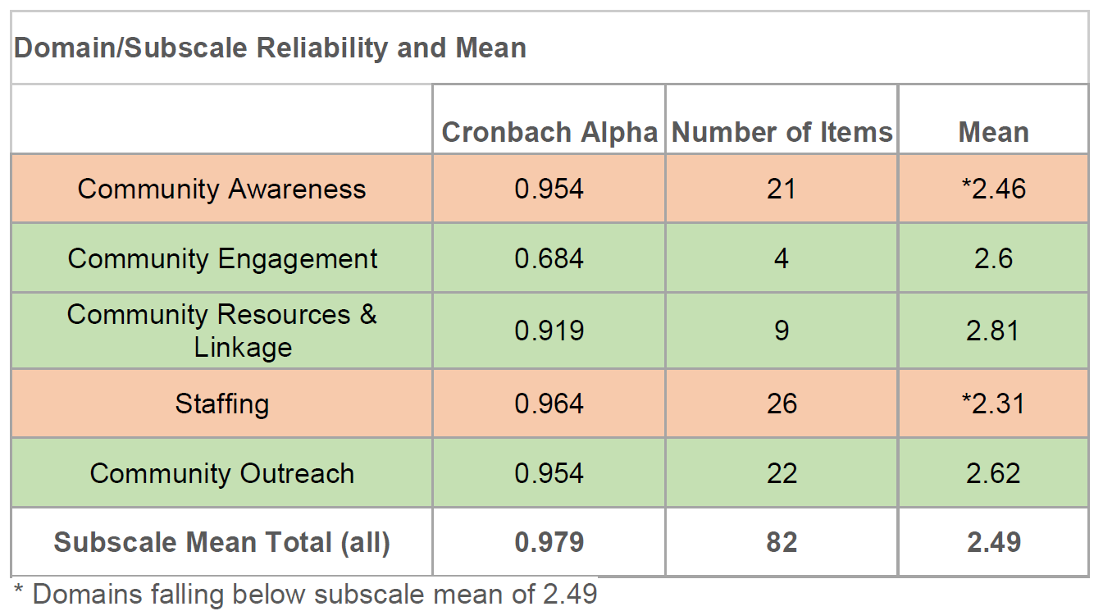
Results | Domain/Subscale Reliability and Mean

Slide 16
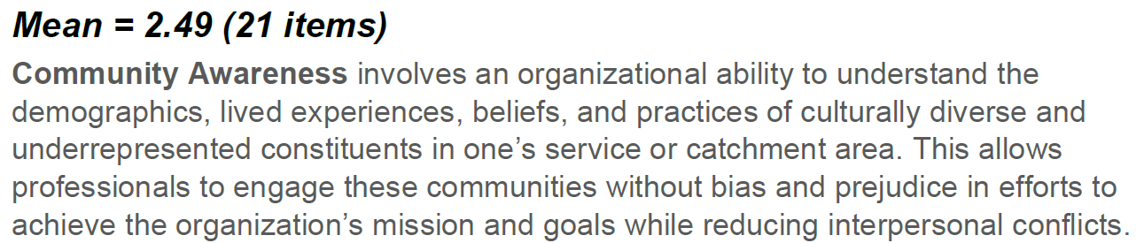
Results | Community Awareness

Slide 17
Results | Community Awareness

Slide 18
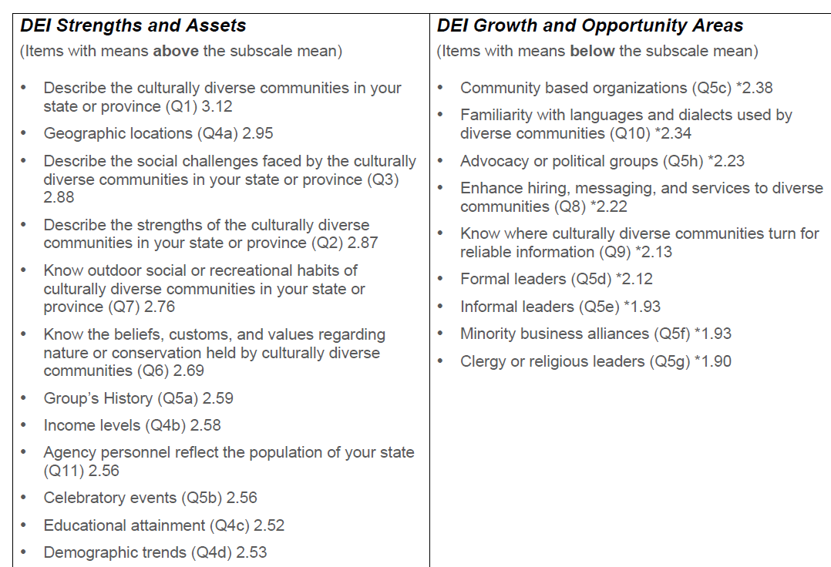
Results | Community Awareness
Results | Community Awareness

Slide 19
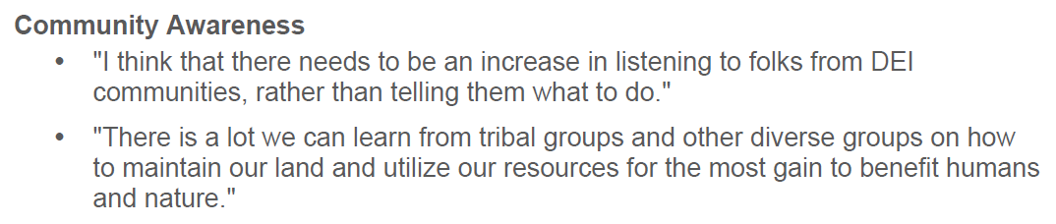
Results | Community Awareness |
Qualitative Comments

Slide 20
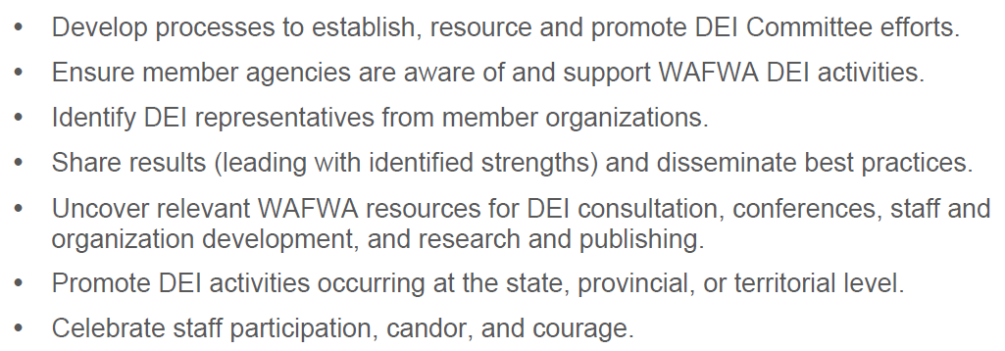
Results | Recommendations

Slide 21
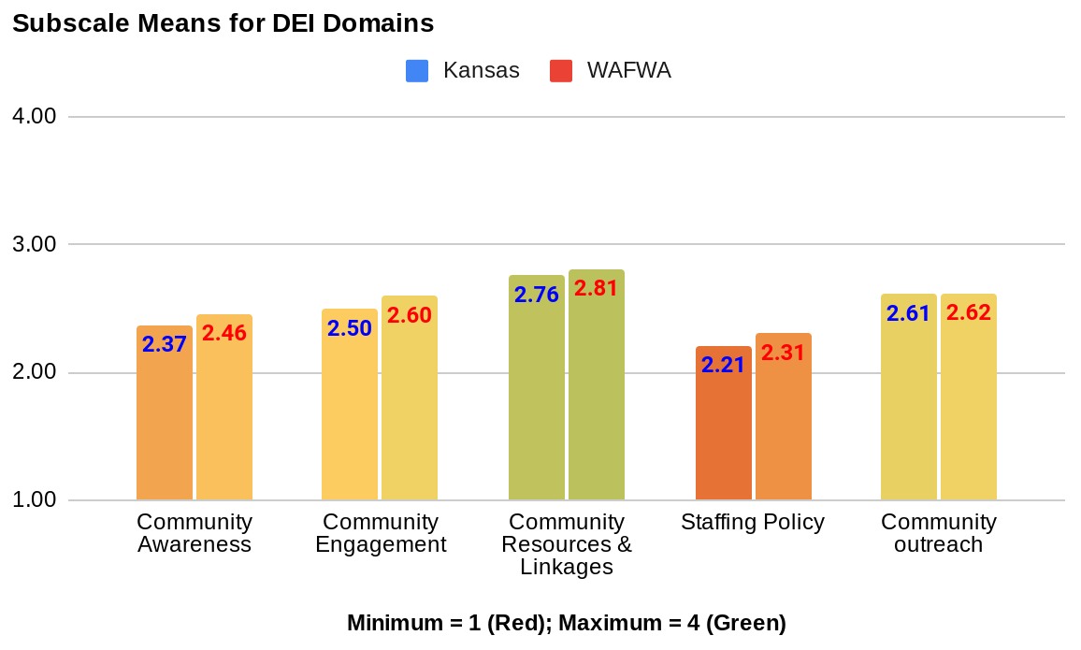
Results | Kansas ~ KDWP

Slide 22
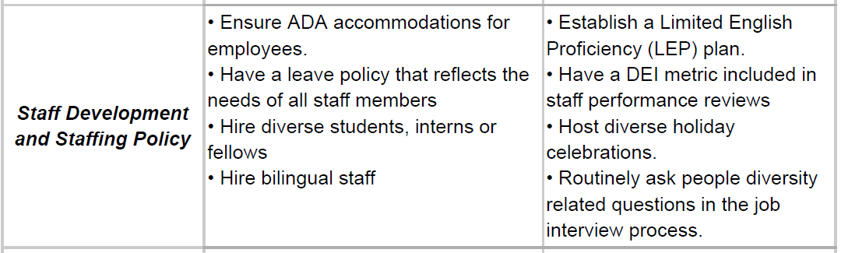
Results | Kansas ~ KDWP

Slide 23
Next Steps
Where do we go from here?
How can the WAFWA DEI Committee help?
What does this look like for various WAFWA states/provinces?

