Slide 1
Notes:
Show LWBH and For Sale Items

Slide 2
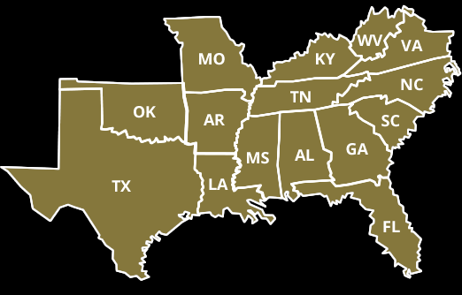
SEAFWA Large Carnivore Working Group
Southeastern Association of Fish & Wildlife Agencies

Slide 3
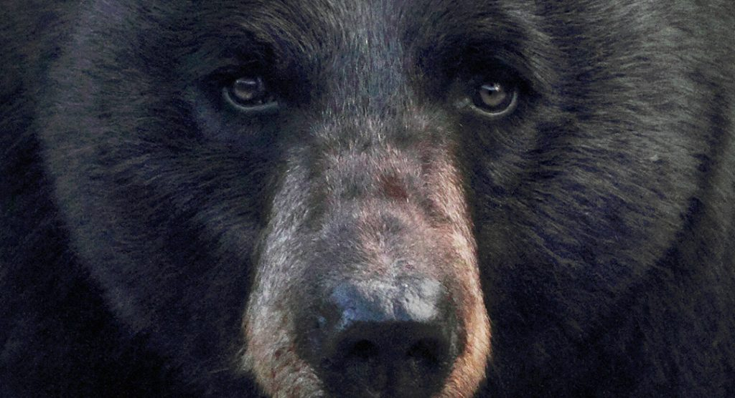
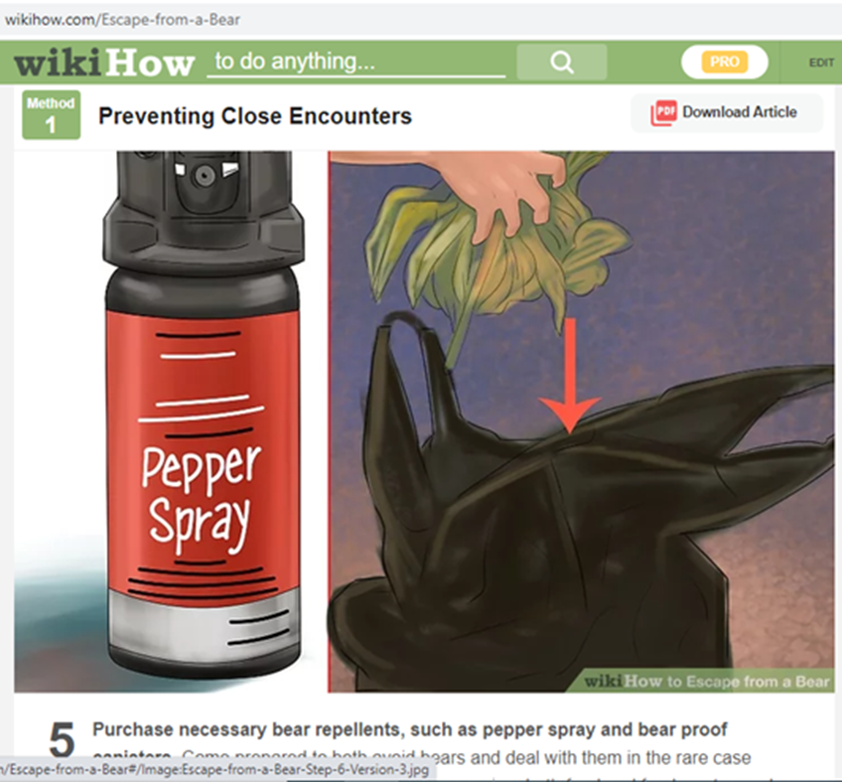
Why BearWise?
More People
More Attractants
Stretched Budgets
Stretched Resources
Mobile Society
Bad Information
Notes:
At the time (2008) only 1% of people got bear information from the State Wildlife Agency

Slide 4
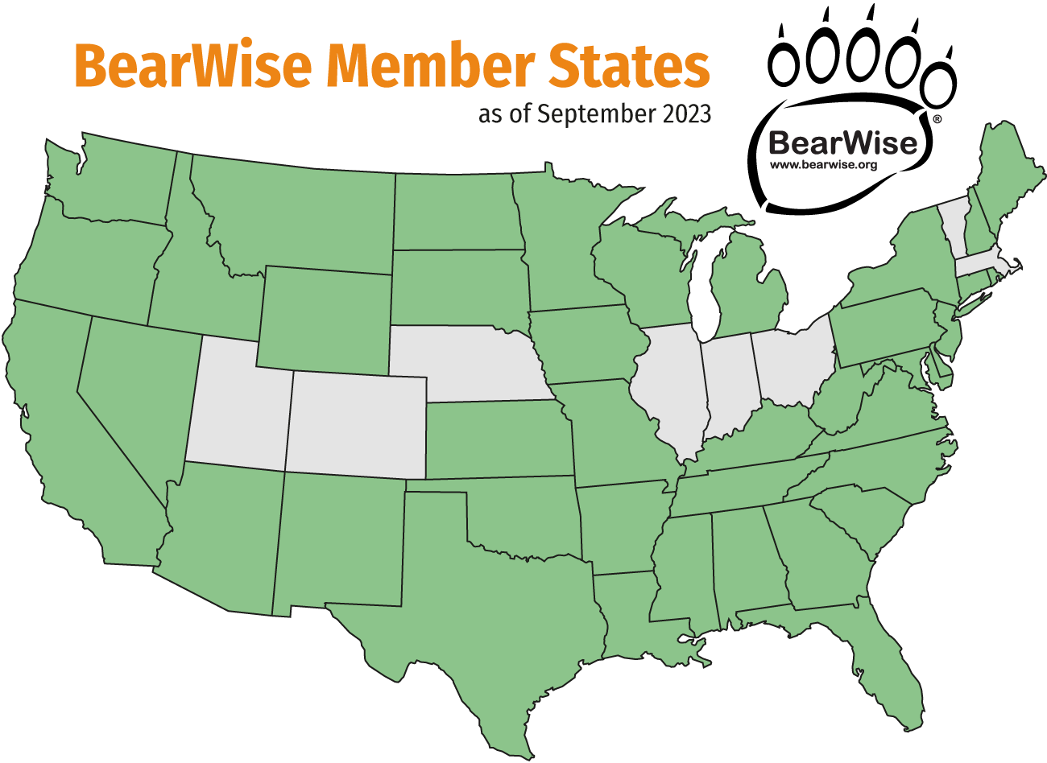
As of September 2023
Notes:
Show LWBH and For Sale Items

Slide 5
BearWise Working Group
Bryant White (AFWA)
Outreach & Creative
Mark Hart, AZ
Image Resource:
Linda Masterson
LaVonne Ewing
Technical
WEST
Ryan Leahy, CA
Rich Beausoleil, WA
NORTHEAST
Emily Carrollo, PA
Jennifer Vashon, ME
MIDWEST
Nate Bowersock, MO
Andrew Tri, MN
SOUTHEAST
Dan Gibbs, TN
David Telesco, FL
Member State Representatives

Slide 6
BearWise Working Group
Bryant White (AFWA)
Outreach & Creative
Mark Hart, AZ
Image Resource:
Linda Masterson
LaVonne Ewing
Technical
WEST
Ryan Leahy, CA
Rich Beausoleil, WA
NORTHEAST
Emily Carrollo, PA
Jennifer Vashon, ME
MIDWEST
Nate Bowersock, MO
Andrew Tri, MN
SOUTHEAST
Dan Gibbs, TN
David Telesco, FL
Member State Representatives

Slide 7
Funding
Member Dues
Store Income (2023)
$2,250
State Purchases (10%) $12,476
BW Materials – private (20%) $ 3,122
Other – Book Sales, donations $ 1.104
$90,000
$16,702
Notes:
Show LWBH and For Sale Items

Slide 8
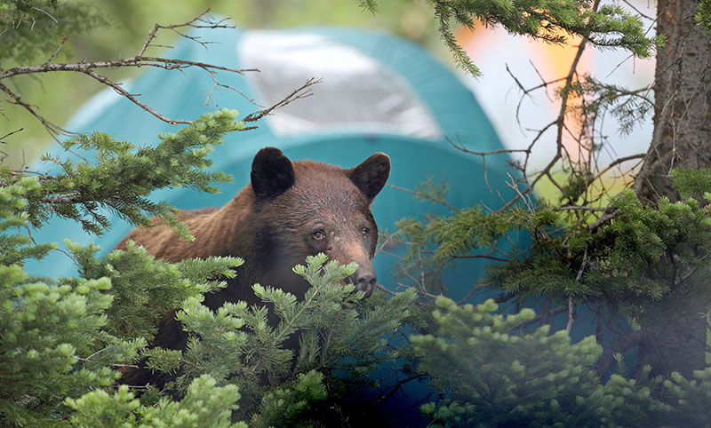
BearWise helps people live responsibly with black bears
Notes:
Show LWBH and For Sale Items

Slide 9
BearWise
Website
Member States
Partners
Social Sharing
Store
Customers
Subscribers

Slide 10
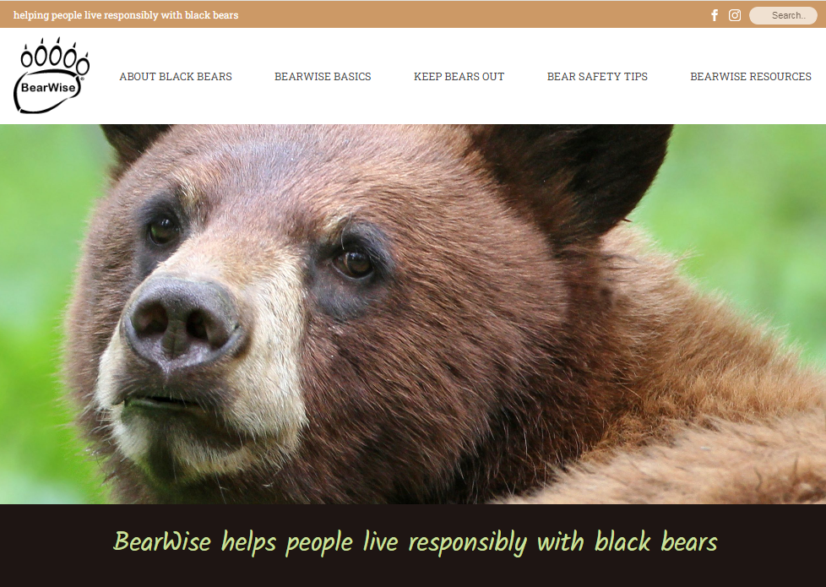

Slide 11
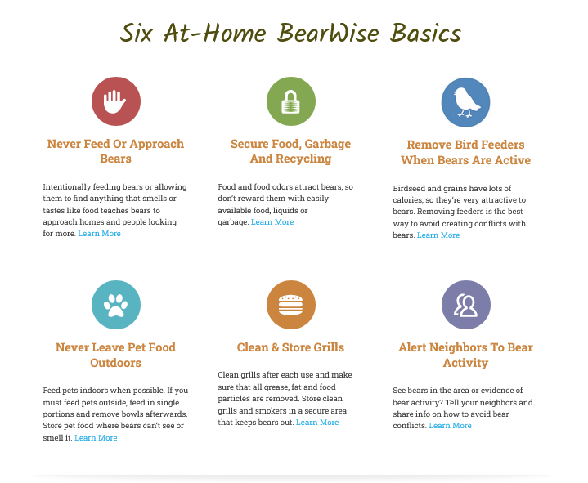
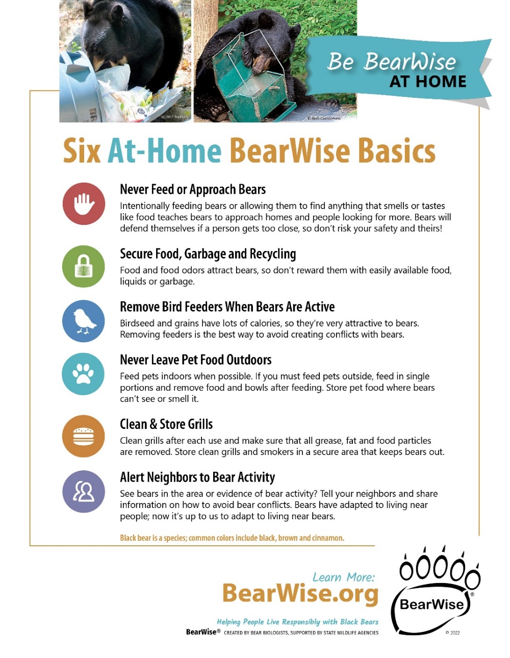
Our Foundation: the BearWise Basics
In Print & Online

Slide 12
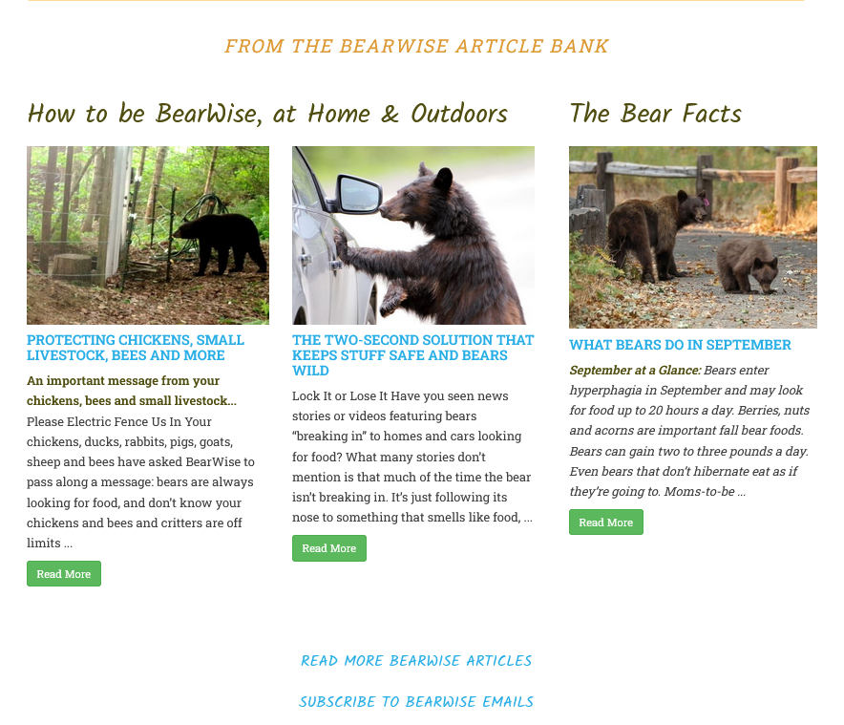
Timely Info in the Article Bank

Slide 13
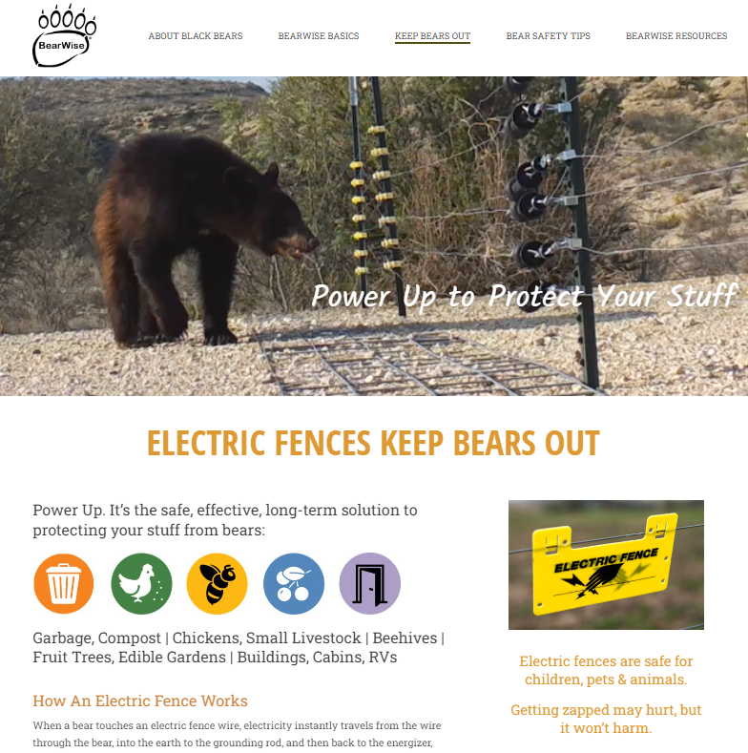
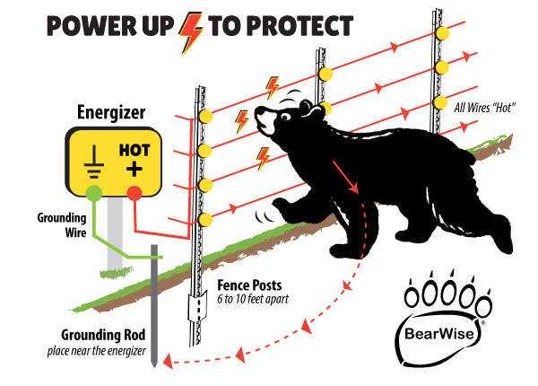
Keep Bears Out Electric Fencing Bear-Resistant Containers and more

Slide 14
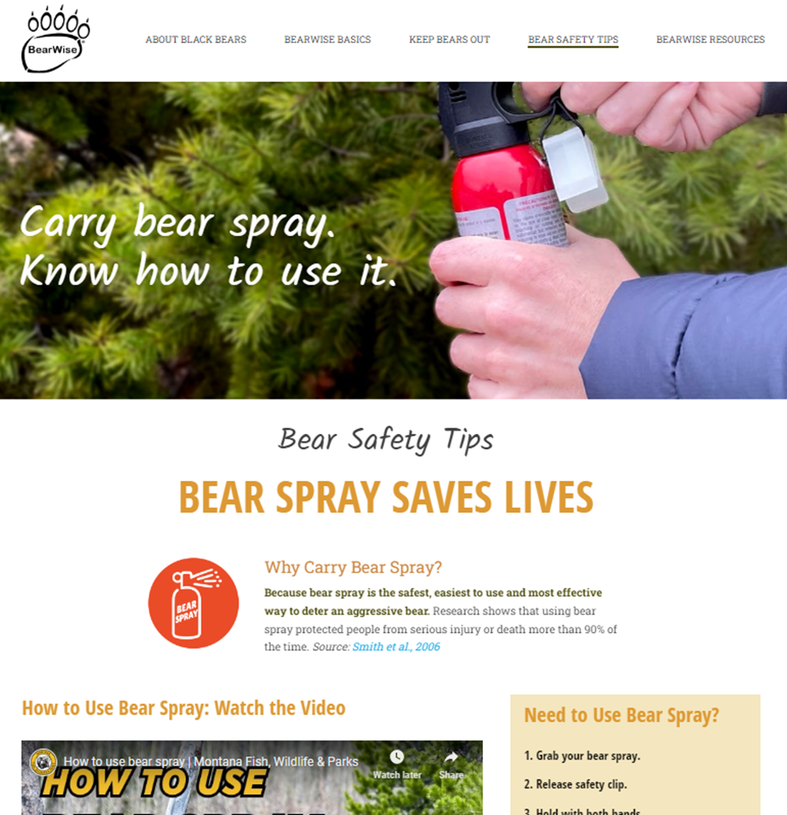
Bear Safety Bear Encounters Dogs & Bears Hike, Camp, Fish Safely Vacation Tips Bear Spray Tips for Hunters

Slide 15
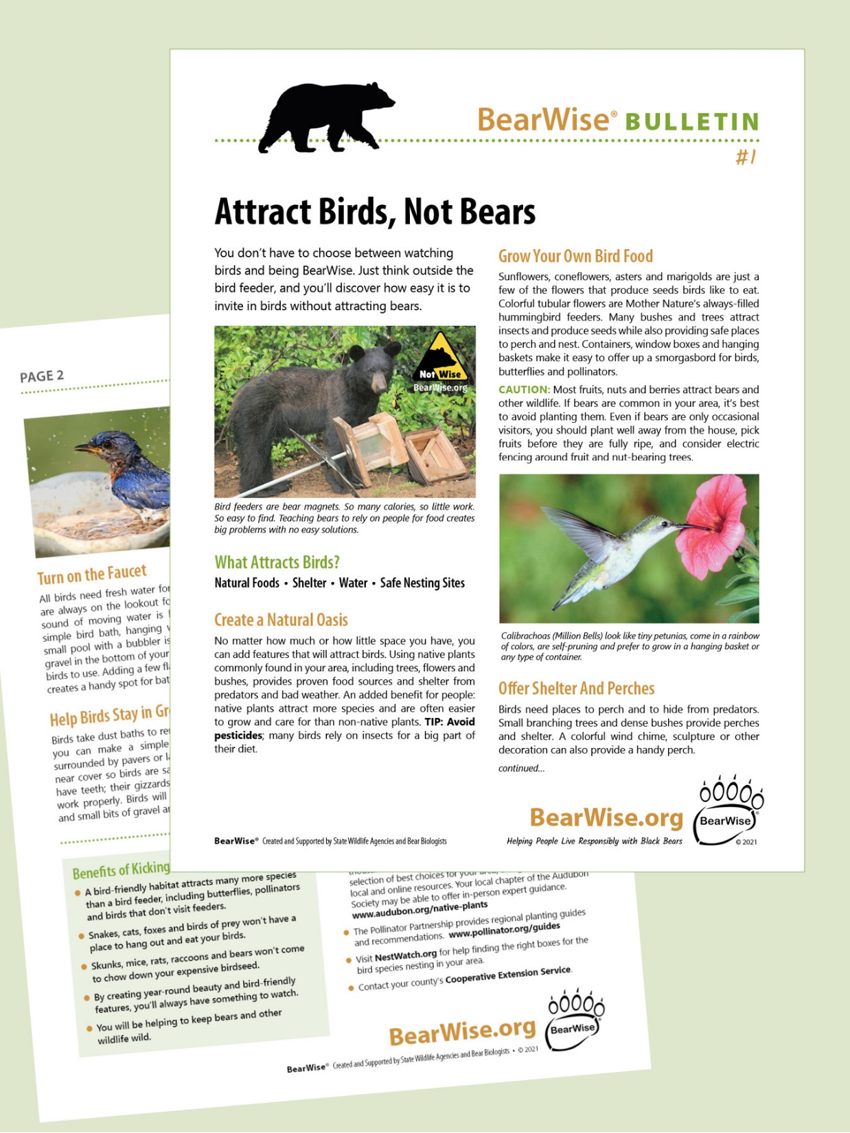
Provide motivation and alternatives to overcome barriers

Slide 16
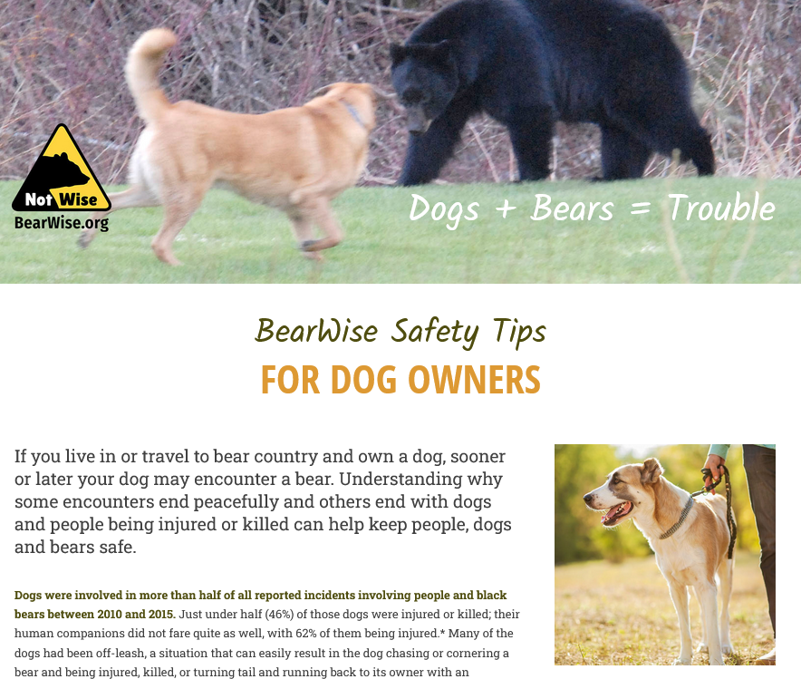
Why dogs and bears don’t mix

Slide 17
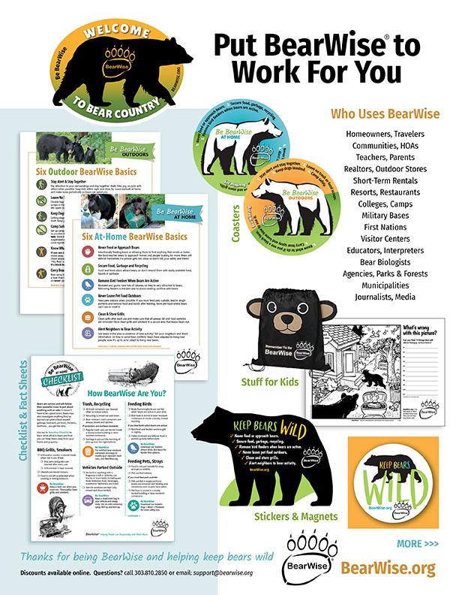
BearWise Store

Slide 18
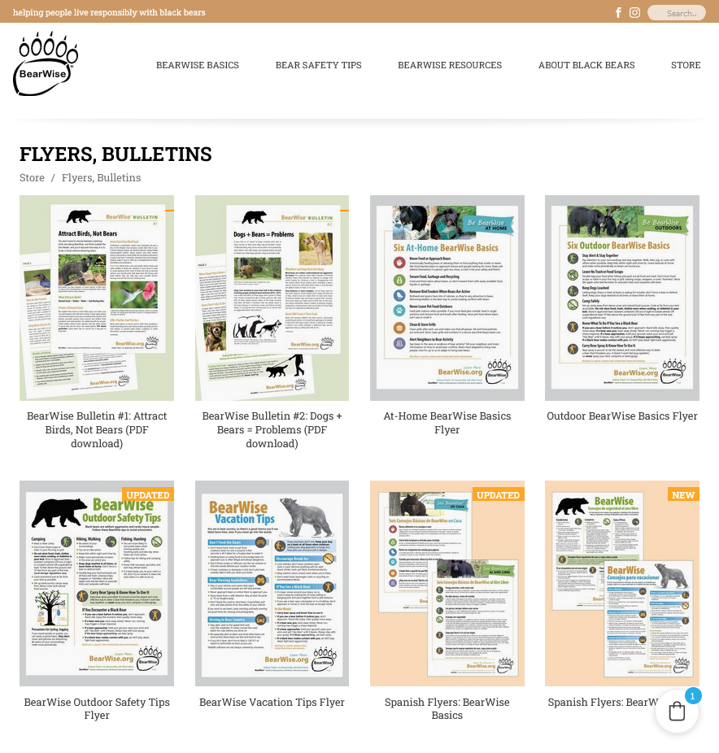
A one-stop shop of free handouts English & Spanish
Gather Information

Slide 19
Wide-Reaching
BearWise materials have gone to every state, across Canada and several other countries
“For our Choctaw Nation Wildlife Camp.”

Slide 20
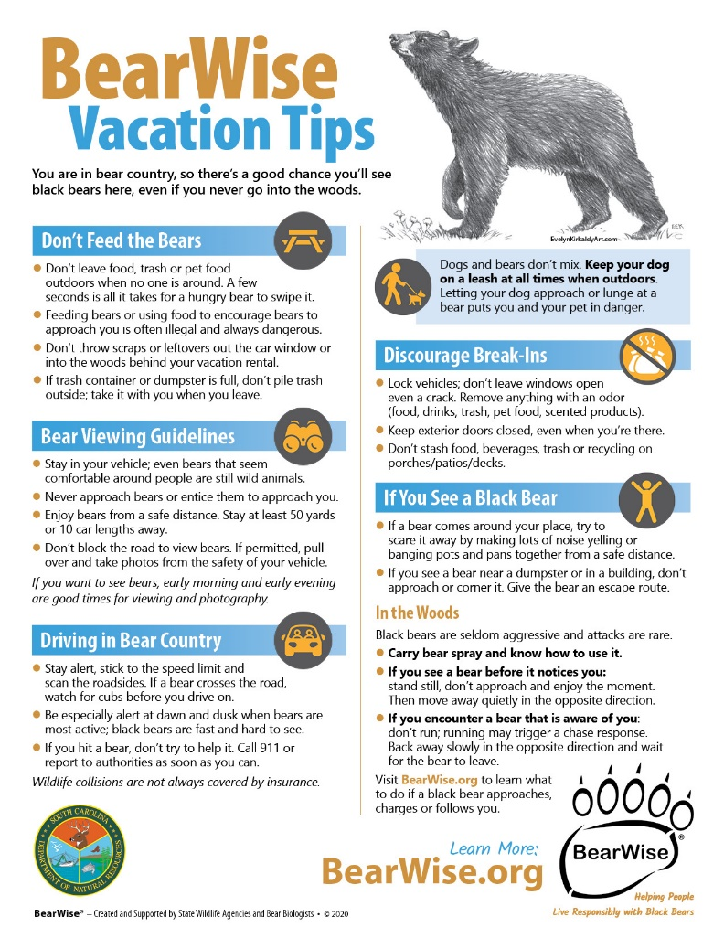
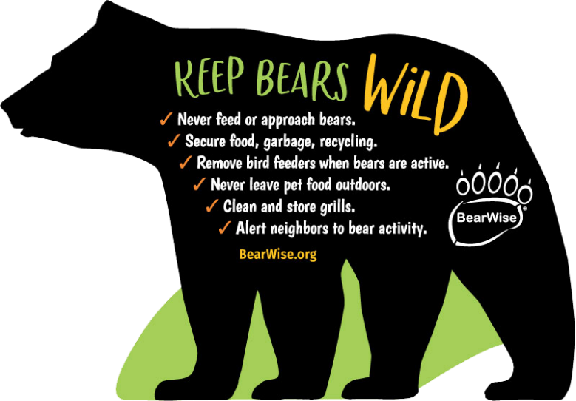
WHO USES BEARWISE
Short-Term Rentals
Homeowners, Travelers
HOAs, Communities
Teachers, Parents
“Our new community group in Vermont will
give away BearWise magnets at fall events.”

Slide 21
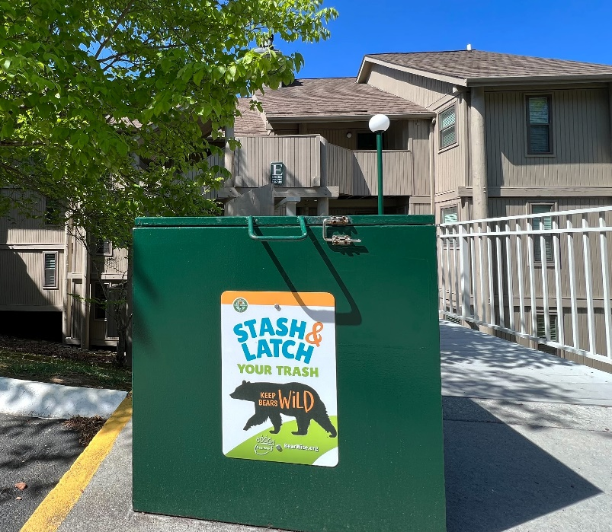
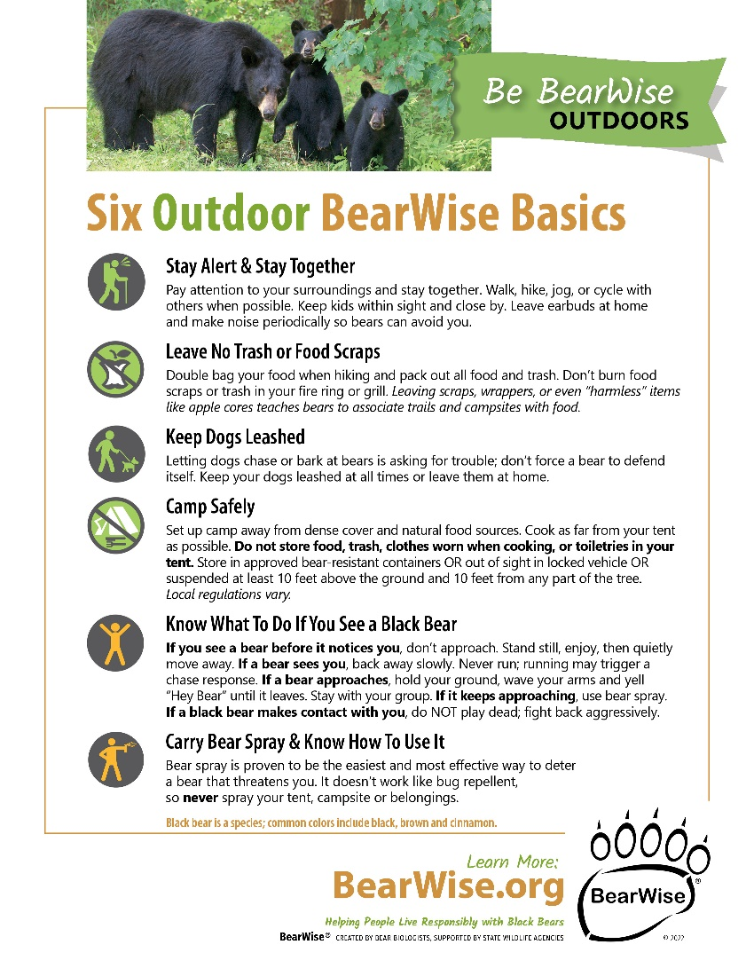
WHO USES BEARWISE
Realtors
Outdoor Shops
Resorts
Recreation Areas

Slide 22
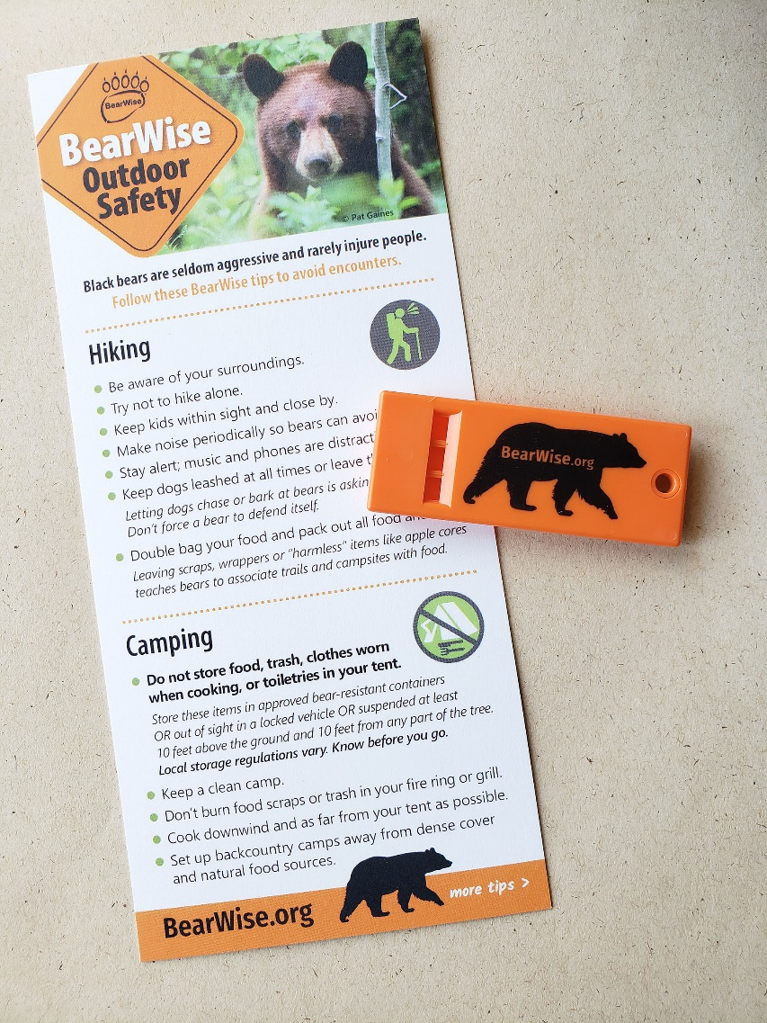
WHO USES BEARWISE
Interpretive Centers
Visitors Centers
Zoos
Radio
Community newspapers

Slide 23
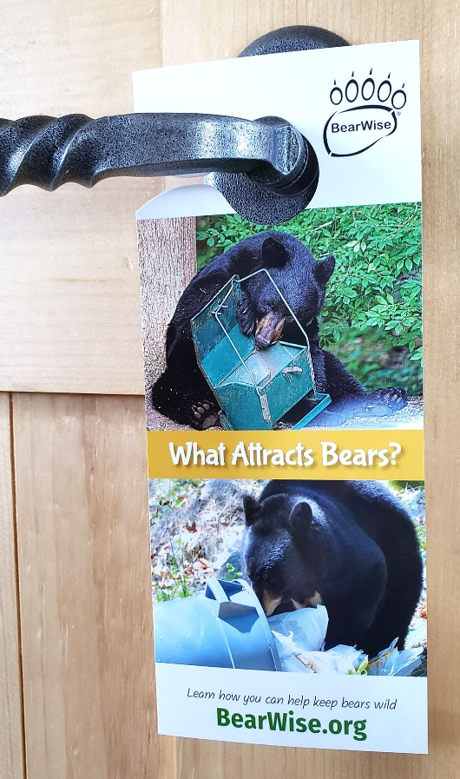
WHO USES BEARWISE
Colleges
Military Bases
First Nations
Municipalities
“For residents of Michipicoten First Nation.”
“Give to each city council member.”
“Display in our police station.”

Slide 24
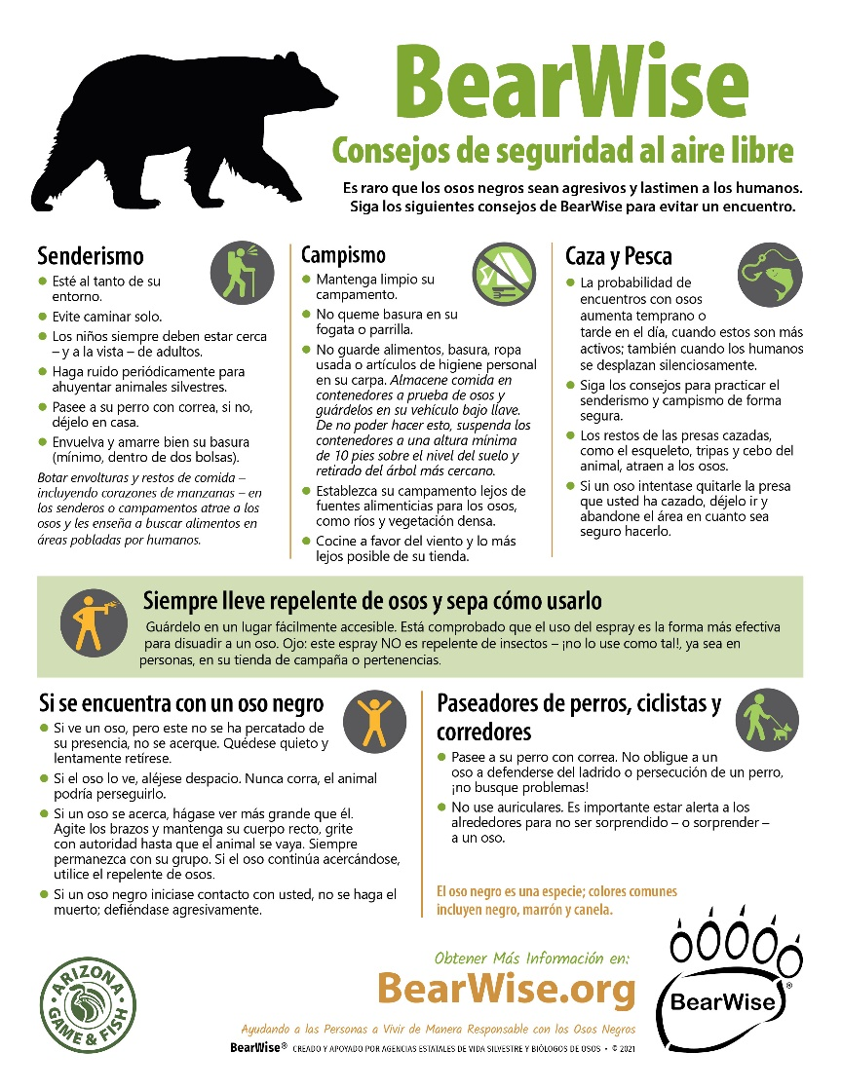
WHO USES BEARWISE
State Wildlife Agencies
Bear Biologists
Parks & Forests

Slide 25
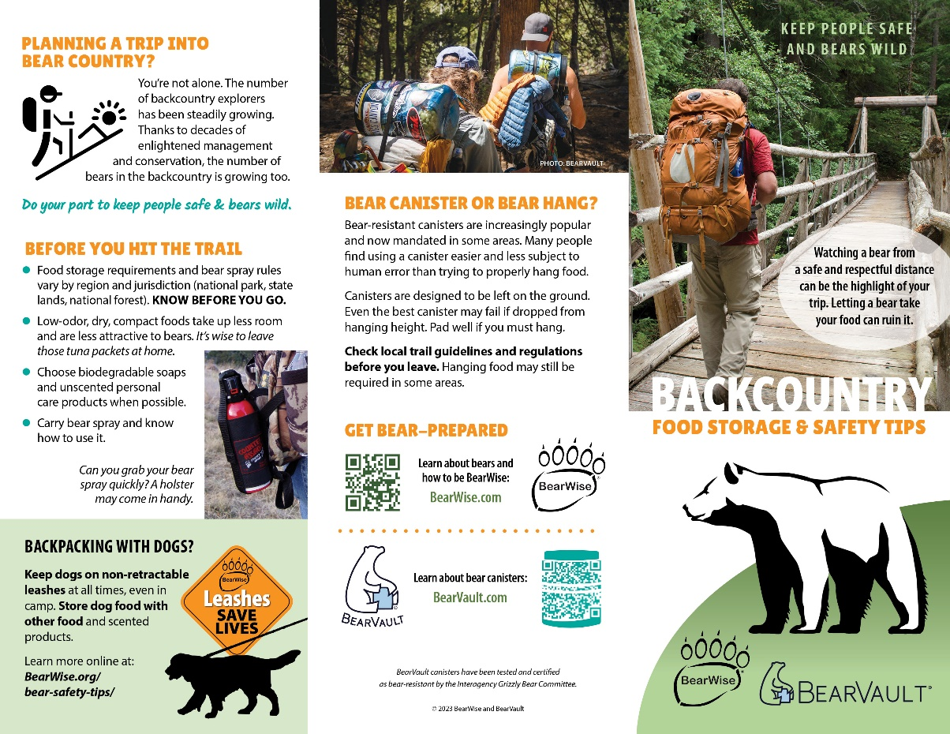
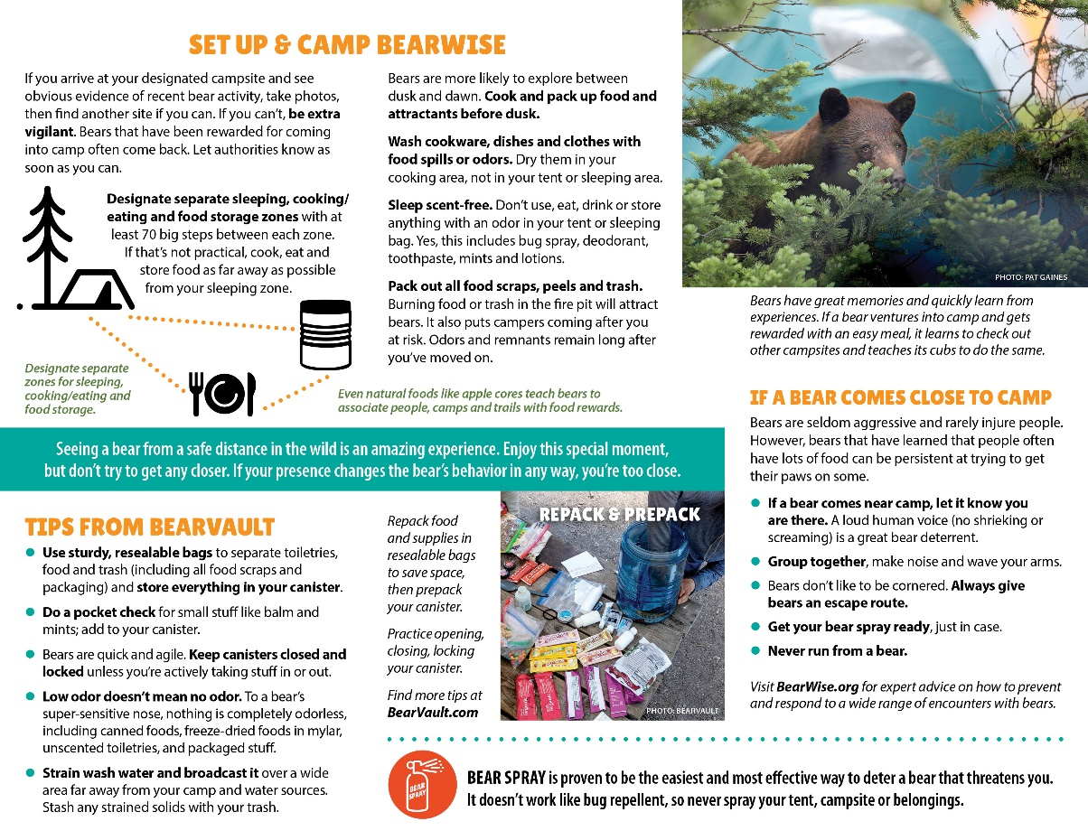
Recent Partnership: Trifold brochure with BearVault

Slide 26
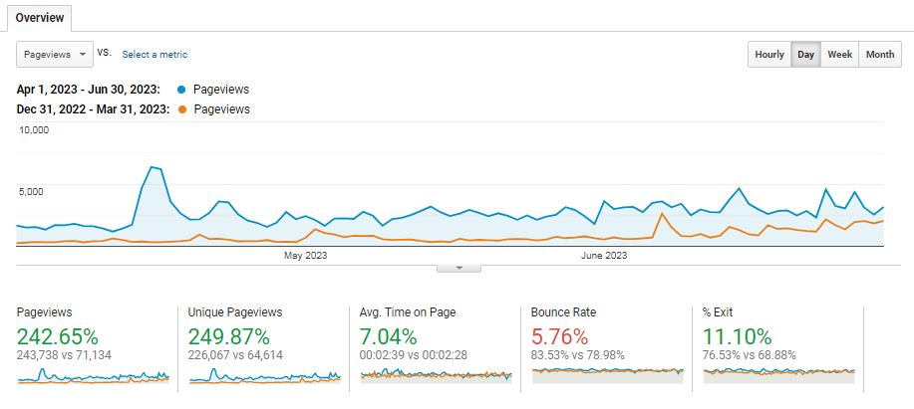
Website Analytics
Most Visited Pages
Bear Encounters
Bear Spray
About Black Bears
Cocaine Bear

Slide 27
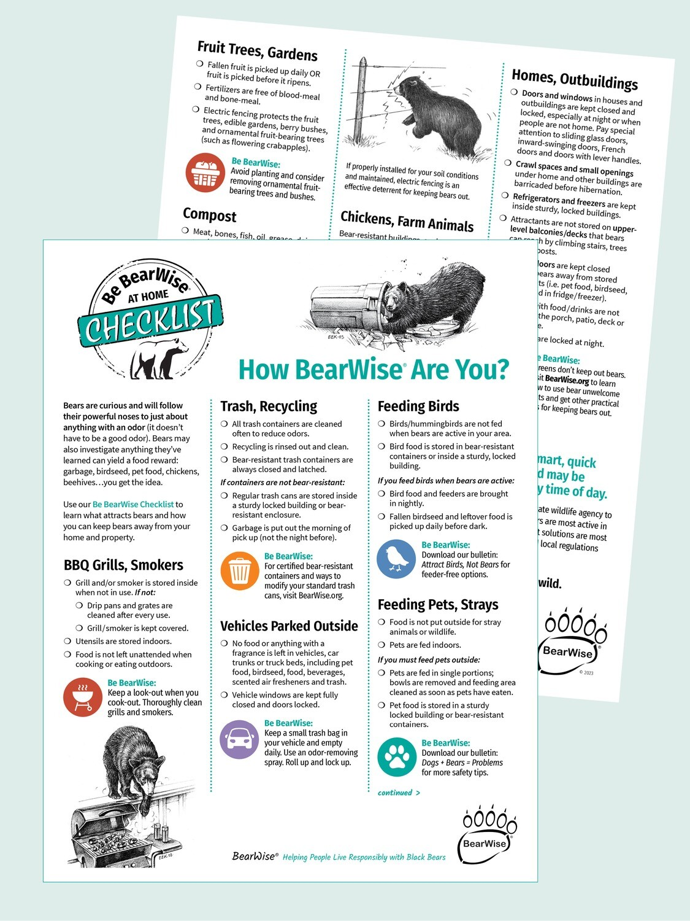
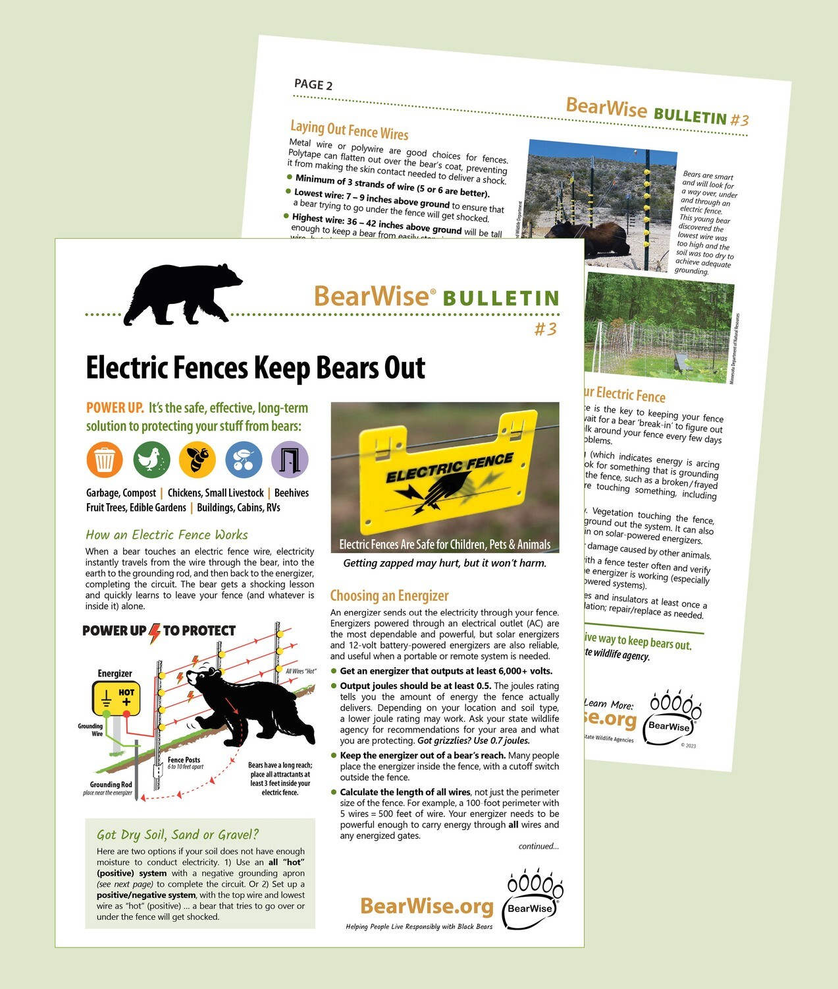
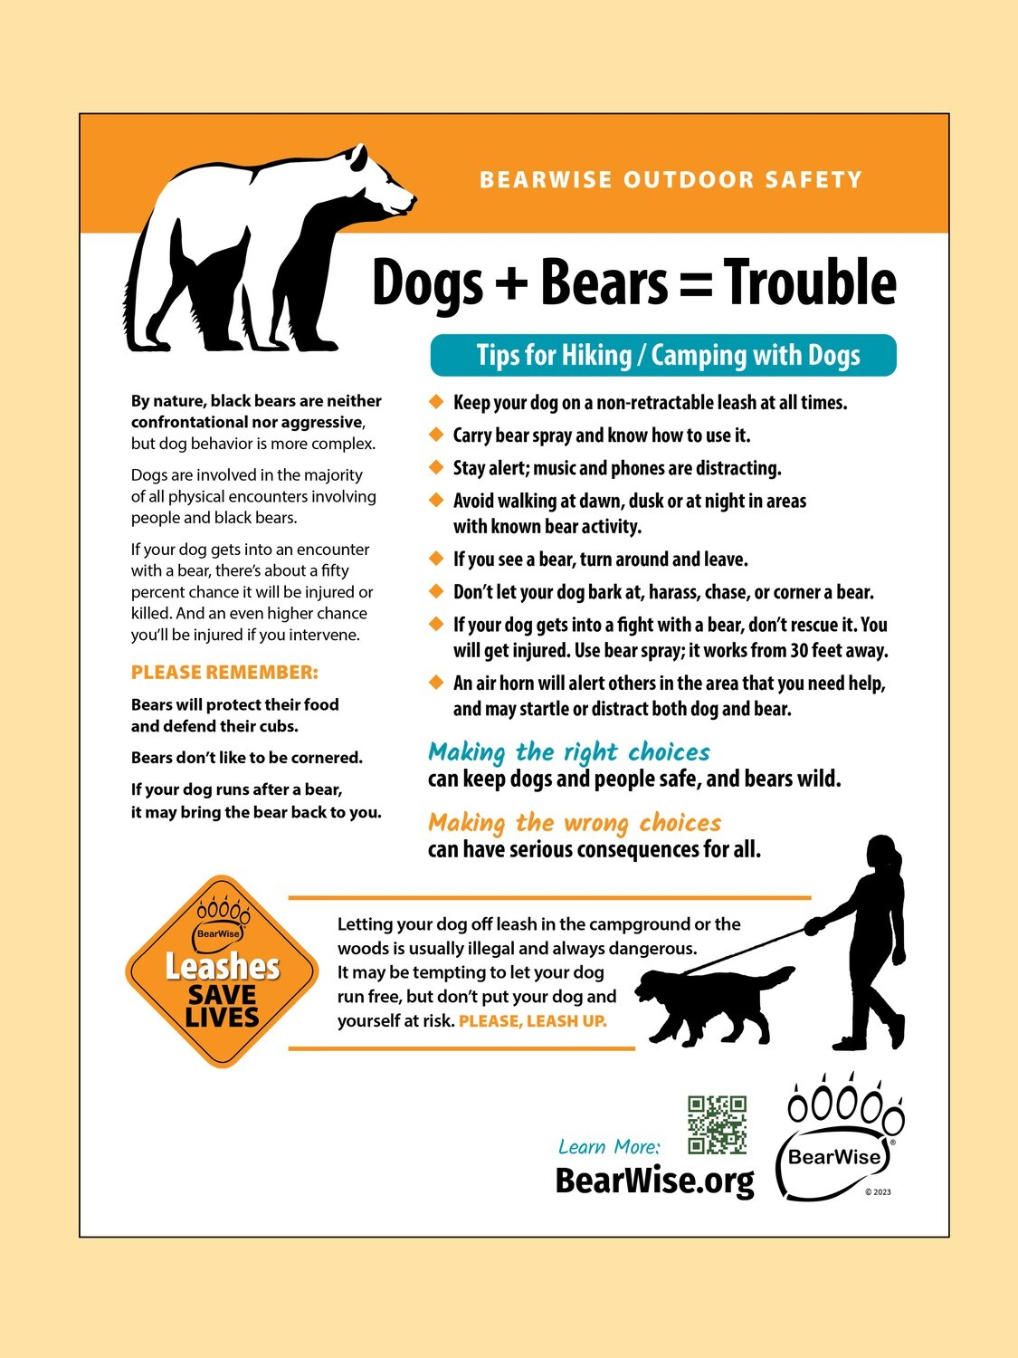
2023 Overview
Notes:
Approximately $88,000

Slide 28
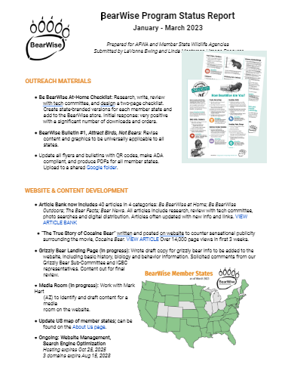
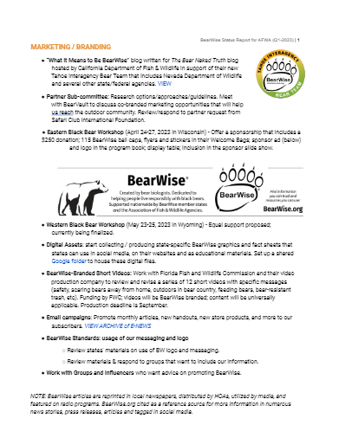
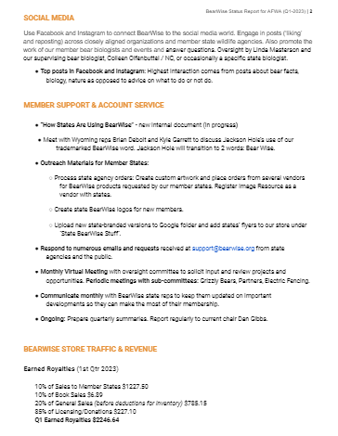
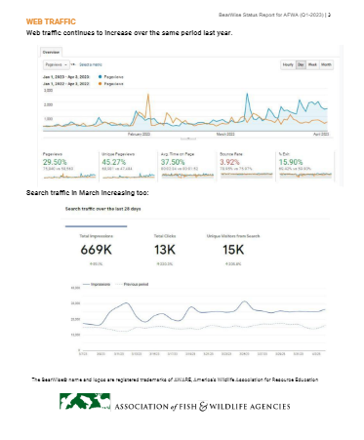
2023 Overview
Notes:
Approximately $88,000

Slide 29
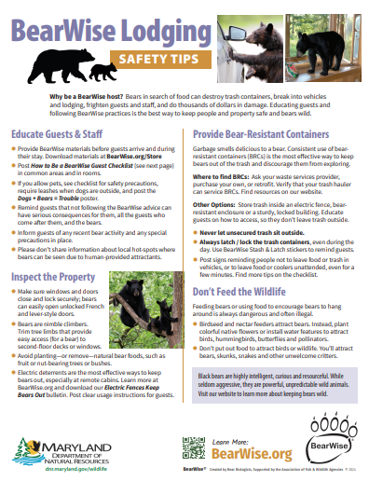
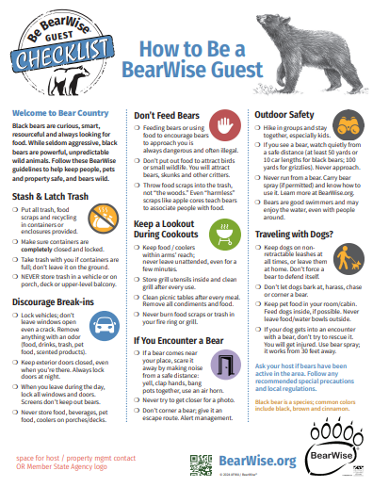
2024 At a Glance
Building a BW Community
Electricity Page
ATC Partnership
Branding Standards
State Rep. Responsibilities

Slide 30
Projected Funding (2024)
Member Dues
Store Income
$85,500
$14,000
2024 Budget
$93,000
Notes:
Show LWBH and For Sale Items

Slide 31
Store Income (2023)
State Purchases (10%) $12,476
BW Materials – private (20%) $ 3,122
Other – Book Sales, donations $ 1.104
Notes:
Show LWBH and For Sale Items

