Slide 1

MDC RAWA Readiness
Nate Muenks, Natural Resource Planning Section Chief
Missouri Department of Conservation
19 April 2022

Slide 2
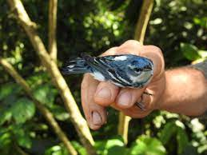
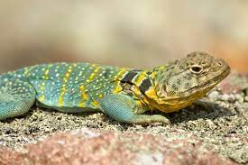
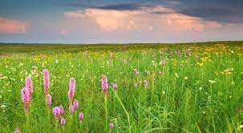
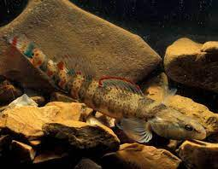
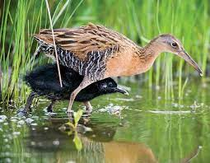
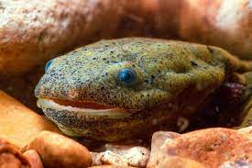
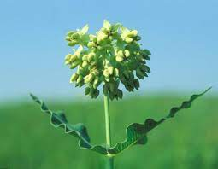
RAWA Ready at MDC – Readiness Team
• Champions
o Sara Parker Pauley
o Outcome Champions and Branch Leaders
• Team co-leaders
o Megan Buchanan
o Lorisa Smith
o Nate Muenks
• Core team members
o Andrew Bond
o Doyle Brown
o Melanie Crane
o Gus Raeker
o Chris Wieberg
o Janet Sternburg
o Max Alleger
o Michael Bill
o Mike Leahy
o Jason Jensen
o Kelly Rezac
o Doug Novinger
o Lisa Potter
o Kimberly Barnett
o Ritchie Jenkins
o Sue Rackers
o Chris Scheppers
o Seth Barrioz
PARTICIPANTS:
• Subject matter advisors and sub-team members (preliminary)
o Tim Anderson
o Matt Combes
o Bruce Drecktrah
o Tony Elliot
o Heather Feeler
o Sherry Fischer
o Justine Gartner
o Shawn Gruber
o Dawn Henderson
o Jessica Hoey
o Kyle Larimore
o Chris Kennedy
o Joel Porath
o Ron Reitz
All Branches Represented
Statewide & Regional Resource Management
Science
Protection
Community and Private Lands
Relevancy
Communications
Education
Policy & Gov’t Affairs
Legislative & Ag Relations
Budgeting and Finance
Human Resources
Information Technology
Infrastructure Management
Conservation Business Services

Slide 3
RAWA Ready at MDC
RAWA Ready Team Guiding Principles
Be driven by the MDC Strategic Plan & Partner Priorities (CCS Guides)
Be inclusive of input from diverse internal and external stakeholders
Understand necessary staffing and budget considerations to the extent possible
Address potential partnership opportunities to increase Missouri’s conservation capacity and impact
Prioritize work and systems that are proactive, collaborative, innovative, future-focused, and measurable

Slide 4
RAWA Ready at MDC
Overall Planning Process
Identify priority needs, focus areas, and initiatives
Gather RAWA ideas and input from MDC staff, partners, stakeholders
Prioritize ideas according to MDC Strategic Plan, the CCS, and other priorities
Develop RAWA Ready Plan
Continuously update and engage MDC staff, partners, and other states

Slide 5
RAWA Directed Use
Three Categories
Engagement
  15% max
Species
  15% min
Habitat
Implement and enhance the CCS to recover and manage SGCN and their habitats
Assist in the recovery of state and federal listed species
  Minimum 15% of total RAWA funds
Wildlife conservation education and wildlife-associated recreation
  Maximum 15% of total RAWA funds
Cross-boundary SGCN
Invasive species, disease, and other risks to SGCN
Enforcement related to SGCN

Slide 6
RAWA Ready Plans – Two Distinct Phases
  RAWA for FY23: March budget addendum, followed by input, coordination, and development of plans and grants
    Budget Built for 3 Scenarios (25%, 50%, 75%) – Needs updated now to fit potential 65%
  RAWA for FY24 – FY26: kicking off with focus groups, followed by gathering more staff and partner input, coordination, and development of plans and grants
      Increased partnership input here!

Slide 7


RAWA for FY23: Timeline
Assess FY23 budget for RAWA eligible items: January 25 – 26
Develop new FY23 RAWA ideas: February 7 – 18
Prioritize and approve: February 22 – March 2
Develop RAWA Commission budget addendum: March 3 – 10
Share with Commission: March 10
Commission budget workshop: March 24 (25% funding scenario taken)
Update addendum to reflect 65.3% funding: TBD

Slide 8
RAWA for FY23: Update the Budget Addendum
Need to update addendum to reflect 65.3% funding scenario (estimated $13.7M)
  Last week we worked with the Governor’s Office and legislators to craft a Governor’s Amendment that will be offered in the Senate this week as they start work on the FY23 budget.
  “The Governor recommends an additional $13,713,000 Conservation Commission Fund and 36 staff to support wildlife conservation and restoration efforts.”

Slide 9
RAWA for FY24 – FY26: Timeline
All-Staff Survey: April 22 deadline
  Director sends to all staff: April 14
  Reminder from Director: April 19
Focus Groups: April 25 – 29
  Habitat: April 25
  Species: April 26
  Engagement: April 27
  Business Services: April 29

Slide 10
RAWA for FY24 – FY26: All-staff Survey
Survey objectives:
  Inform RAWA priorities, but also inform other program areas and strategic planning
  Provide first opportunity for all staff to contribute to MDC’s RAWA Ready efforts
Will be used to inform focus group dialogue

Slide 11
RAWA for FY24 – FY26: Focus Groups
Goal: engage in iterative dialogue to develop preliminary RAWA priorities
  Priority objectives: Identify BIG BUCKETS of work we want to focus on FY24-26
  Strategic initiatives within priority objectives
    Ways and means
    Hurdles and barriers
    Internal capacity needs
    Partnership needs and opportunities
  Planning and measurement systems
Notes:
What missing, seem logical, red flags or concerns, any ideas

Slide 12

MDC Internal Communications
Key messages
RAWA 101
Legislation status
RAWA Ready team plans, updates
Timelines
Input needed
Channels
Centralized
  Director’s message
  Expanded Leadership
  All-staff meetings
  Employee newsletter
  MDC minute
  Staff surveys
Weekly Email Updates
To: Branch Chiefs, Outcome Champions, RAWA Ready Team (forward as you see fit)
Include: legislation update, assignment updates, what to expect in coming week

Slide 13

Thank you for your time!
Nate Muenks, Natural Resource Planning Section Chief
2901 West Truman Blvd
Jefferson City, MO 65102
Nate.Muenks@mdc.mo.gov

