Slide 1


Diversity is Nature’s Greatest Asset
Including All Students
in Project WILD
Webinar, Sept. 26 2018
with Featured Presenter:
Sherry Adrian, Ph.D.
Associate Professor
adrians@southwestern.edu
This presentation was compiled by Sherry Adrian, Ph. D.

Slide 2
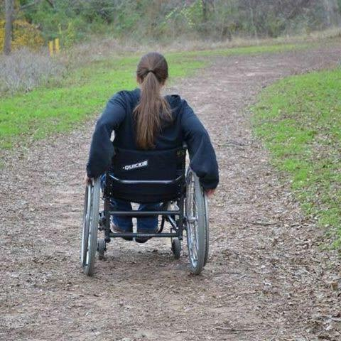
Diversity is Nature’s Greatest Asset
Including All Students
in Project WILD
Sherry Adrian, Ph.D.
Associate Professor
Southwestern University
Georgetown, Texas
adrians@southwestern.edu
This webinar is being recorded.

Slide 3
ESSENTIAL QUESTIONS
What is effective about the lesson design that results in all students being included?
Who might be excluded from a lesson and how can I revise the lesson so that all of my students enjoy “learning about Earth as home for [all] people and wildlife” (Project WILD, 2018, p. v.)

Slide 4

Workshop Agenda
Explore 3 approaches used to design (or analyze existing) lessons to include students more fully.
Analyze sample Project WILD lessons using at least two approaches.
Recommend possible revisions to sample Project WILD lessons to more fully include students.

Slide 5
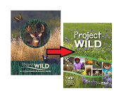
A Note about New Content
New
Content

Slide 6
As a teacher you will need...
Repertoire and Choice
Effective and essential questions – focused connection making; student-driven questions and connection-making
Experiential learning – exploration; discovery; application; analysis; problem-solving; centered in students’ lives
Cooperative learning - metacognition, problem solving and social skills
Critical thinking through reflection – expression of ideas (written/oral/visual); critical analysis; metacognition; self-regulation and assessment
Direct instruction – foundational concepts; vocabulary development; skills and procedural knowledge
Action generating – real problems and solution-oriented; innovation; creativity

Slide 7
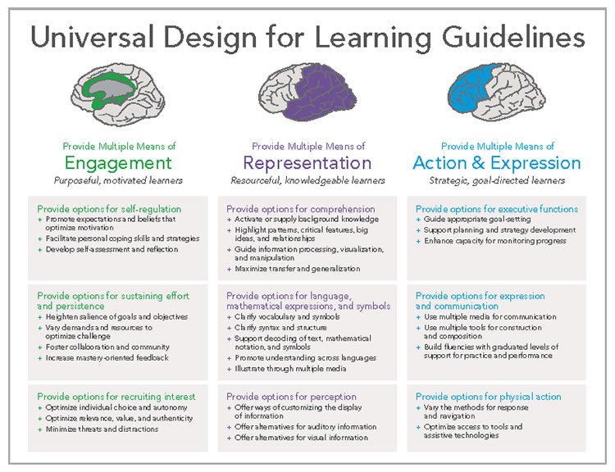
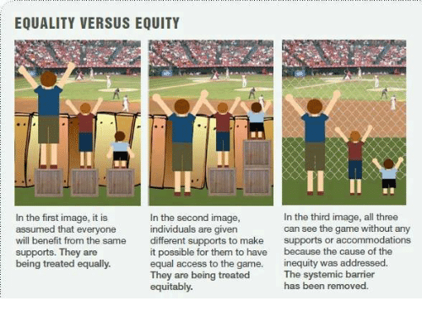
ACCESS to a FREE and APPROPRIATE EDUCATION (FAPE)by...

Slide 8
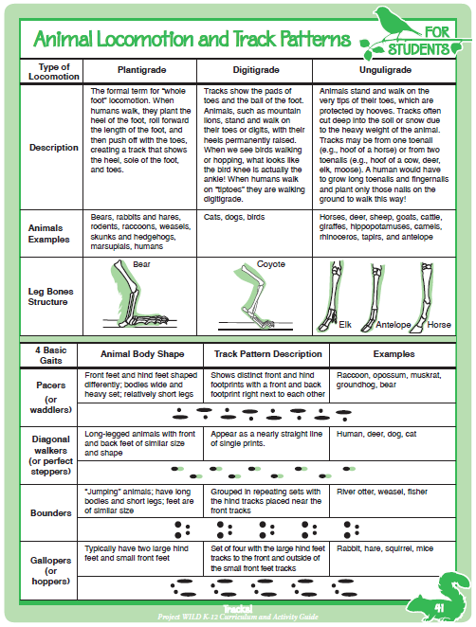
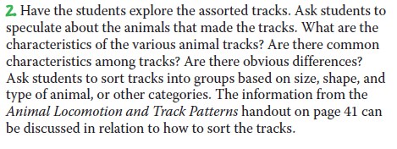
New
Content
Tracks!
Part A: Track Identification

Slide 9

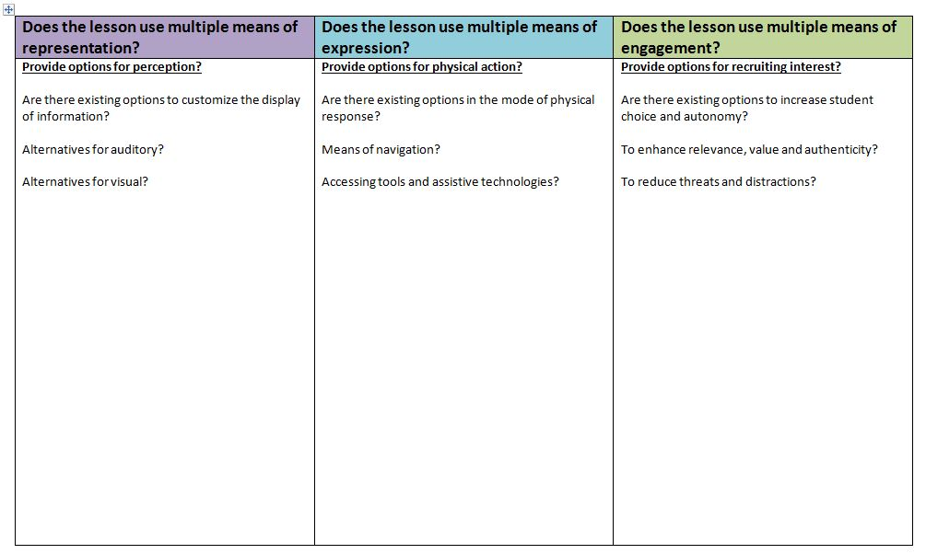
Analyzing lesson by Universal Design for Learning Principles
Tracks! pp. 36-41; Upper Elementary, Middle School

Slide 10
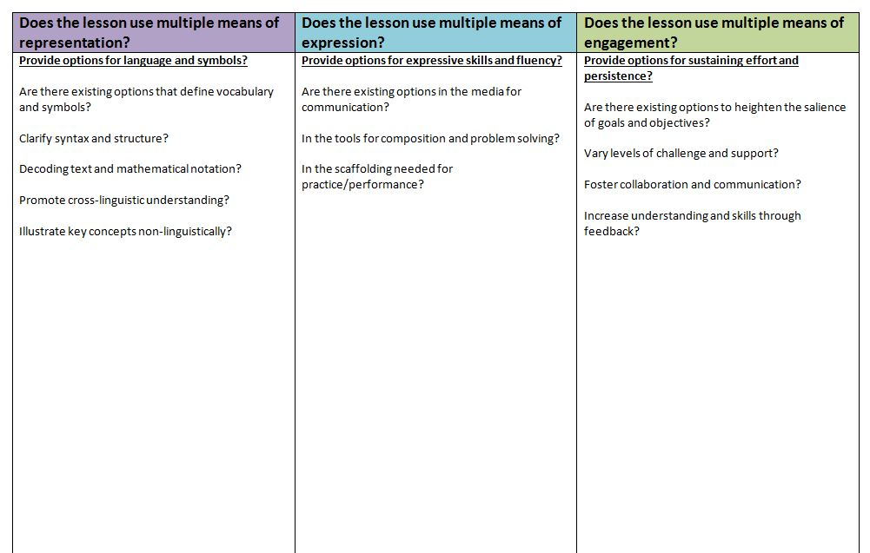
Analyzing lesson by Universal Design for Learning Principles
Tracks! pp. 36-41; Upper Elementary, Middle School

Slide 11
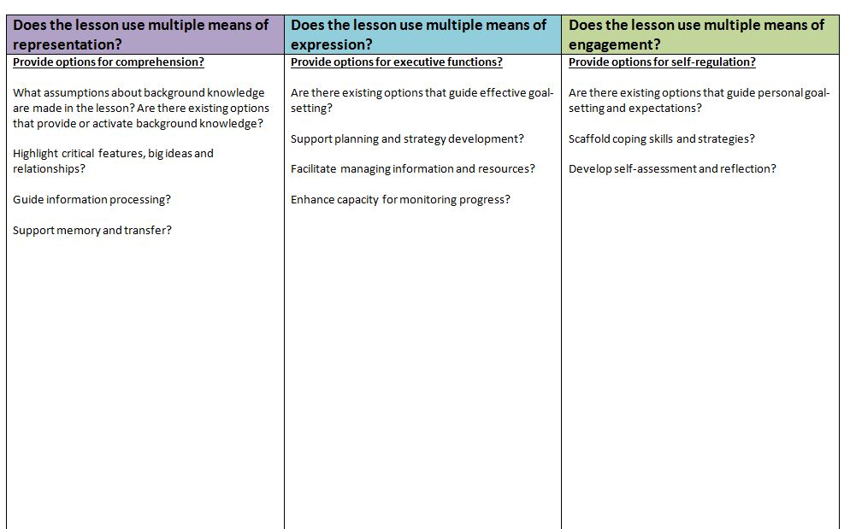
Analyzing lesson by Universal Design for Learning Principles
Tracks! pp. 36-41; Upper Elementary, Middle School

Slide 12
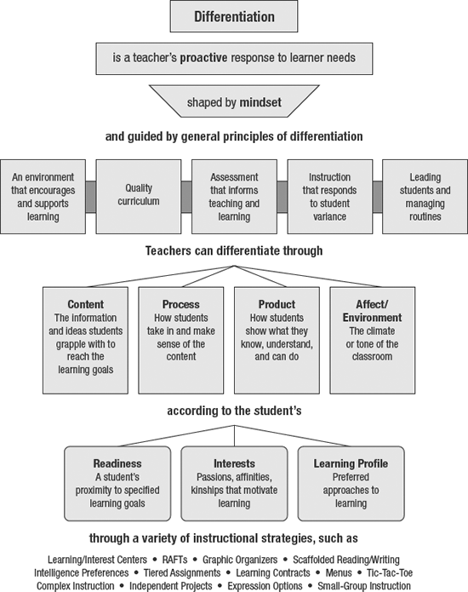
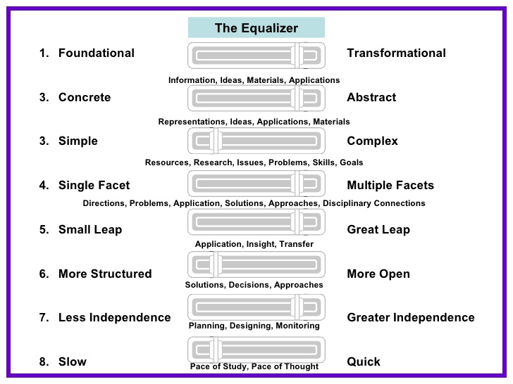
DI-Tomlinson: Respectful Tasks
Differentiated Instruction
Tomlinson, CA (2014). The differentiated classroom: Responding to the needs of all learners. Alexandria, VA: ASCD.

Slide 13
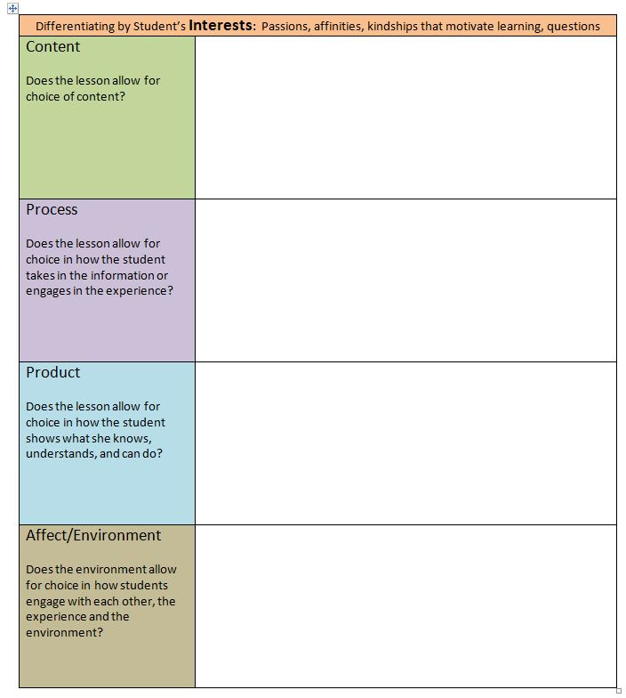
Differentiating by INTEREST
Passions
Affinities
Kindships that motivate learning
Essential Questions

Slide 14
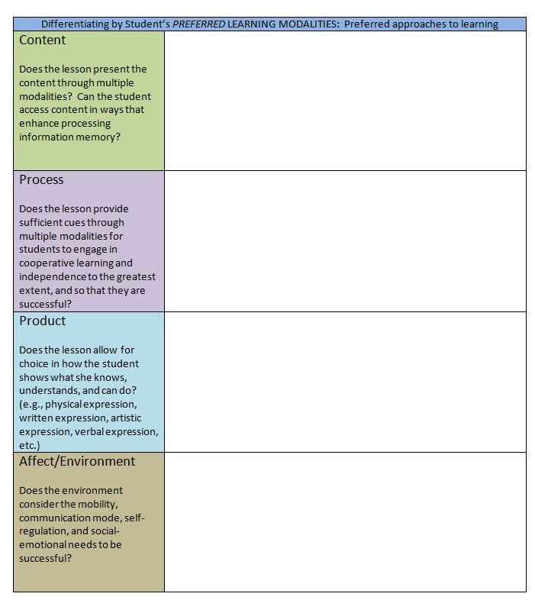
Differentiating by PREFERRED
LEARNING STYLE
The student’s preference in how she takes in information and how she demonstrates what she knows, understands, believes, and can do.

Slide 15
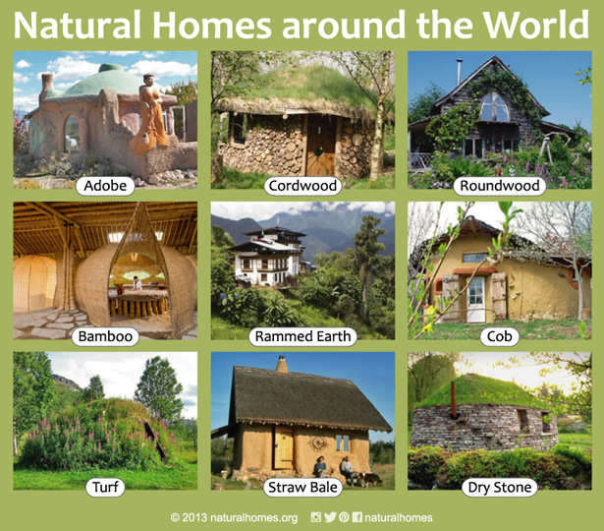
Analyzing lesson by Carol Ann Tomlinson’s Differentiated Instruction Model
My Kingdom for a Shelter, pp. 70-72
Lower Elementary, Upper Elementary, Middle School
Turn to page 3
Differentiating by Readiness:
Students proximity to learning goals

Slide 16
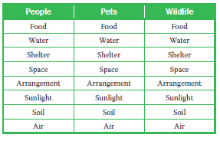
New
Content
My Kingdom for a Shelter
Procedure 1-3. The three-column chart
Comparing the essential needs for people,
pets, and wildlife.

Slide 17
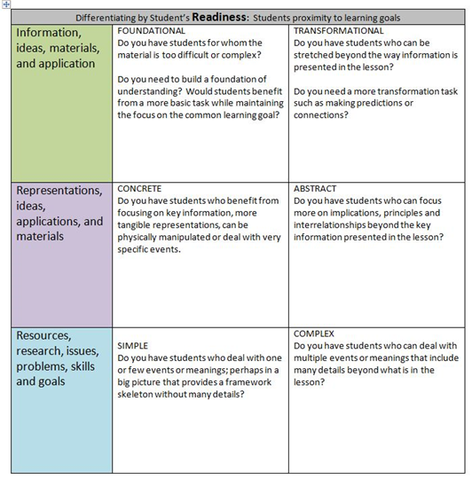
Differentiating by READINESS
A student’s READINESS is not fixed…
DI requires the growth mindset that students’ levels of readiness vary from subject to subject, unit to unit, and lesson to lesson. Decisions related to readiness focus on providing all students with meaningful, respectful and challenging learning experiences.

Slide 18
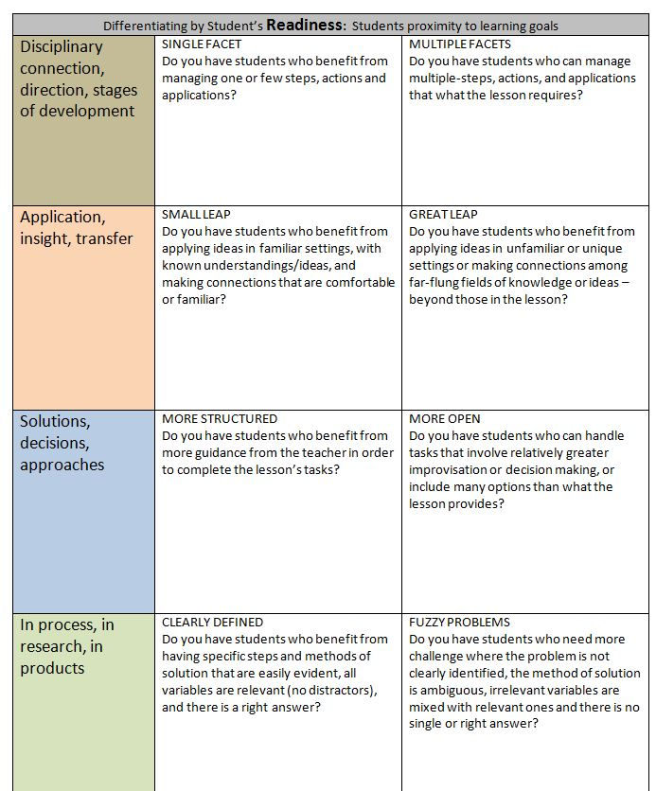
Differentiating by READINESS, continued

Slide 19
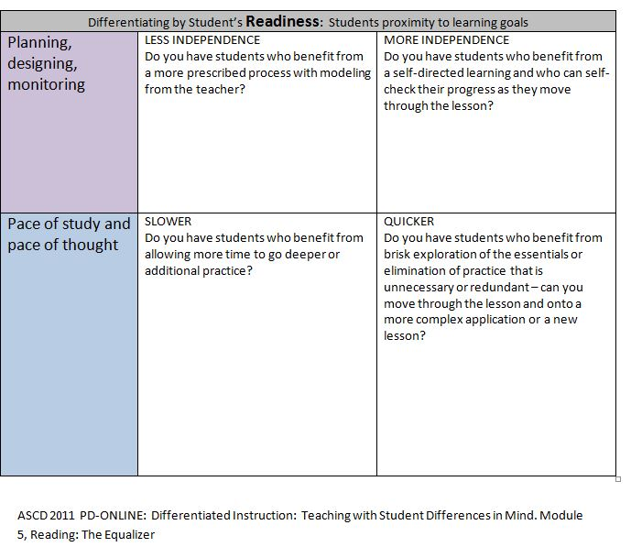
Differentiating by READINESS, continued

Slide 20
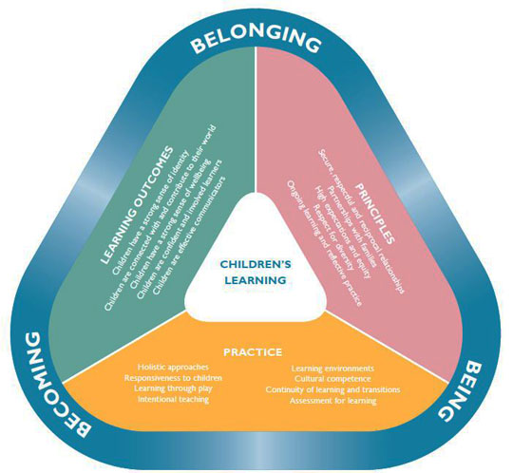
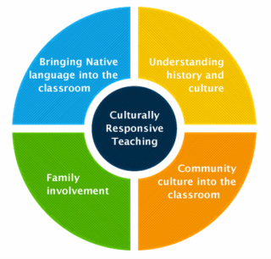
Differentiate instruction through CRT
Culturally Responsive Teaching (CRT)

Slide 21
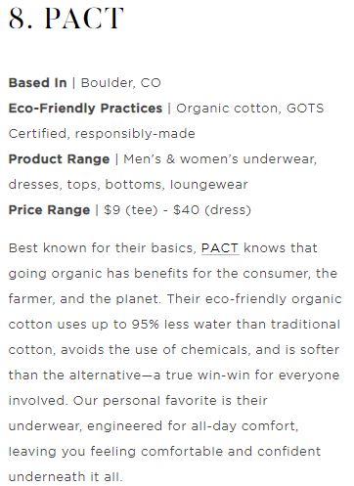
Analyzing lesson by Culturally Responsive Teaching Principles
What You Wear is What They Were, pp. 304-308
Lower/Upper Elementary, Middle School

Slide 22
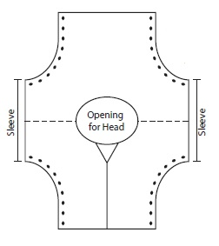
New
Content
What You Wear Is What They Were
“Make a Coat” for younger students

Slide 23
References and Recommended Resources
http://www.ascd.org/publications/educational-leadership/sept95/vol53/num01/A-Framework-for-Culturally-Responsive-Teaching.aspx
https://www.caroltomlinson.com/
http://www.cast.org/
Gay, G. (2010). Culturally responsive teaching: Theory, research and practice. New York: Teachers College Press.
https://www.socialthinking.com/

Slide 24
Project WILD encouragement
As you conduct your training sessions, are you engaging your participants in examining who is and who is not being included in Mother Nature’s “classroom?”

Slide 25
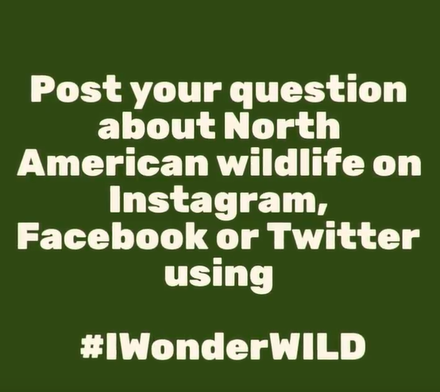
Announcements
#IWonderWILD
October 15 – November 16
https://www.youtube.com/watch?v=8yCyYacOwt4

Slide 26


Announcements
Project WILD Sessions
@
NAAEE & NSTA

