Slide 1
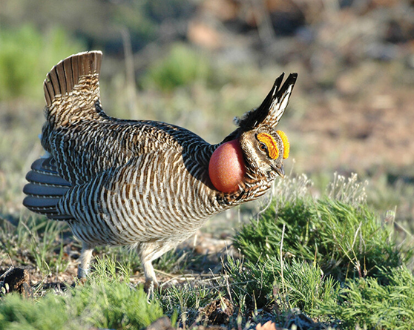
Multistate Conservation Grant Program
May 9, 2024

Slide 2
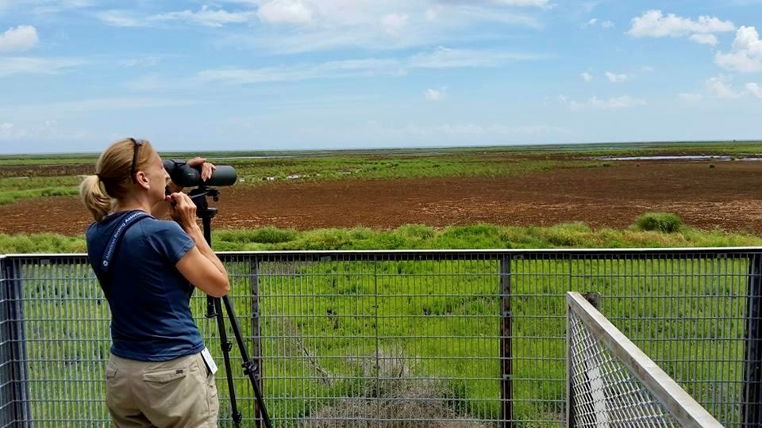
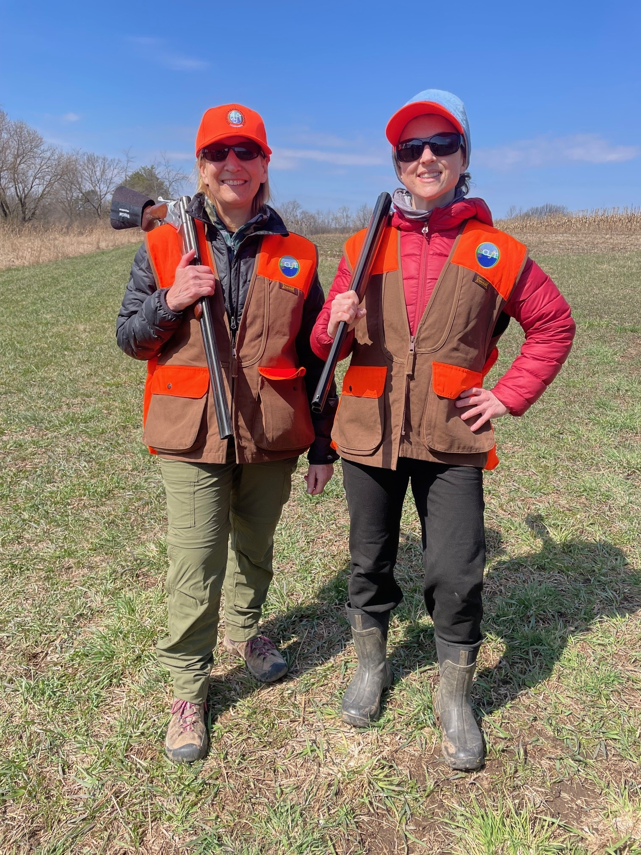
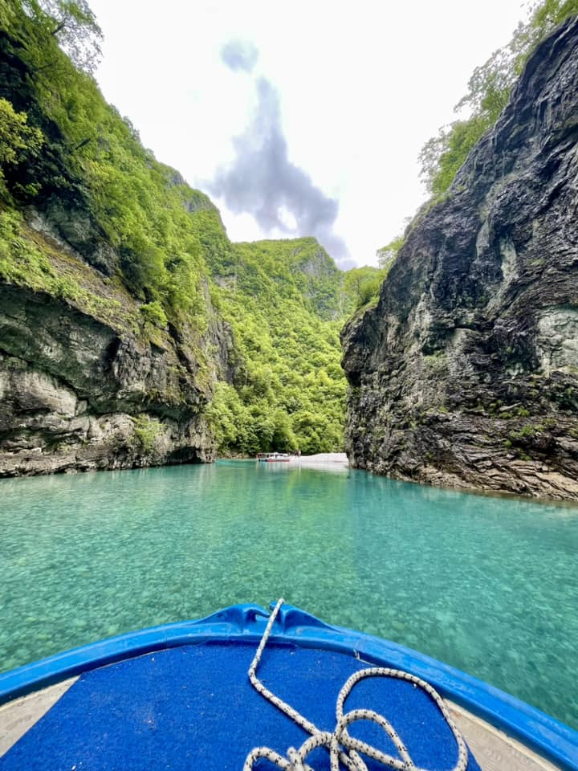
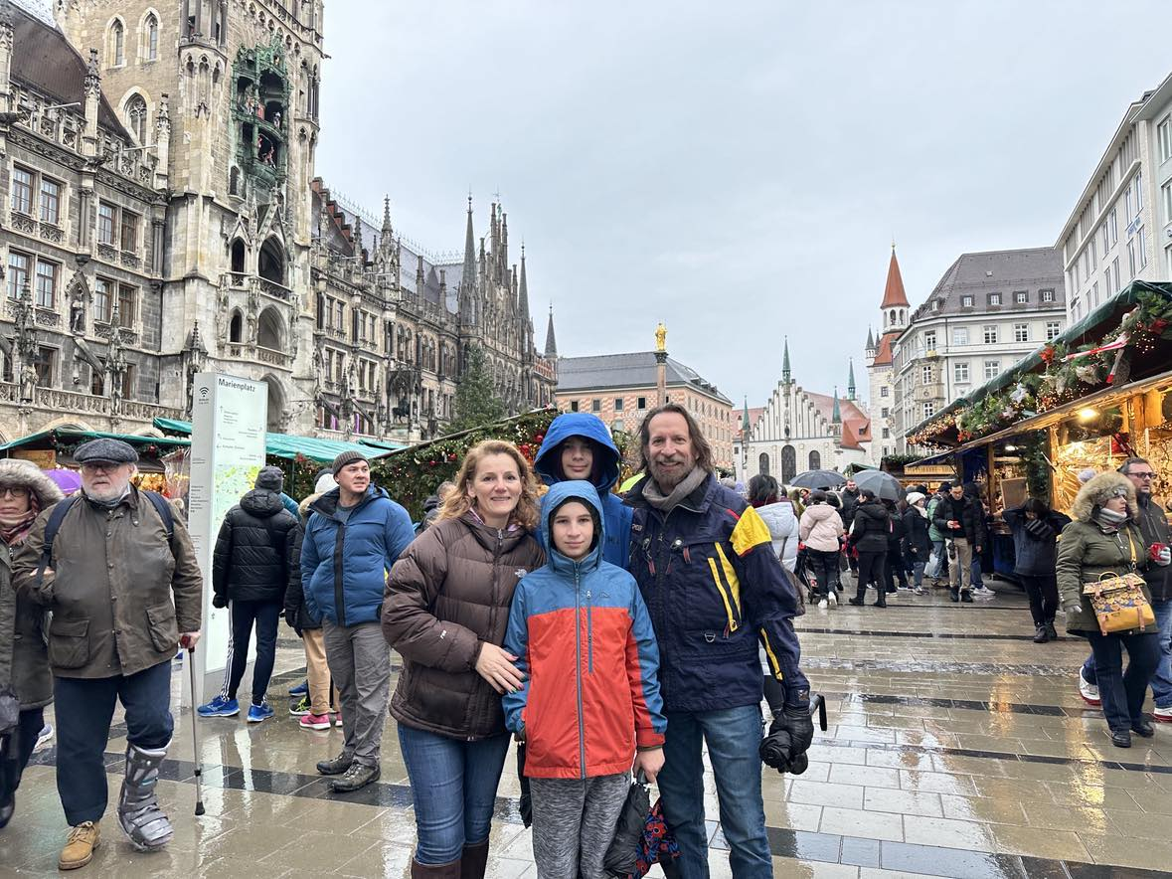
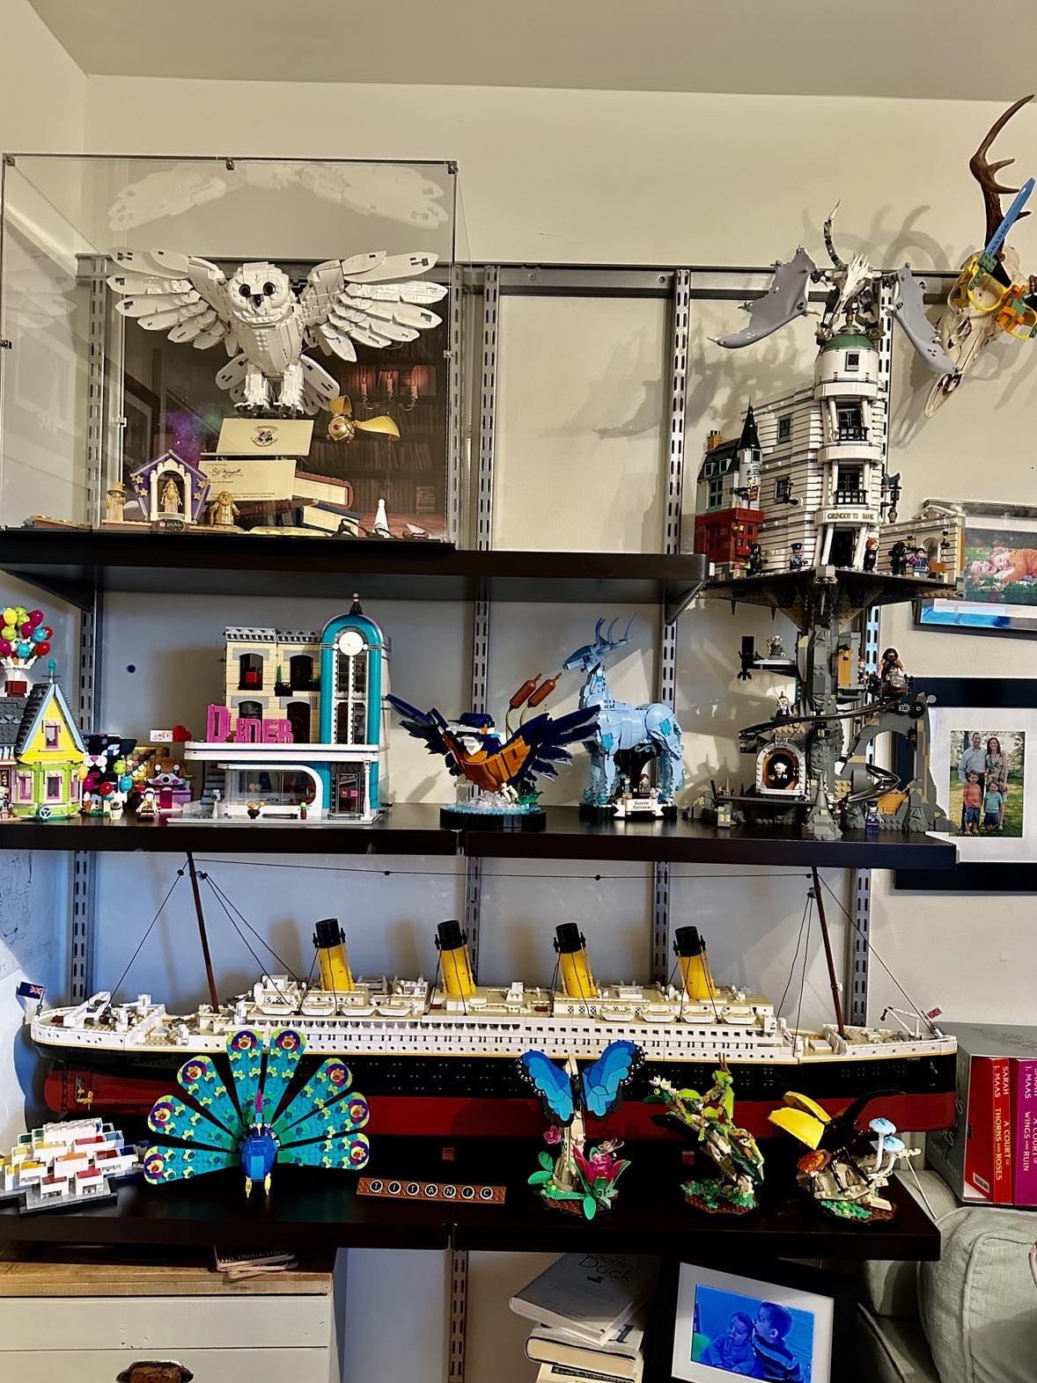
Karen Bennett, MSCG Coordinator
Office of Conservation Investment, USFWS
Silvana Yaroschuk, MSCGP Program Manager
Association of Fish and Wildlife Agencies

Slide 3
Multistate Conservation Grant Program:
Training Overview
Multistate Conservation Grant Program (MSCGP) Background
Purpose & Administration
Funding Source
Quick Facts & 2024 MSCGP Awarded Grants funding summary
2025 MSCGP Process
Eligibility
Elements of the Proposal
Project Statement Requirements
Budget Requirements & Tips
Application Review Process
Resources for Applicants
Q&A

Slide 4
Multistate Conservation Grant Program (MSCGP): Purpose
“To fund projects that address regional or national priority needs of State fish and wildlife agencies and their partners that are beyond the scale, scope, and capabilities of a single State.”
Notes:
The MSCGP was authorized by Congress to provide funding to address the regional and national level priorities of State fish and wildlife agencies that are beyond the scale, or possibilities of a single State to do on their own with their available resources and capacity. It is a unique financial assistance program in that it is not only administered by the Service, but it is jointly administered in cooperation with the Association of Fish and Wildlife Agencies.
The Service publishes an annual Notice of Funding Opportunity, setting various important dates in partnership with AFWA. AFWA manages and conducts the review of all applications and submits a priority list of projects that they recommend for funding. The Service then awards funding and manages the grant awards and ultimately closes out completed projects.

Slide 5
Multistate Conservation Grant Program was established in 2000 under the Wildlife and Sport Fish Restoration Programs Improvement Act, which amended the Wildlife Restoration Act (Section 11) and Sport Fish Restoration Act (Section 14) to include the Multistate program.
In 2000, the “Traditional” Multistate Conservation Grant Program (T-MSCGP) authorized the Secretary of the Interior to make up to $6 million available annually the program.
$3 million from Wildlife Restoration funds and $3 million from Sport Fish Restoration funds for wildlife and sport fish conservation, restoration and management projects and projects that provide public use and benefit from these resources.
In 2019, the Modernizing Pittman-Robertson Fund for Tomorrow’s Needs Act authorized an additional $5M under the Multistate program for Hunter and Recreational Target Shooter Recruitment (R3-MSCGP) and projects that promote a national hunting and shooting sport recruitment program.
Notes:
The Wildlife Restoration and Sport Fish Restoration programs are arguably two of the most successful conservation programs in history. In Federal FY 2020, just shy of $1 billion was provided through these two mandatory programs to State fish and wildlife agencies for the conservation of wild birds, mammals, sport fish, and habitat. Additionally, State’s also fund various other activities including hunter and recreational shooter development programs, boating and recreational fishing access development programs, public target range construction, and aquatic resources education and recreational fishing programs to just name a few.
In 2000, both the Wildlife Restoration and Sport Fish Restoration Acts were amended by the Wildlife and Sport Fish Restoration Programs Improvement Act. This amendment created the Multistate Conservation Grant Program (MSCGP) and authorized the Secretary of the Interior to make up to $6 million available annually ($3 million each from Wildlife Restoration and Sport Fish Restoration) for grants under the MSCGP.
On December 20, 2019, President Trump signed the Modernizing the Pittman Robertson Fund for Tomorrow’s Needs Act which further amended the Wildlife Restoration Act to create a new Hunter Recruitment and Recreational Shooter Recruitment (R3) Multistate Conservation Grant Program. It authorized the Secretary of the Interior to make up to $5 million available annually, specifically for R3 grants that promote a national hunting and shooting sport recruitment program, including related communications and outreach activities.

Slide 6
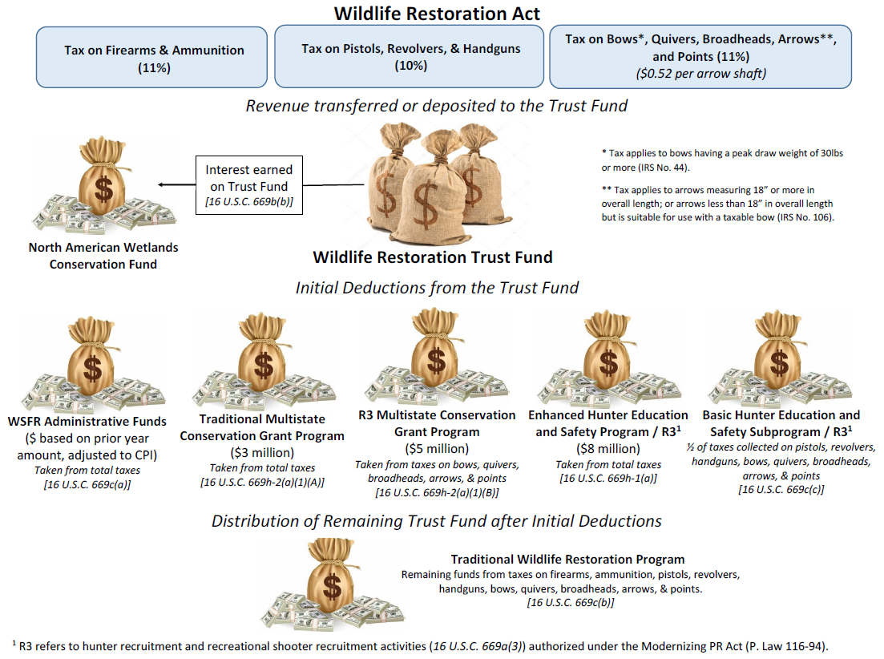
Notes:
For those that may not be familiar with where the MSCGP funding comes from, let’s first look at the Wildlife Restoration Act. The Wildlife Restoration Trust Fund receives revenues from manufacturer excise taxes. These taxes include an 11% excise tax on certain firearms and ammunitions, a 10% excise tax on certain pistol, revolvers, and handguns, and finally an 11% excise tax on bows, quivers, broadheads, arrows and points. Taxes collected during the year are provided out the following year in the following fashion. The interest on the trust fund is dedicated to the North American Wetlands Conservation Funds.
Next, we see several deductions. Annually, $3 million is deducted from the Trust fund and provided to the Traditional MSCGP. This $3 million is taken from the total amount of taxes collected and deposited into the Trust fund from the preceding year. Next we see that $5 million is deducted from the Trust fund and provided to the R3-MSCGP, This $5 million is comprised solely from the taxes collected on bows, quivers, broadheads, arrows, and points.
Several other deductions also are taken from the Trust fund to include administrative funding provided to the Service to administer and manage its grant programs. The remaining funds are then provided to State/Territorial fish and wildlife agencies in the form of three different mandatory apportionment programs established under the Wildlife Restoration Act.

Slide 7
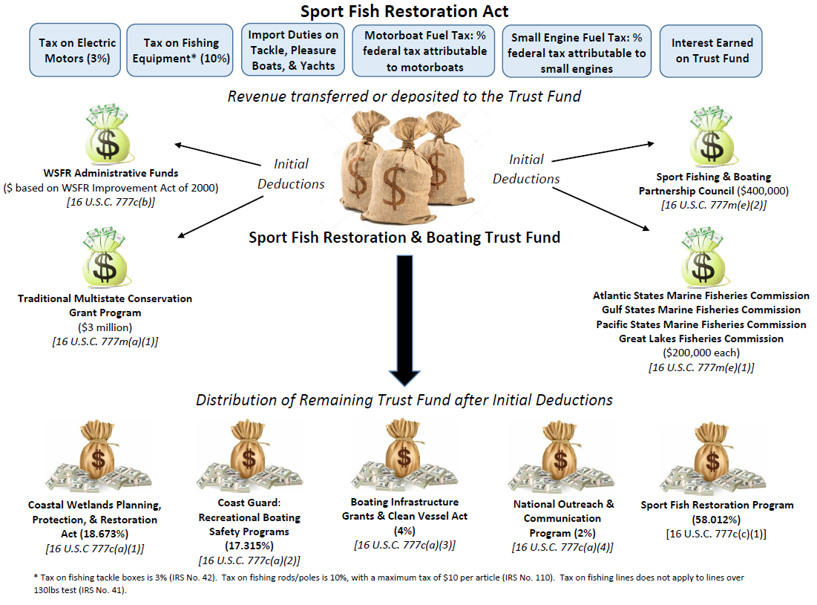
Notes:
The Traditional MSCGP also receives funding from the Sport Fish Restoration Act as well. Similar to the Wildlife Restoration Trust fund, the Sport Fish Restoration and Boating Trust Fund receives funding annually from manufacturer excise taxes collected on electric motors, fishing equipment/tackle, and from import duties on tackle, pleasure boats, and yachts. The Trust Fund also receives a significant amount of revenue from that portion of the Federal fuel tax that is attributable to motorboats and small engines. Revenues from motorboat and small engine fuel taxes have historically provided in excess of over 70% of the total amount of revenue that annually goes into the Sport Fish Restoration and Boating Trust Fund.
The following year, in addition to several other initial deductions, we see that $3 million from the Sport Fish Restoration and Boating Trust fund is authorized to the Traditional MSCGP. When we add this amount to the $3 million that also comes from the Wildlife Restoration, this is where the Traditional MSCGP annually provides up to $6 million in funding. $3 million comes from the Wildlife Restoration Trust Fund and $3 million comes from the Sport Fish Restoration and Boating Trust Fund.

Slide 8
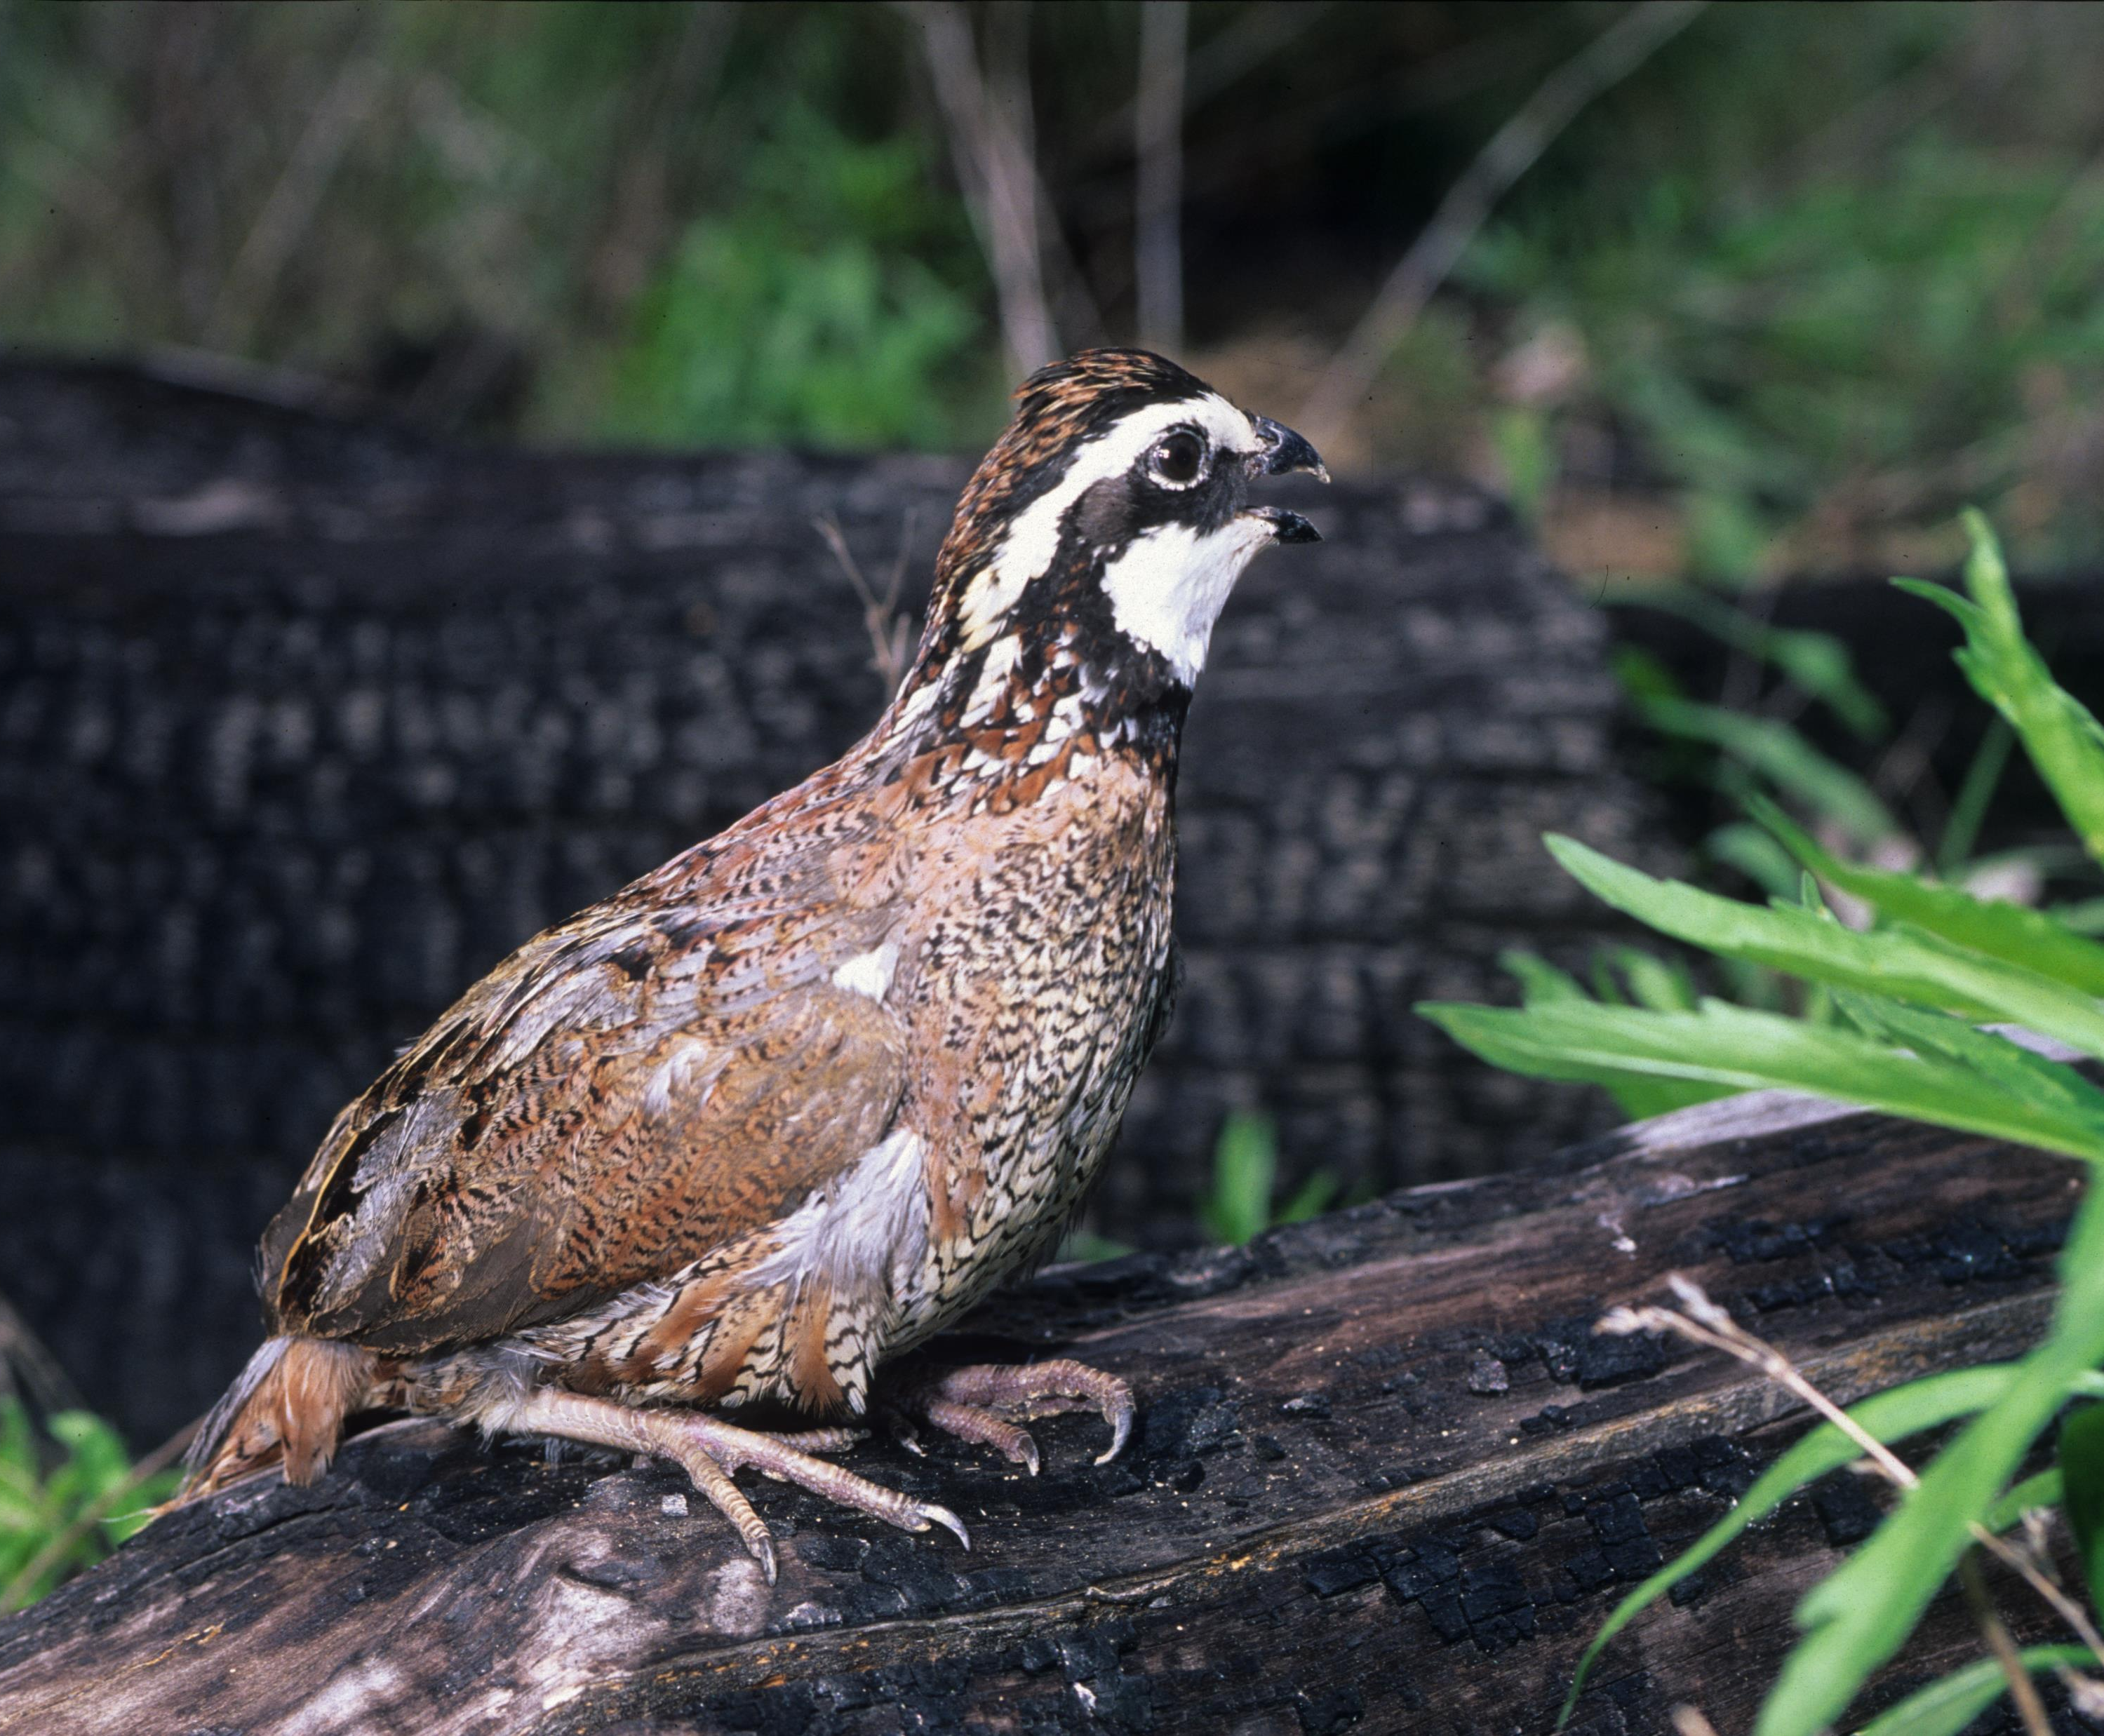
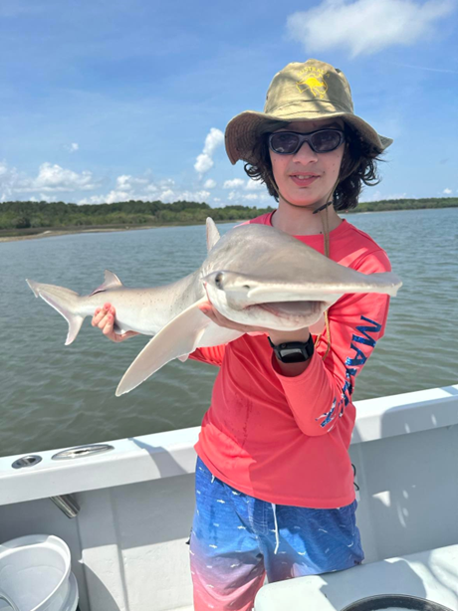
MSCGP Program Administration
The Association of Fish and Wildlife Agencies (AFWA) and the U.S. Fish and Wildlife Service (USFWS) cooperatively administer the MSCG process.
AFWA develops/updates Strategic Priorities in consultation with state agencies, conservation partners, and industries.
USFWS publishes the Notice of Funding Opportunity (NOFO).
AFWA solicits grant proposals that address the annual Strategic Priorities and selects projects that best address the priorities.
AFWA then submits a recommended list of Priority Projects to the USFWS for Director’s approval.
USFWS completes review and approval of MSCGP grant applications, issues awards, and manages and monitors the grant awards.

Slide 9
Quick Facts
Since 2000, over 600 grants have been awarded through MSCGP, which adds up to about $160M.
Approx. 45-55 grants have been awarded annually since R3-MSCGP funds were added in 2020.
Range of grant funds awarded:
T-MSCGP: $ 50,000 - $ 350,000
R3-MSCGP: $100,000 – $ 1,000,000
100% Federal Funds – no matching/cost-sharing funds required!
Performance Period is January 1 - December 31 (with few exceptions).

Slide 10
2024 MSCGP Awarded Grants

Slide 11
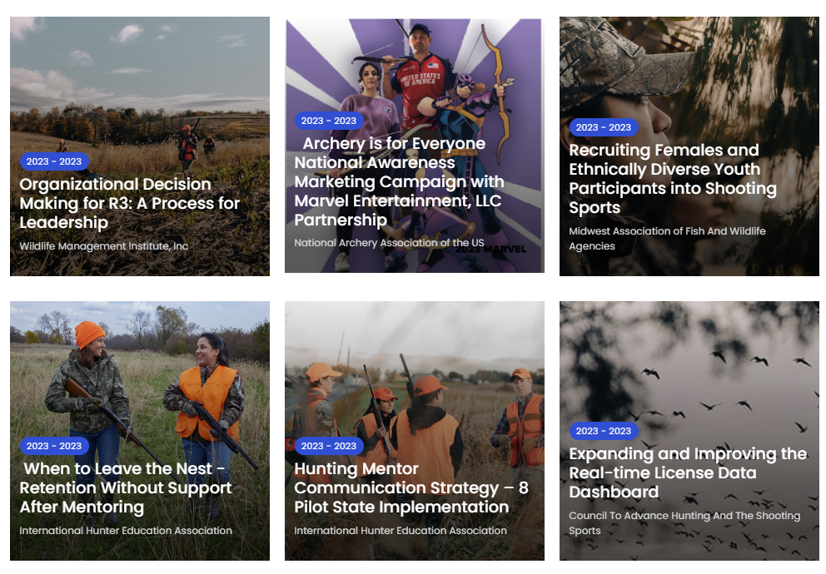
How to Find Projects Supported by Multistate Grants
AFWA Multistate Database

Slide 12
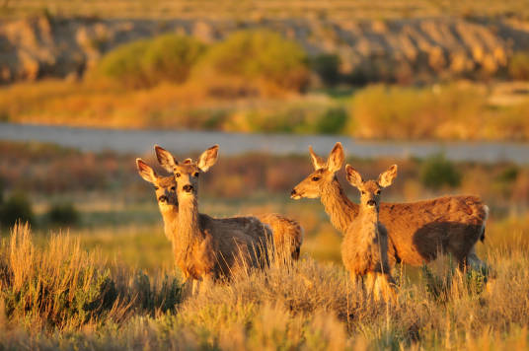
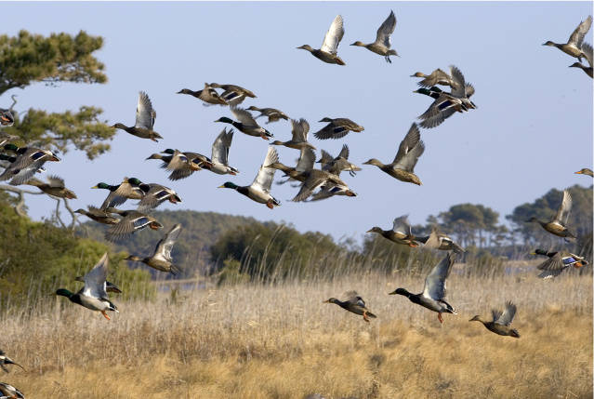
2025 Multistate Conservation Grants:
Application Requirements & Process

Slide 13
Resources for Eligibility, Allowable Costs and Application Content:
Notice of Funding Opportunity (NOFO)
2 CFR 200 Uniform Guidance for Federal Awards: Changes Coming Soon!
AFWA MSCGP Website
AFWA Grant Proposal Guidelines
Grant Proposal Template
Budget Narrative and Table Template

Slide 14
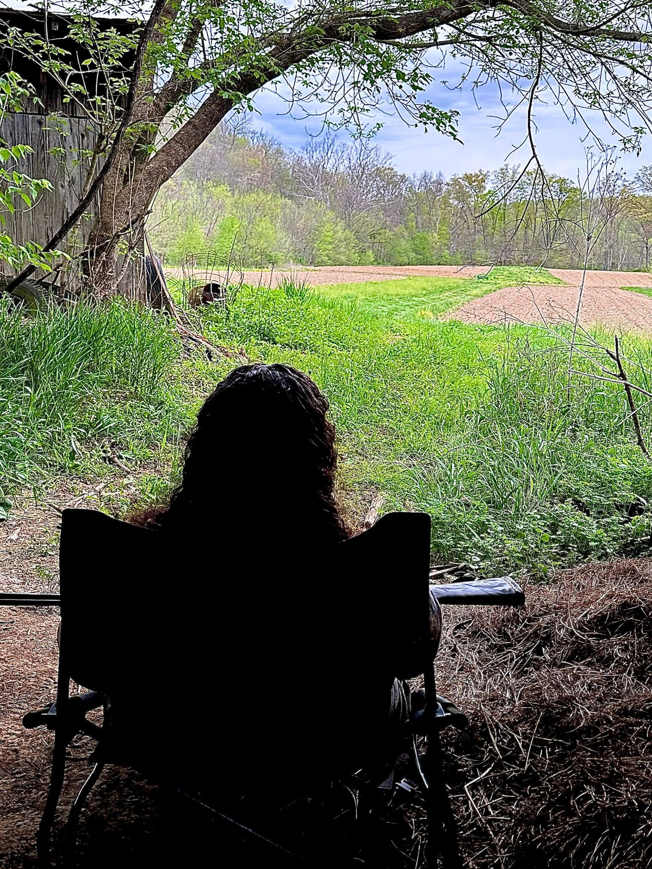
Eligibility
Applicants:
A State or a group of States;
Nonprofit organizations;
Public Institutions of higher education (IHE); and
USFWS, to carry out the National Survey of Fishing, Hunting, and Wildlife-Associated Recreation.
Project Must Benefit:
At least 26 States; or
A majority (over 50%) of the States in a USFWS Region; or
A majority of the States in an AFWA Regional Association.
Project must address one of MSCGP Strategic Priorities
Project must be on the Priority List of Projects that AFWA submits to USFWS for review and approval.
Species and Activity Eligibility

Slide 15
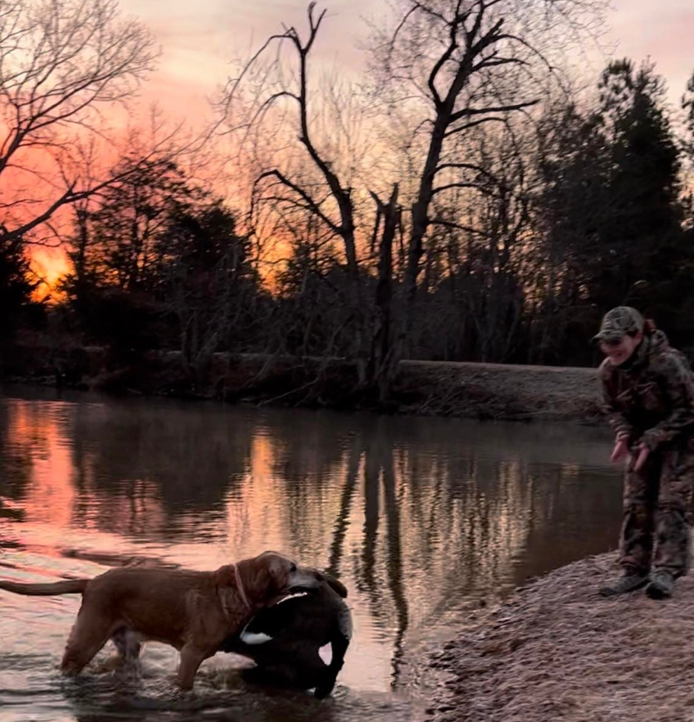
Strategic Priorities
Conservation & Science
Expanding Relevancy & Engagement
Recruitment, Retention, Reactivation (R3)
AFWA Priorities Identified in AFWA Funding Principles (submitted by ExCom)
Capacity Building, Conservation Education, and Coordination of Conservation Policies
Notes:
Strategic Priorities are reviewed and updated each year based on emerging new priorities. It’s a 10-page document that defines and elaborates on each priority to make it easier for the applicants to see what needs are and for the reviewers who are scoring to definer if those proposals address those priorities.

Slide 16
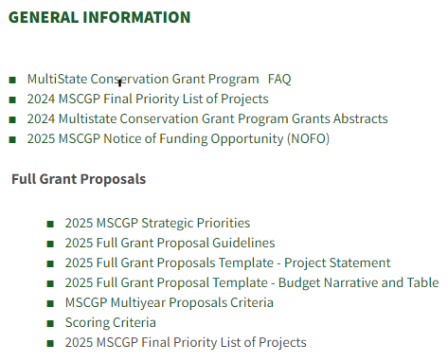
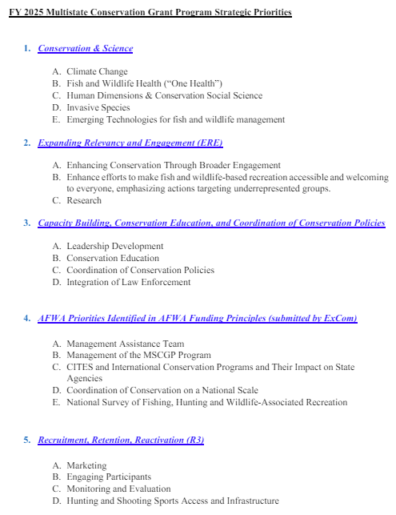
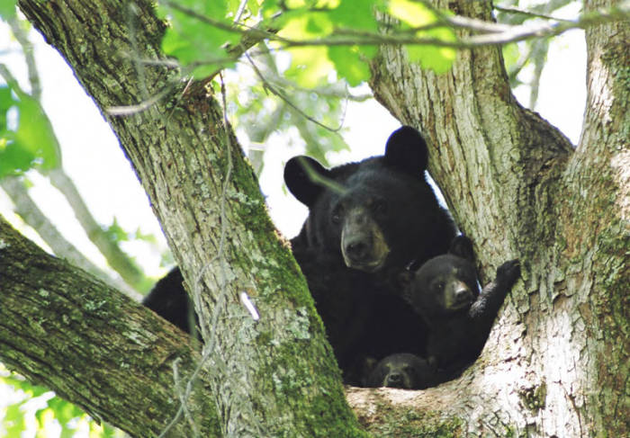
2025 Strategic Priorities: AFWA Multistate Conservation Grant Program Website

Slide 17
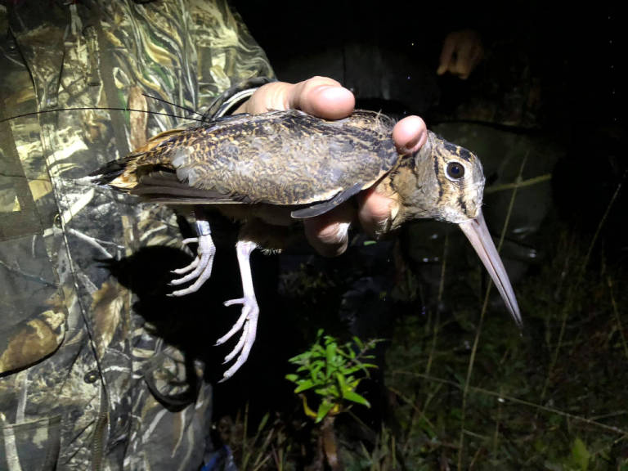
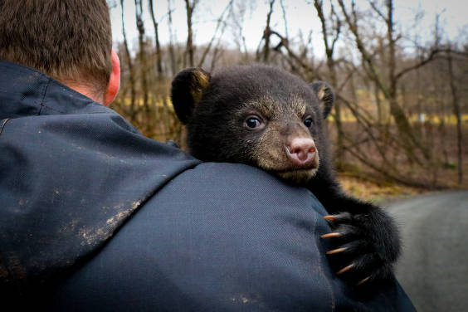
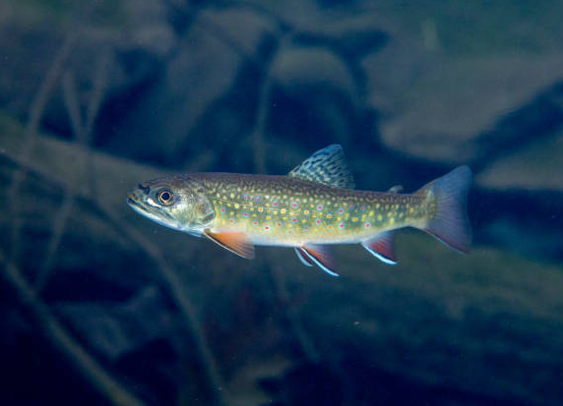
Species Eligibility
The purpose of the proposed projects must benefit the following:
MSCGP Wildlife Restoration funds: Indigenous or naturalized species of wild birds or mammals.
MSCGP Sport Fish Restoration funds: Aquatic gill-breathing vertebrates with paired fins having marine or freshwater recreational value.
Context matters: Other species MAY be eligible if the project’s stated Need, Purpose, and Results & Benefits focus on how the otherwise-ineligible species directly impacts conservation of wild birds or mammals or sport fish.
For example: Invasive species, food resources, habitats and disease projects are eligible if the proposal demonstrates purpose of the project is to improve conservation for wild birds or mammals or sport fish.

Slide 18
Project Title: Developing eDNA tools for use in Aquatic Invasive Species detection to improve conservation efforts for sport fish and waterfowl
Abstract/Need: Aquatic Invasive Species (AIS) can have drastic impacts on populations of waterfowl and sport fish through a variety of environmental impacts including habitat alterations, outcompeting native prey items, and altering food web dynamics. In 2020, it was estimated that AIS cost the US at least $23 billion dollars. Early detection of AIS can be critical in enabling managers to provide rapid response measures in order to prevent establishment or further spread of AIS along with directing limited restoration funds. Detecting AIS can be a very costly and time-intensive endeavor when traditional sampling methods are used. Environmental DNA (eDNA) is a powerful tool for biodiversity assessments and the early detection of AIS, but eDNA assays are missing for most aquatic plants....
Purpose: The purpose of the proposed research project is to contribute to science required by managers of sport fish, waterfowl, and aquatic invasive species by developing a cost-effective tool and standard operating procedure for detecting aquatic invasive plant species in the Mississippi River Basin using environmental DNA (eDNA) monitoring.
Species Eligibility – Project Purpose Matters – Example:

Slide 19
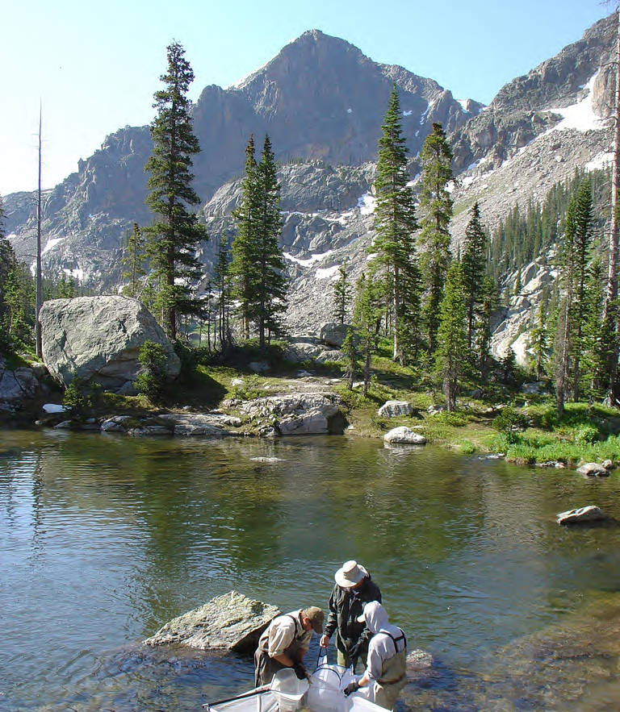
Activity Eligibility
Activities that carry out the purposes of the Wildlife Restoration Act or Sport Fish Restoration Act:
Conservation, restoration, management, and enhancement of wild birds and mammals and sport fish and providing for public use and benefit from these resources.
Project examples using Traditional MSCGP funds include: Research on populations, contaminants, diseases, invasive species and human dimensions surveys; development of models, databases and technology; training; best practices for conservation, etc.
Project examples using R3 MSCGP funds include: Research on barriers, attitudes, participation, effectiveness, marketing; Marketing projects involving social media, mentoring, templates, photo and video collections, toolkits; Training and course development; Participation through program development and events; etc.

Slide 20
Activity Eligibility cont’d
What about Education, Outreach and Communication or Construction activities?
WR Act – Educating responsible hunters and archers in skills, knowledge, and developing responsible attitudes. R3 outreach, communication, events, marketing, etc. Projects that inform, translate or otherwise offer technical assistance directly in support of findings or accomplishments of projects funded by the Wildlife Restoration Act.
SFR Act – Enhancing the public’s understanding of water resources, aquatic life forms, and sport fishing, and developing responsible attitudes toward the aquatic environment. R3 outreach, communication, events and marketing.
Construction activities have historically not been funded under MSCGP awards because it is difficult to demonstrate a benefit to 26 or more states or half the states in a USFWS region or regional association of fish and wildlife agencies.

Slide 21
Public relations to promote a state fish and wildlife agency (2 CFR 200).
General conservation education or wildlife education that is not specifically related to sharing accomplishments or findings funded by WR Act or SFR Act.
Law enforcement activities, i.e., enforcement of fish and wildlife laws and regulations.
Establishment, publication, and dissemination of regulations issued by a State; includes laws, orders, seasonal regulations, bag limits, creel limits, license fees. Except when done to directly support R3 and remove barriers to participation (e.g., increase knowledge, familiarity and comfort with rules, reduced confusion and fear).
Producing revenue as primary purpose; includes all processes and procedures directly related to printing, distribution, issuance or sale of licenses or permits.
Promoting opposition to regulated taking of fish or hunting or trapping wildlife.
General wildlife damage control where the purpose is not eligible under the WR Act or SFR Act.
What Activities are Ineligible?

Slide 23
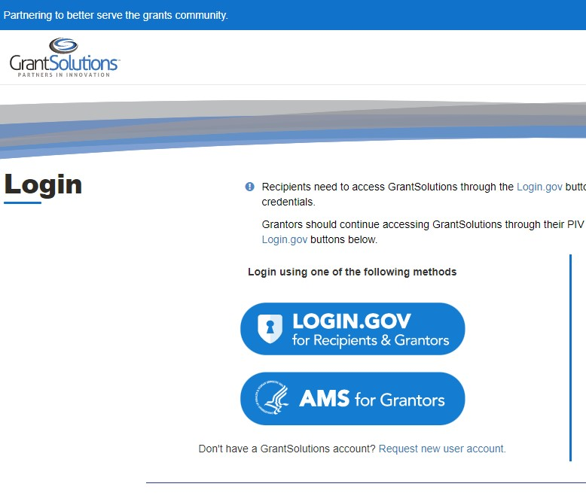
2025 Process Timeline
June 7, 2024, 11:59 PM ET: Full Grant Proposals Due to AFWA Portal (no Federal Forms) - https://afwamscgp.smapply.io/ No proposals shall be submitted to GrantSolutions at this point.
June 10 – 27, 2024: AFWA reviews proposals for eligibility.
July – August 2024: Technical Review Teams, National Grants Committee, and Office of Conservation Investment review the proposals and provide feedback.
September 2024: A Direct Announcement will be posted in GrantSolutions and selected applicants will be invited to submit full grant proposals with all required Federal forms. Applicants may also be asked to address proposal feedback from the National Grants Committee (NGC).
September 15, 2024: Final proposals – with requested edits addressing feedback – are due in AFWA Portal.
Mid to Late September 2024: Final applications (proposals with required Federal forms) due in GrantSolutions.
Late September 2024: Priority List of Projects is approved at AFWA Annual Meeting during the Business Meeting.
October 1, 2024: Priority List of Projects is submitted to USFWS for Director approval.
October 1 – December 31, 2024: USFWS reviews and awards grants. May have additional questions that applicants MUST be timely about addressing!
January 1, 2025: Grant start date, period of performance begins.
MSCGP Proposals are not required in TRACS anymore!

Slide 24
MSCGP Application Process
Part I: Grant Proposal – Via AFWA Portal by 06/07/2024
Project Narrative
Key Personnel Qualifications (Limit – one paragraph per individual)
Part II: Required Federal Forms – Via AFWA Portal and GrantSolutions by mid-September 2024
Project Abstract
Application for Federal Assistance (SF 424)
Budget Information for Non-Construction Program (SF 424-A)
Negotiated Indirect Cost Agreement (NICRA) – if applicable from budget
Required Statements (template available on AFWA MSCGP Website)
Budget Narrative and Budget Table
Notes:
For the remainder of the webinar, we will focus on the application requirements for the Multistate Program.
The primary focus will be on Part 1 of the Grant Proposal process—note that this is completed through the AFWA Portal and is due June 7,2024.
At this initial stage, you are only completing the project narrative, budget, qualifications of participating individuals, and other information from the template.
As noted earlier, selected projects will move forward to the final application process that includes formal submission to GrantSolutions along with standard federal forms… We will touch on that a bit later.

Slide 25
Grant Proposal
AFWA developed Grant Proposal Guidelines (aka detailed instructions) and a separate blank Grant Proposal Template for applicants to populate with information.
Both are available on AFWA’s MSCGP website.
Grant Proposal = Applicant and Project Information + Project Statement
Follow along as we highlight some of the key proposal components.
Notes:
TO assist applicants, AFWA developed a template to ensure all the required sections are included.
We will now walk through the core elements of the Multistate proposal and provide some additional guidance of sections of the proposal that have historically needed a little more meat on the bones…
Again these resources are all available to you on the afwa website…

Slide 26
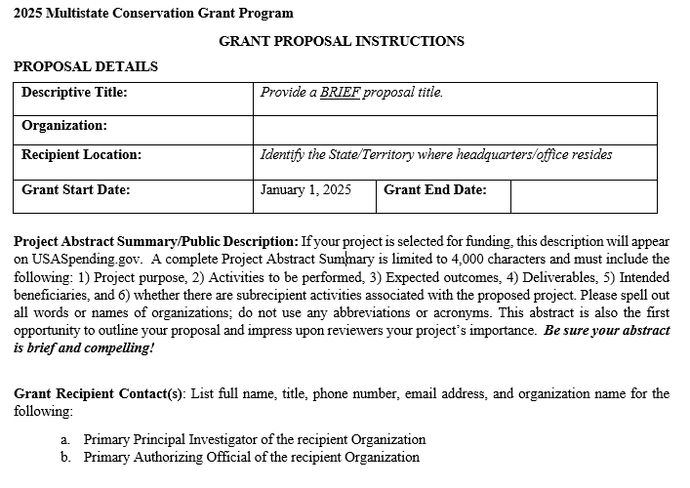
Applicant and Project Information
Notes:
Proposal Details:
Title: Set the stage for your proposal – what’s the first thing you want the reviewers to see?
Recipient Location: This is the location of the organization applying for the grant… we recognize that the reach of the proposal will certainly include more than 1 state…
Start Date: Grants are anticipated to begin Jan 1, 2025 and are traditionally awarded for one year – making the end date December 31, 2025.
Project Abstract:
Provide a high level summary of your project – consider this like an elevator pitch for the proposal. What is the purpose, goal, and expected outcome of the project?
Don’t want to be overly technical in the project abstract – those details will come in later sections.
Do not include any sensitive information that you would not want displayed to the public in this section. If ultimately selected for funding the project abstract will be viewable by the public.
In Part II of the application, there is a requirement for Project Abstract in Grant Solutions. At this stage, the Federal awarding agency will use the project abstract to populate the public description of the award in USA Spending. This is a standard process for all Federal funding – not specific to the Multi State Grant Program.
Contacts:
Principle Investigator: The person drafting proposal, overseeing the project, competing the reports. If there is more than one person responsible for these activities, include all involved…
Primary Authorizing Official… this means the person or people with signatory authority for recipient organization.
If you plan to issue subawards, it is highly recommended that you include the contact information for those organizations here as well.
Purpose here is to provide a complete picture of the people overseeing the project – both in the recipient organization and any subrecipients involved.

Slide 27
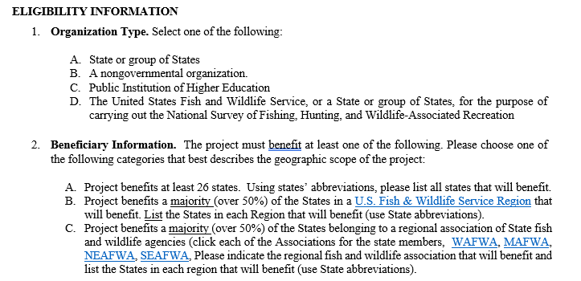
Notes:
Covered on previous slides

Slide 28
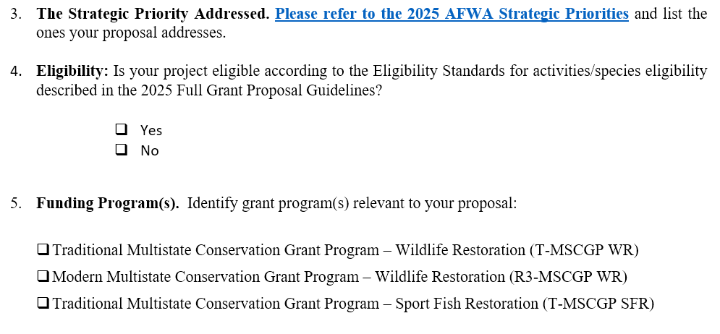
NOTE: Refer to the Grant Proposal Guidelines under “4. Eligibility Standards” and “5. Definitions” to inform your response.

Slide 29
PROJECT STATEMENT
Need
Purpose
Objectives
Approach
Results or Benefits Expected
Deliverables
Timeline
Monitoring and Evaluation
Qualifications of Key Personnel

Slide 30
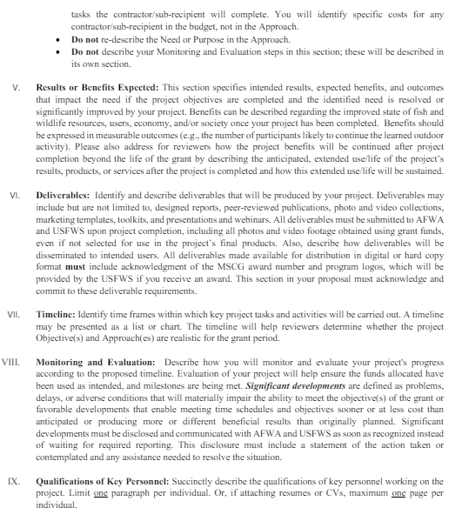
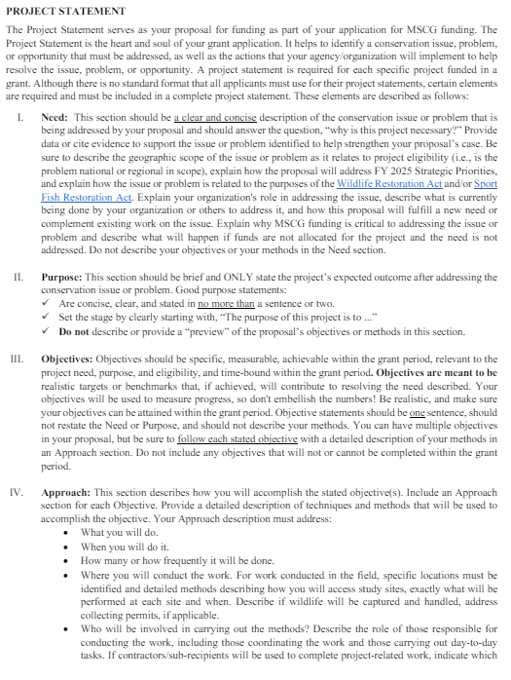
Grant Proposal Guidelines:
Project Statement
Detailed Instructions
Available on AFWA’s MSCGP Website
Grant Proposal Guidelines – Project Statement section

Slide 31
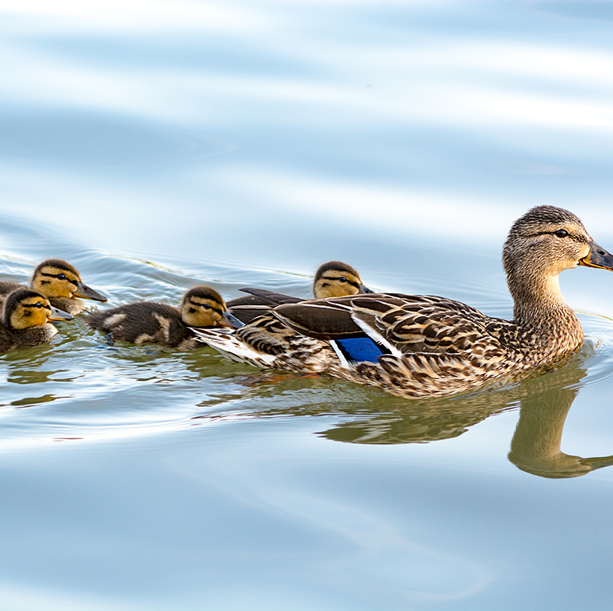
I. Need and II. Purpose
Need:
Identify the conservation issue, problem or opportunity.
Be clear and concise.
Purpose:
“The purpose of this project is…”
What is the desired outcome of the proposed project?
Be BRIEF and clear.
Purpose: The purpose of the proposed research project is to contribute to science required by managers of sport fish, waterfowl, and aquatic invasive species by developing a cost-effective tool and standard operating procedure for detecting aquatic invasive plant species in the Mississippi River Basin using environmental DNA (eDNA) monitoring.
Notes:
Need Statement:
Identify the conservation issue, problem, or opportunity.
Evidence to suppose problem
Articulate the null alternative –
Purpose Statement:
What is the desired outcome of the proposed project.
Provide State fish and wildlife agencies better information to assess risk to human consumption. Also provides information to hunters who harvest waterfowl for consumptive purposes.
Need: Insufficient information on contaminant load.
Purpose: Describe benefit to users/habitat/species identified in the need.

Slide 32
III. Objective and IV. Approach
Objectives:
Specific, measurable, achievable, and time-bound within the grant period.
Relevant to the project’s need, purpose, and eligibility.
Approach:
Include an Approach section for each Objective.
Provide a detailed descriptions of techniques and methods that will be used to accomplish the objective.
IMPORANT: For field work, identify specific locations, timing and details regarding exactly what will be done in the field.
Notes:
Describes the specific, detailed narrative conservation methods (actions) that will be funded to achieve each proposed Objective and resolve the Need.
These sections outline and describe how the project will be implemented and accomplished.
It should clearly show that the applicant plans to use sound design, appropriate procedures, and accepted FW principles.
Should be written to include details to assist OCI in making its compliance determinations.

Slide 33
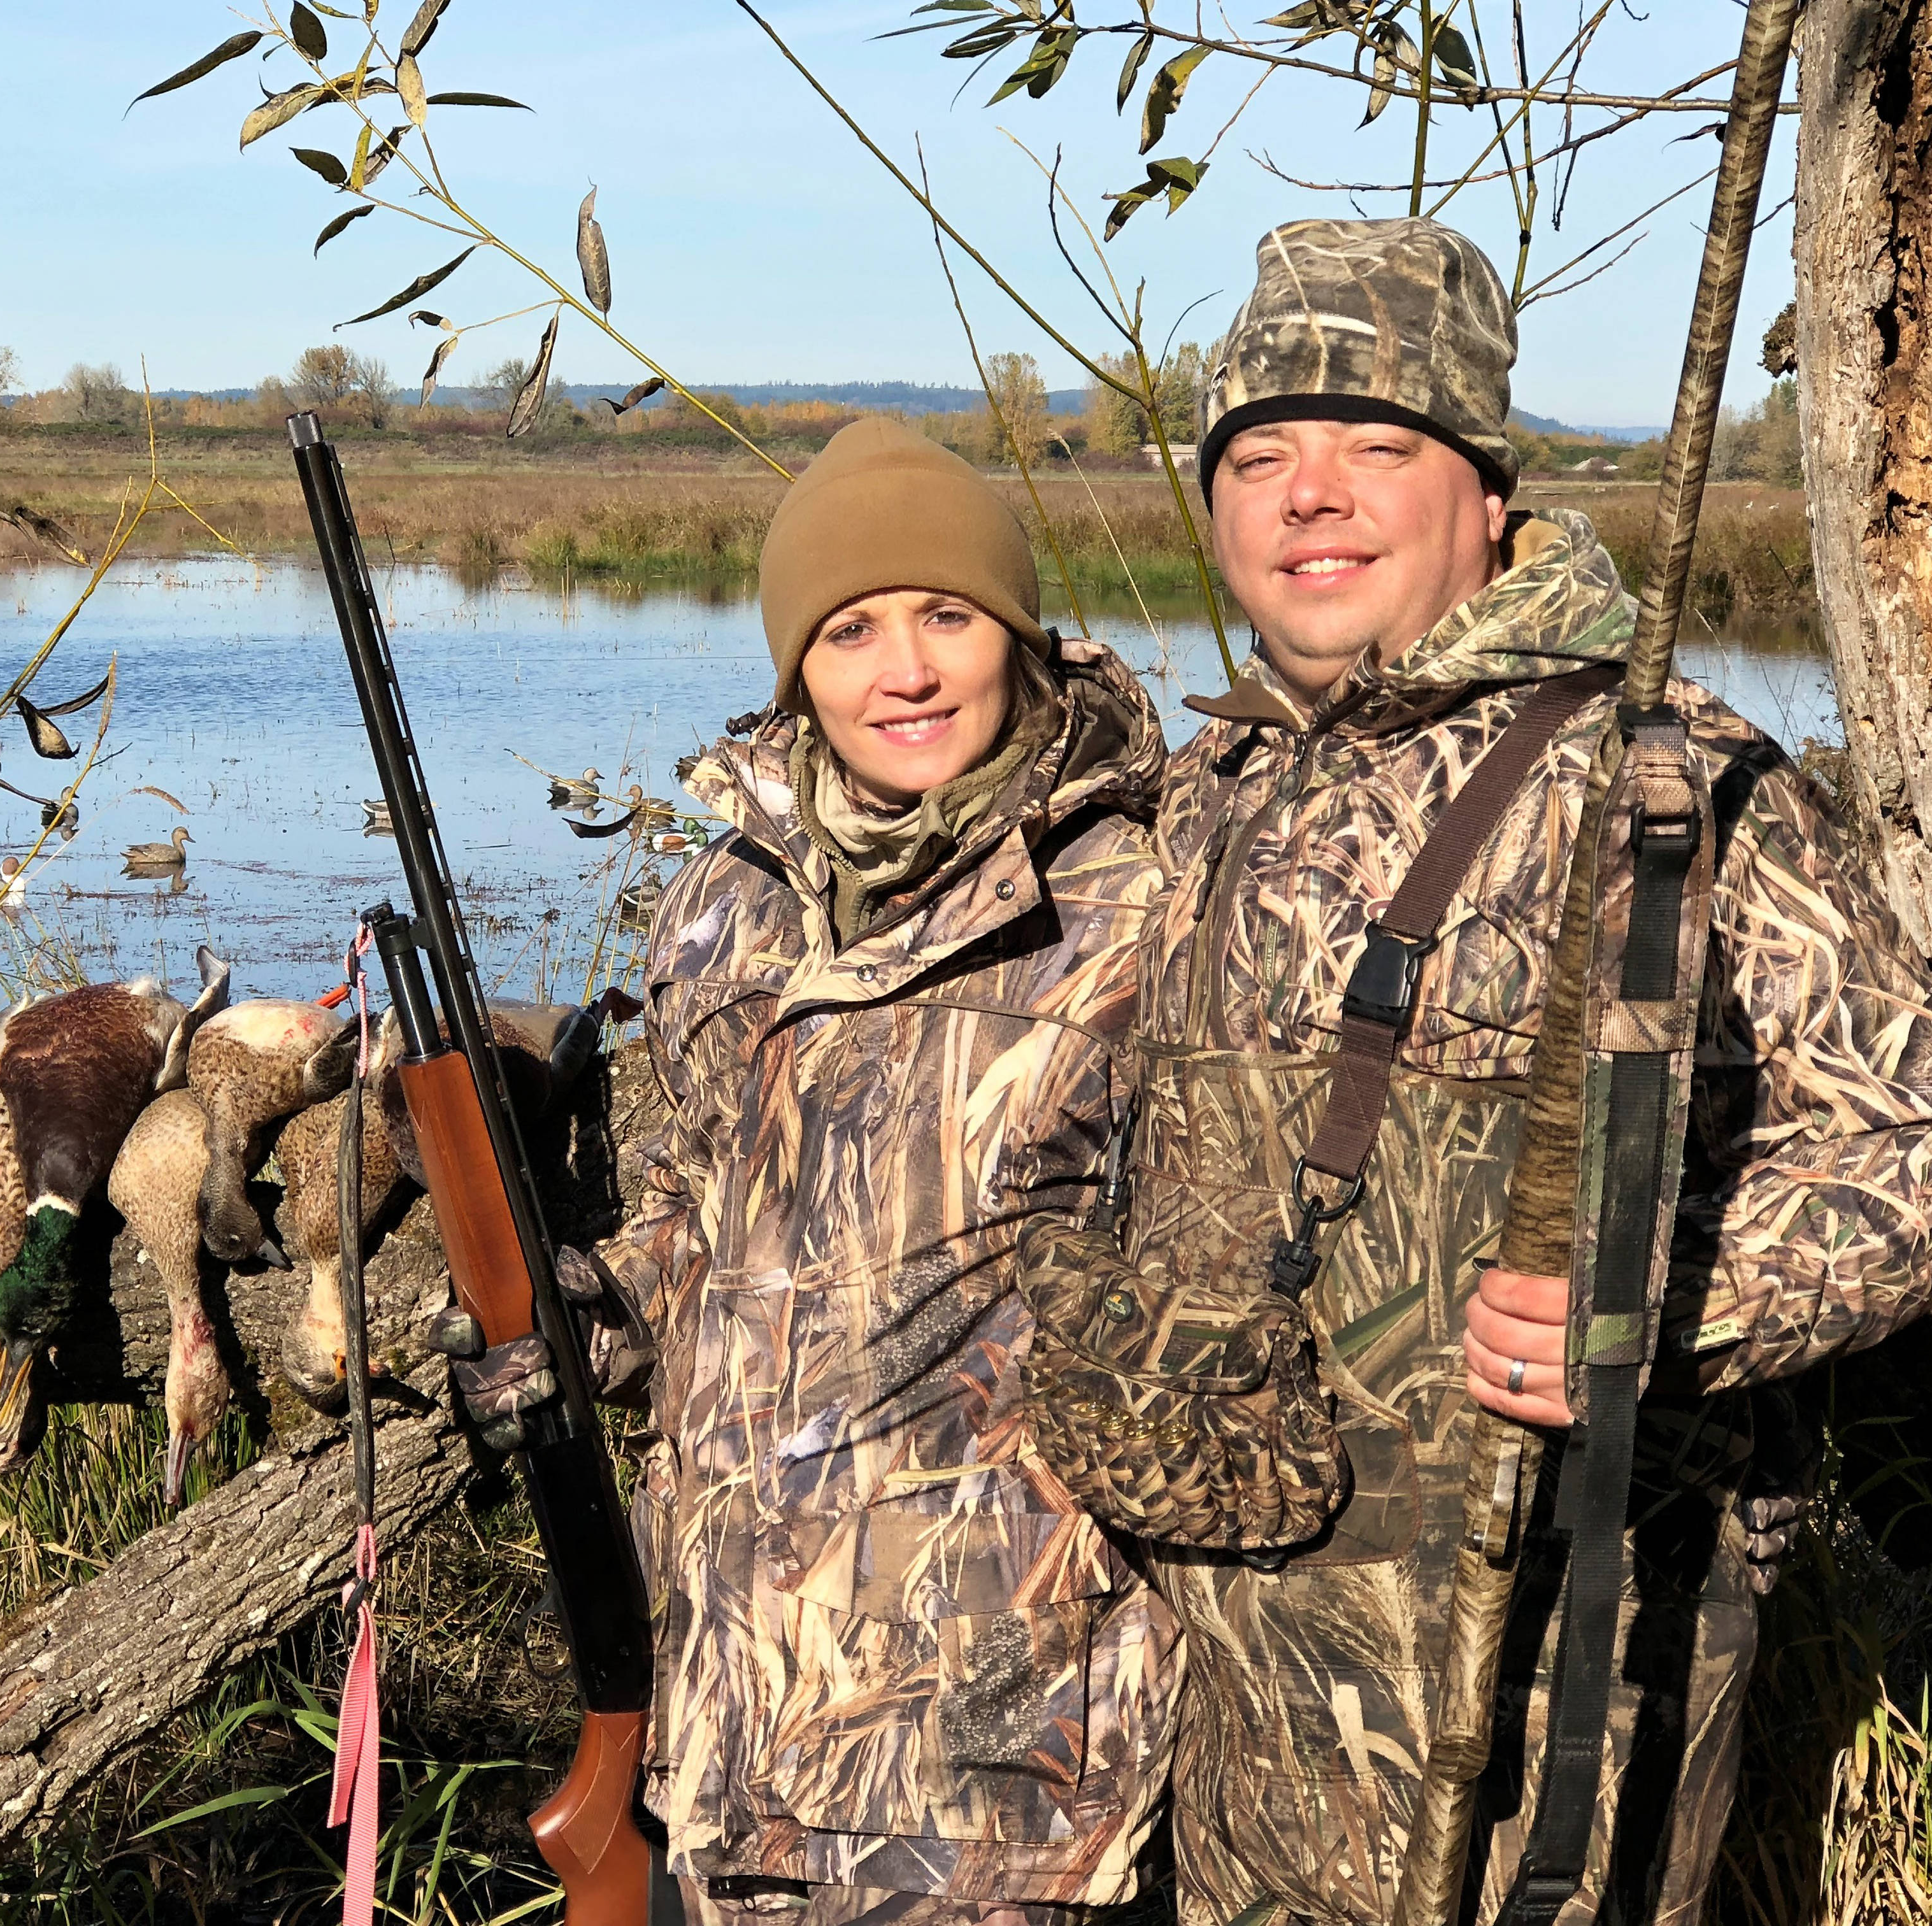
V. Results & Benefits Expected
Describe intended results if objectives are completed and the need is resolved.
Address how the benefits will continue after the project has ended.
Notes:
Describes the specific, detailed narrative conservation methods (actions) that will be funded to achieve each proposed Objective and resolve the Need.
These sections outline and describe how the project will be implemented and accomplished.
It should clearly show that the applicant plans to use sound design, appropriate procedures, and accepted FW principles.
Should be written to include details to assist OCI in making its compliance determinations.

Slide 34
VI. Deliverables
Describe Deliverables that will be produced. Examples include:
Designed reports, peer-reviewed publications;
Photo and video collections;
Marketing templates and toolkits;
Presentations, workshops and webinars;
Others
All deliverables and products created or obtained using grant funds must be submitted to USFWS upon project completion, even if not selected for use in the project’s final Deliverables (e.g., photos, B-roll video).
NOTE: All Deliverables MUST include the Acknowledgement Statement provided with the grant’s Notice of Award:
Notes:
Deliverables may include but are not limited to, designed reports, peer-reviewed publications, photo and video collections, marketing templates, toolkits, and presentations and webinars.
All deliverables must be submitted to AFWA and USFWS upon project completion, including all photos and video footage obtained using grant funds, even if not selected for use in the project’s final products. Also, describe how deliverables will be disseminated to intended users.
All deliverables made available for distribution in digital or hard copy format must include acknowledgment of the MSCG award number and program logos, which will be provided by the USFWS if you receive an award. This section in your proposal must acknowledge and commit to these deliverable requirements.

Slide 35
VII. Timeline
The timeline will help reviewers determine whether the project Objective(s) and Approach(es) are realistic for the grant period.
Identify time frames within which key project tasks and activities will be carried out.
A timeline may be presented as a list or chart.

Slide 36
VIII. Monitoring and Evaluation
Describe how will you monitor and evaluate your project's progress according to the proposed timeline.
Evaluating your project will help ensure that the allocated funds have been used as intended and that milestones are being met.
Significant developments must be disclosed and communicated with USFWS as soon as recognized instead of waiting for required reporting.

Slide 37
IX. Qualifications of Key Personnel
Demonstrates readiness and ability to complete the proposed project.
Describe the qualifications of key personnel working on the project.
Limit 1-2 paragraphs per person.
This Photo by Unknown Author is licensed under CC BY-SA-NC

Slide 38
Budget Information
Recommended budget template, which includes both the Budget Narrative and Table in one document, is provided on AFWA’s MSCGP website.
Budget Narrative
Budget Table
Consult AFWA’s Grant Proposal Guidelines for detailed instructions.
Consult the NOFO as well.
Notes:
Do we want to pick a good example grant for the previous years? Showing is probably better , all wording is already in the guidelines

Slide 39
Budget
Information provided should demonstrate that your project is cost-effective and that the proposed costs are necessary and reasonable to accomplish the proposed objectives.
Provide cost estimates for each Budget Category in the Budget Table.
Provide a description of the costs in the Budget Narrative. Explain the relationship between the budget category estimates and the objectives/approaches.
Be sure to include information for
Costs that require Prior Approval per 2 CFR 200.308 & 407. Prior Approval examples: Salary/Fringe, Travel, Contracts, Subawards, and Participant Support Costs.
Third-party In-kind Contributions (match is not required for MSCGP)
Program Income
Indirect Costs
Notes:
Connect and explain the relationship between the proposed objectives, approach, and budget categories.

Slide 40
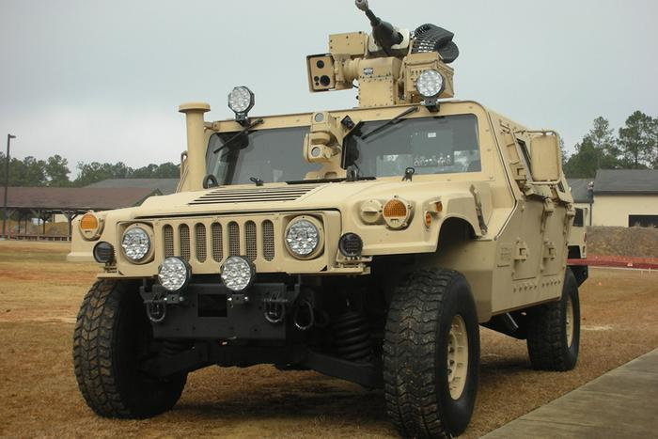
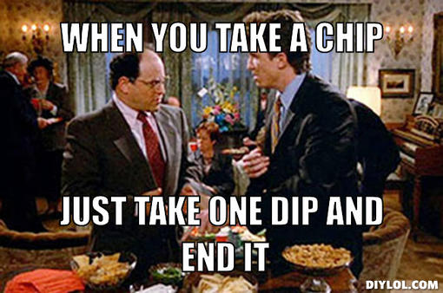
Allowable Costs
2 CFR 200.403
Conform to 2 CFR 200 and terms & conditions of Federal award.
Consistent with policies and procedures for both Federal and non-federal entity.
Necessary and reasonable.
Not included as a cost of another Federal program.
Adequately documented.
Incurred during the approved budget period.

Slide 41
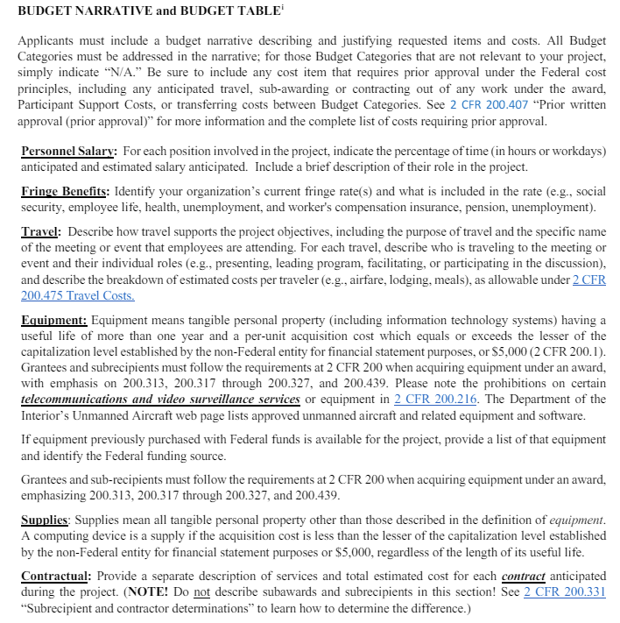
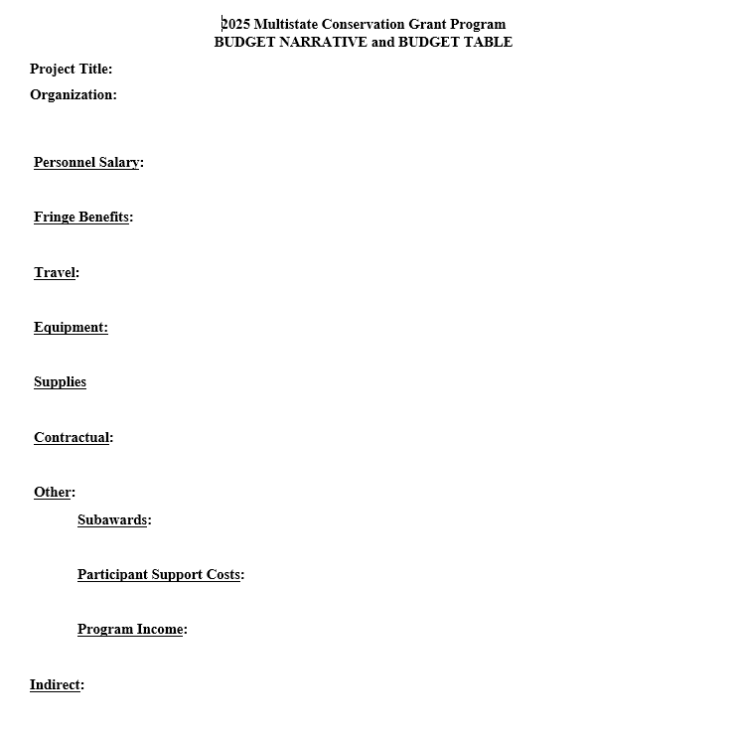
Grant Proposal Guidelines: Budget Narrative Instructions
Budget Narrative and Table – Recommended Template
**AFWA’s recommended template available on AFWA’s MSCGP website.**

Slide 42
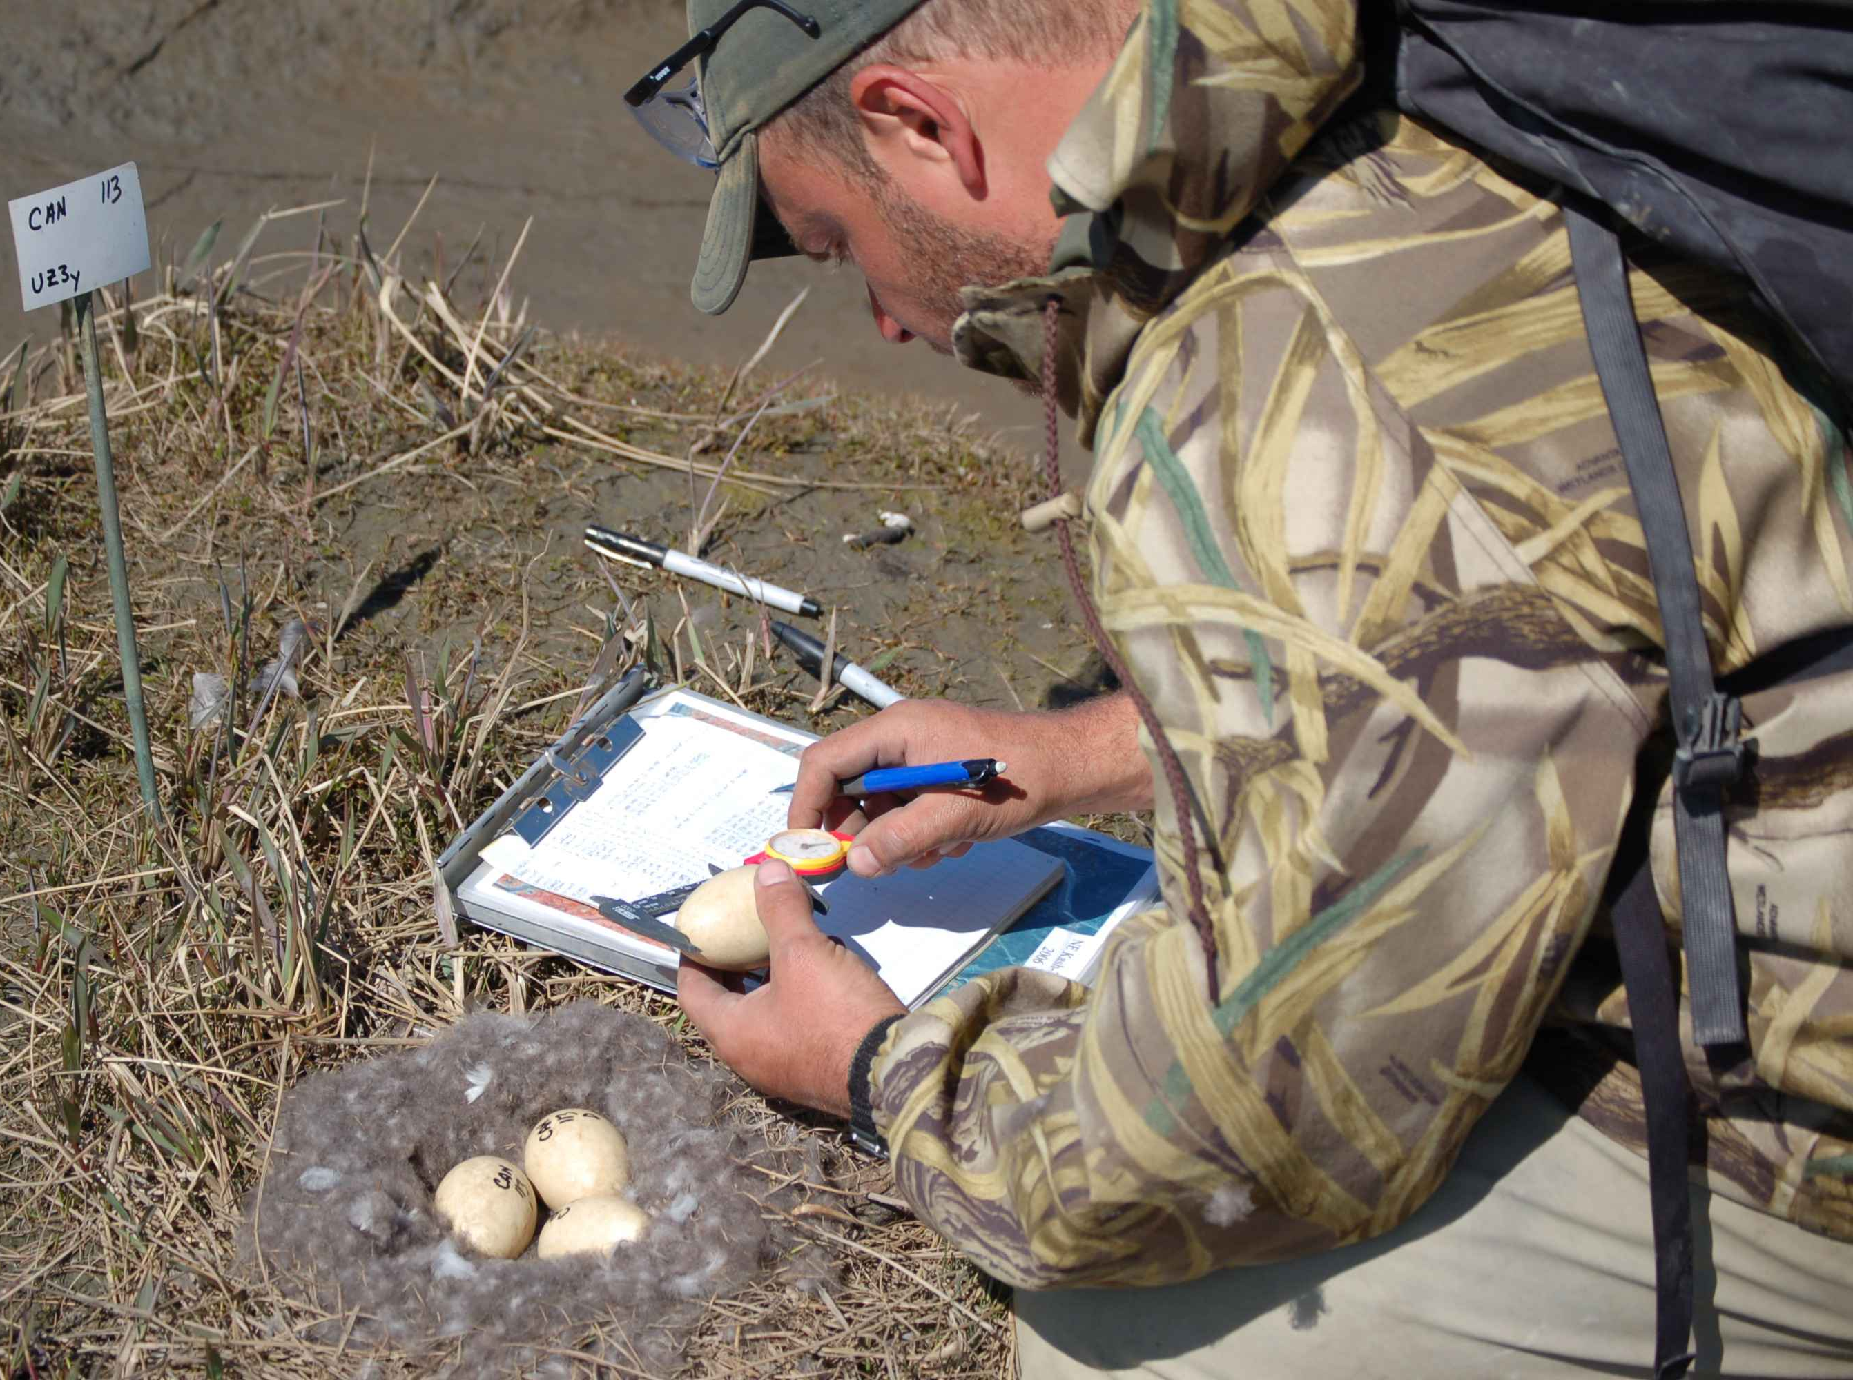
Budget Categories
Personnel
2 CFR 200.430: Compensation – personal services.
Salary/wages for each employee performing work on the proposed project.
Estimate percent time for each employee.
Briefly describe the role with the project.
Fringe Benefits
2 CFR 200.431: Compensation – fringe benefits.
Identify the organization’s current fringe rate(s)
Describe what is included in the rate (e.g., social security, employee life, health, unemployment, worker's compensation insurance, pension, unemployment).
Notes:
OMB-approved common form for applicants (not individuals) of Federal financial assistance funding.
Form is available in GrantSolutions and grants.gov.
OMB-approved common form for budget information for non-construction or construction programs.

Slide 43
Budget Categories (cont’d)
Travel
2 CFR 200.475: Travel costs.
Funds for travel costs of employees working on the proposed project.
Describe purpose of travel and how travel supports the project objectives.
Identify specific meetings or events (etc.) and number of employees attending and roles for each (e.g., presenting, leading, facilitating, participating).
Provide breakdown of estimated costs per traveler (e.g., for airfare, lodging, meals).
Notes:
OMB-approved common form for applicants (not individuals) of Federal financial assistance funding.
Form is available in GrantSolutions and grants.gov.
OMB-approved common form for budget information for non-construction or construction programs.

Slide 44
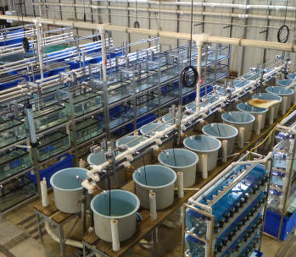
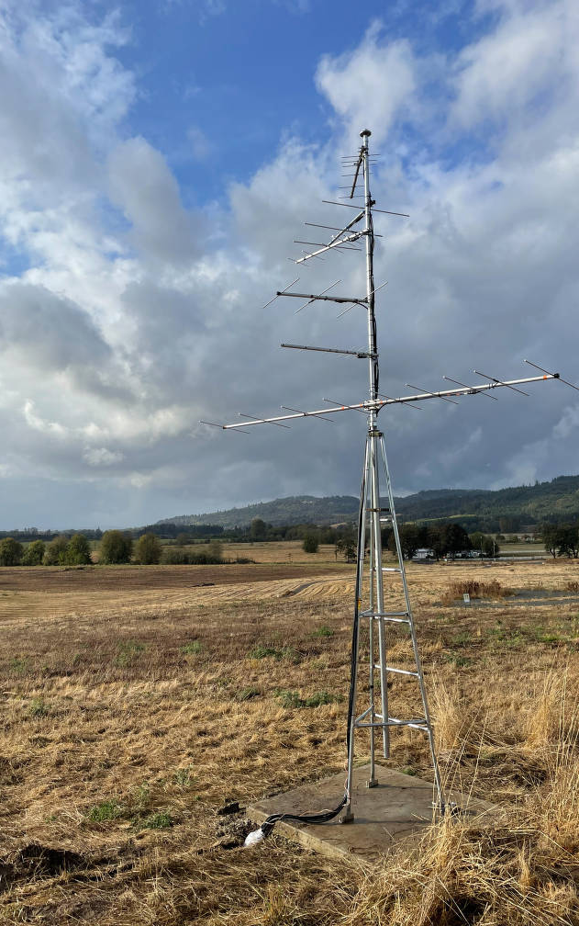
Budget Categories (cont’d)
Equipment
2 CFR 200.313, 2 CFR 200.1, 2 CFR 200.436, 2 CFR 200.439
Having a useful life >one year and per-unit acquisition cost greater than or equal to $5,000 or the $ amount for equipment established by your organization, whichever is less.
Describe how each piece of equipment proposed in budget supports the project objectives.
Review other important information in Grant Proposal Guidelines regarding other equipment details.
Supplies
2 CFR 200.314, 2 CFR 200.453, 2 CFR 200.1
Items other than those described for equipment.
List types of supplies needed to support the project.
This Photo by Unknown Author is licensed under CC BY-SA-NC
Notes:
OMB-approved common form for applicants (not individuals) of Federal financial assistance funding.
Form is available in GrantSolutions and grants.gov.
OMB-approved common form for budget information for non-construction or construction programs.

Slide 45
Budget Categories (cont’d)
Remember!
Document your determination and maintain this information in your grant files.
Contractor vs. Subrecipient (Contract vs. Subaward)
BE AWARE! 2 CFR 200.331 Subrecipient and contractor determinations: Provides information to guide determination. Describes characteristics of contracts vs subrecipients.
Substance and purpose of the relationship is more important than the form of agreement. Consider the participatory effort of the entity you are engaging in the project.
Contractor Characteristics:
Provides the goods and services within normal business operations;
Provides similar goods or services to many different purchasers;
Normally operates in a competitive environment;
Provides goods or services that are ancillary to the Federal award; and
Is not subject to compliance requirements of the Federal program as a result of the agreement.
Subrecipient Characteristics:
Has its performance measured in relation to whether objectives of the project were met;
Has responsibility for programmatic decision-making;
Responsible for adhering to requirements specified in the Federal award; and
Uses the Federal funds to carry out the purpose of the project, as opposed to providing goods or services for the benefit of the Federal award recipient.
Describe each contractual service required to accomplish project objectives.
List estimated cost per contractor (named or TDB).
Review 2 CFR 200 for other specific contract requirements.
Document your determination (Subrecipient vs. Contractor) and maintain this information in your grant file.
Subawards should be listed under the “Other” budget category.
Notes:
OMB-approved common form for applicants (not individuals) of Federal financial assistance funding.
Form is available in GrantSolutions and grants.gov.
OMB-approved common form for budget information for non-construction or construction programs.

Slide 46
Subaward Process Management
Step 1: Subrecipient vs. Contractor Determination
§ 200.331 Subrecipient and contractor determinations (a), (b), & (c)
Step 2: Subrecipient Risk Assessment
§ 200.332 Requirements for pass-through entities (b)
Step 3: Monitoring Plan Development
§ 200.332 Requirements for pass-through entities (d) & (e)
Step 4: Subaward Agreement Development
§ 200.332 Requirements for pass-through entities (a) & (c)
Step 5: Federal Funding Accountability and Transparency Act
FFATA Reporting Website

Slide 47
Budget Categories (cont’d)
Contractual
Describe each Contract and services that will be performed.
Only describe contracts – not Subawards – under this budget category.
Subawards will be listed under the "Other" Budget Category.
Other
Subawards – Describe each Subaward and the role of the subrecipient in carrying out project objective(s).
Printing costs
Conference costs
Rental costs
Training costs
Participant Support Costs:
Examples include stipends or subsistence allowances, travel allowances, and registration fees paid to or on behalf of participants or trainees (but not employees) in connection with conferences, or training projects.
NOTE: Regarding Fiscal Agents: For Applicants intending to act as a fiscal agent for another organization must clearly state that they are acting as a fiscal agent and why this role is necessary for the project. Fiscal agents must be clearly identified in the budget and described in the Budget Narrative (add a section for Fiscal Agent), including which costs (if any) they will charge to the grant.
A Fiscal Agent is a pass-through entity who will manage only the financial aspects of the grant and delegates implementation of the project objectives to a subrecipient.
Notes:
Focus more here on the indirect. We can show an example of how to calculate MTDC and the percentage on it and also show a NICRA and how to calculate indirect that applies to that. I think OCI training team had some great slides on this that they showed at the AGM

Slide 48
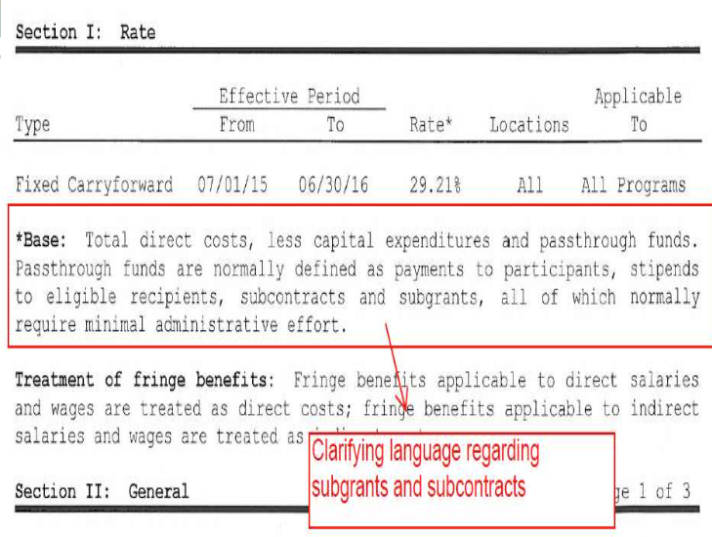
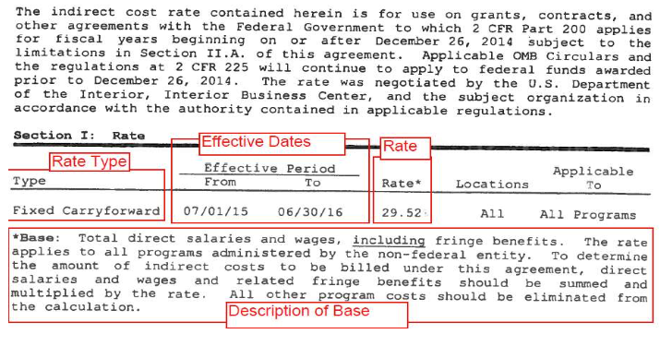
Budget Categories (cont’d)
Indirect 2 CFR 200.414
Expenses of doing business that are not readily identified with a particular grant, project, or activity, but are necessary for the general operation of the organization.
Negotiated Indirect Cost Rate Agreement (NICRA): Applicants must either have an approved NICRA to charge indirect costs to award; OR
If no NICRA, Applicant may use a de minimis rate (2 CFR 200.414), which is currently 10% and is applied to the Modified Total Direct Cost (MTDC). MTDC is defined in 2 CFR 200.1.
Two NICRA Examples:
Base Costs
MTDC includes:
Direct salaries, wages and fringe benefits
Travel
Supplies
Contractual Services
Up to the first $25,000 of each subaward
MTDC excludes:
Equipment
Capital expenditures
Rental costs
Tuition remission, scholarships and fellowships
Participant support costs
Portion of each subaward in excess of $25,000.
Other items may only be excluded to avoid a serious inequity in the distribution of indirect costs.

Slide 49
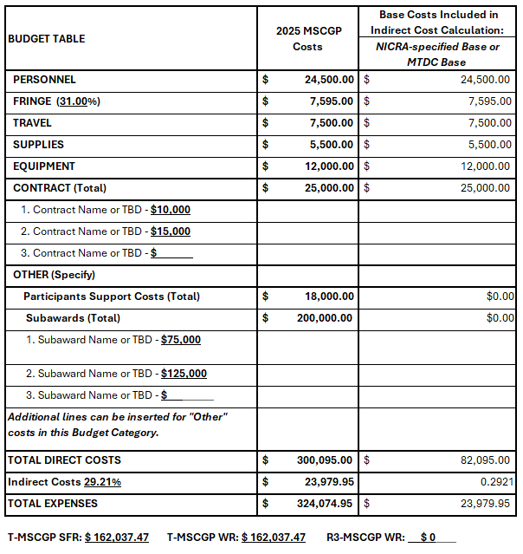
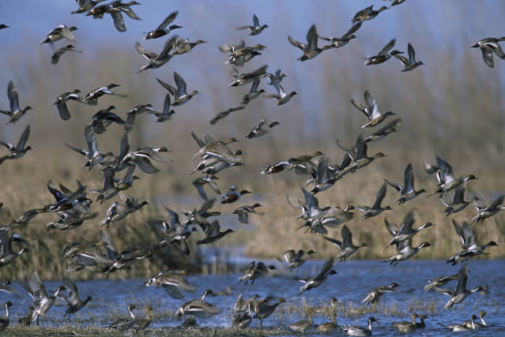
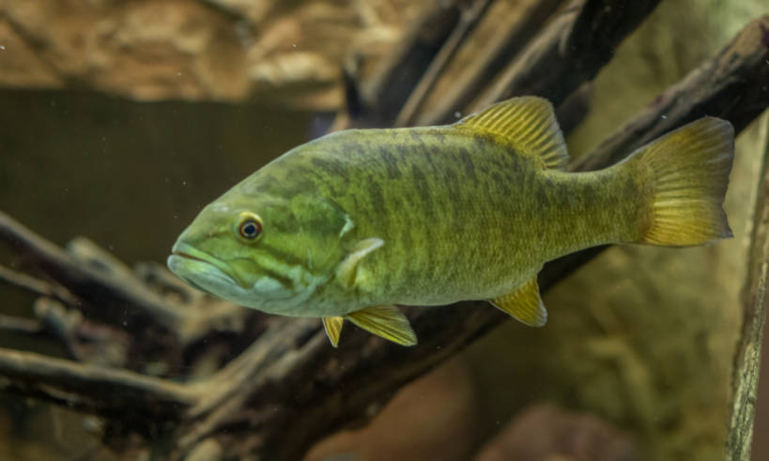
Using Negotiated Indirect Cost Rate Agreement (NICRA) as basis for Indirect Costs
Remember to identify which funds you are requesting.
This example is a research project evaluating aquatic habitats for waterfowl and sport fish.

Slide 50
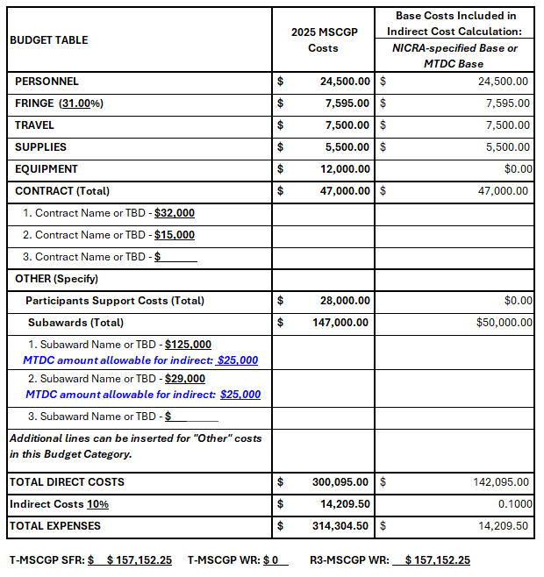
Using de minimis rate and Modified Total Direct Cost (MTDC) as basis for Indirect Costs
MTDC includes:
Direct salaries, wages and fringe benefits
Travel
Supplies
Contractual Services
Up to the first $25,000 of each subaward
MTDC excludes:
Equipment
Capital expenditures
Rental costs
Tuition remission, scholarships and fellowships
Participant Support Costs
Portion of each subaward in excess of $25,000.
Other items may only be excluded to avoid a serious inequity in the distribution of indirect costs.
Remember identify which funds you are requesting.
This example is a project proposing human dimensions and marketing training for R3 practitioners – those who engage anglers, hunters and recreational target shooters.

Slide 51
After June 7th, AFWA staff conducts a Preliminary Review for:
Eligibility
AFWA assigns proposals to Review Teams for review and scoring using the technical scoring criteria.
There are 5 Review Teams based on priority areas:
Conservation and Science,
Engagement,
Coordination,
AFWA priorities, and
R3.
Each Review Team meets to discuss scoring and rank the applications.
A Draft list of proposals ranked by the Review Teams is sent to:
Office of Conservation Investment reviews for compliance
the National Grants Committee (NGC) reviews and finalizes the list.
Proposal Review Process

Slide 52
2025 MSCGP Ranking Criteria
8 Technical Scoring Criteria:
Relevance: Effective deliverables that address strategic priority and help F&WA.
Project Objectives: Clear specific, measurable, time-bound.
Methods: A reliable approach is used to accomplish objectives.
Outcomes and Sustainability: Long-term and sustainable impacts can be quantified.
Monitoring & Evaluation: Articulated process to document project success.
Project Cost: Proposed costs are reasonable.
Guidelines: Applicant followed guidelines outlined in the announcement.
Open-Ended Questions: The project overlaps (with other projects) or requires changes or improvements.
Notes:
Transition back from Tom/Silvana by noting that a well-written Project Statement will directly speak to each of these ranking criteria. If you fully describe the need, approach, results and benefits and describe the budget elements thoroughly in the budget narrative, your proposal elements will fall directly into these ranking criteria used for scoring.

Slide 53
SAM.gov Registration: System for Award Management
UEI: Unique Entity Identifier; 12-alphanumeric, replaced DNS number; issued through SAM.gov.
GrantSolutions: Authorized Representative user account and Principal Investigator user account.
ASAP Registration: Automated Standard Application for Payment)
If your proposal is recommended for funding, be prepared to register in all these systems!
Registration may not happen quickly once initiated.
Delays in registration may impact your Full Proposal
Required System Registrations:
If invited to submit a complete grant application in GrantSolutions.
Notes:
There are only three weeks between the notification for a request of full proposals and the deadline for submission.
While the intention is that most of the work on the proposal itself has been completed through the initial submission stage, some of the additional administrative requirements can take some time – particularly if you or your organization are unfamiliar with the process.
To that end, while it’s not a specific requirement for the initial application phase, I would encourage you to familiarize yourself with these requirements and processes such that you are not caught off guard if you were to be invited to submit a full proposal.
Start working on ASAP as this may take longer…

Slide 54
SAM.gov Registration Requirement
System for Award Management (SAM)
Federal repository into which applicants/recipients must provide required information to do business with the Federal government.
Unless waived, you must have, and maintain, an active registration in SAM to receive or amend a Federal grant.
Registration is free at www.SAM.gov
Notes:
In order to do business with the Federal government, applicants must register in the System for Award Management (SAM). SAM is a Federal repository that houses information about applicants and recipients who do direct business with the Federal government.
Unless you are waived, you must be registered in SAM prior to submitting a formal application for Federal funding to a Federal awarding agency. Once you have an active SAM registration, recipients are required to update their information in SAM on at least an annual basis in order to maintain the active registration. If you let your SAM registration expire, the FWS will not be able to make any financial amendments to your approved grant, while your registration is expired. Information that you will need to register in SAM includes: (1) DUNS; (2) Legal business name; (3) Address; (4) Taxpayer Identification Number (TIN)
What purpose does SAM serve? Prior to approving a Federal grant, Federal awarding agencies must verify the applicant has an active SAM registration and must do a search on the applicant (and its key project personnel) to see if they are excluded in any way from receiving Federal funds (SAM exclusions database).
Remember, in order to register in SAM, applicants must first obtain a unique entity identifier (UEI).

Slide 55
SAM.gov: UEI and General Certifications
Applicants can obtain the following through SAM.gov Registration:
Unique Entity Identifier (UEI):
Federal law mandates that entities applying for Federal grants have a valid UEI.
UEI is a 12-character alphanumeric code assigned to an entity by SAM.gov.
Financial Assistance General Certifications and Representations:
Replaces SF-424B – Assurances for non-construction programs certification.
Registration is free at www.SAM.gov
Notes:
Federal law, and the regulations at 2 CFR 25, mandates that all entities applying for Federal grants must a valid unique entity identifier (UEI) as a universal identifier. This requirement to have valid UEI carries forward for recipients and is also required for subrecipients who receive subawards directly from the pass-through entity.
A UEI is a unique, 9-digit number that verifies the existence of a business entity worldwide.
If you have applied for federal awards in the past, you may be familiar with a DUNS number which previously served as the Unique entity identifier. Within the last year, the Federal government transitioned to UEI managed directly by SAM.gov.

Slide 56
GrantSolutions Registration
U.S. Department of Interior mandated that all bureaus use GrantSolutions beginning May 2020.
Financial assistance software platform that allows Federal agencies to manage grants throughout the entire award life cycle.
Role-based system: Organization identify their users and roles assigned to each user. Click here to go to GrantSolutions.
Need to register as a new recipient in GrantSolutions? Click here to fill out the Recipient User Account Request Form.
Notes:
The Service adopted GrantSolutions as its official system for financial assistance in May 2020. GrantSolutions is a role-based system that allows both the Service and its applicants/recipients to fully utilize and manage financial assistance grant awards throughout the entire life cycle of the grant award. It allows recipients to search for and apply for funding, as well as fulfill the grant award requirements once they are awarded a grant. If you are not registered in GrantSolutions, you will be required to do so prior to submitting a grant application. In order to register, new users must complete a Recipient User Account Request Form (there is a link provided to this directly on the powerpoint slide) and submit it to the GrantSolutions Help Desk.
Applicants/Recipients have the ability to assign up to 5 different roles to various individuals within their organization. Each role allows users to complete different tasks in GrantSolutions. The roll of “Authorizing Official/Representative” is the highest level roll for recipients in GrantSolutions, but other roles include “Financial Officer”, “Financial Officer Support”, and “Program Director/Principal Investigator”.

Slide 57
ASAP: Requesting Payments Under Federal Grants
U.S. Treasury’s Automated Standard Application for Payments (ASAP).
Fully electronic system.
Unless waived, recipients must be registered and have a payment method established before Federal funds can be obligated to a grant.
Reminder! If your organization “Head of Organization” or “Financial Official” or “Payment Requestor” will be changing, update ASAP to avoid delays in payment requests!
Notes:
Applicants who receive a Federal grant will be required to enroll in the U.S. Treasury’s Automated Standard Application for Payments (ASAP) in order to receive payments under their grant. If you have never enrolled in ASAP or have never been enrolled in ASAP under a FWS grant, then WSFR staff will facilitate your enrollment by sending you an ASAP enrollment form. Once completed, WSFR will initiate your enrollment by entering information in ASAP. ASAP will notify your organization POC how to complete the enrollment process, including enter your organization’s banking information into the system.
Once your enrollment is complete, as you incur eligible and allowable costs under the grant, the person you designate with the “Payment Requestor” role can request payments as frequently as you want. You do not need to send an invoice to the Service to receive your grant funds. Funds are typically deposited electronically into your account the next business day. It is important to remember that recipients must not draw down all their funds immediately on a grant. Payments must minimize the time between requesting funds and your subsequent disbursement of those funds to pay for allowable costs or on a reimbursement basis. Additional information will be provided in your Notice of Award.

Slide 58
Submission Reminders
Grant proposals must be submitted by Friday June 7, 2024 by 11:59 PM ET to:
AFWA via their application portal (requires a user account):
https://afwamscgp.smapply.io/
Submission to GrantSolutions not required at this time!!
Applicants are encouraged not to wait to the last minute to submit applications.
NO TRACS
Notes:
Si

Slide 59
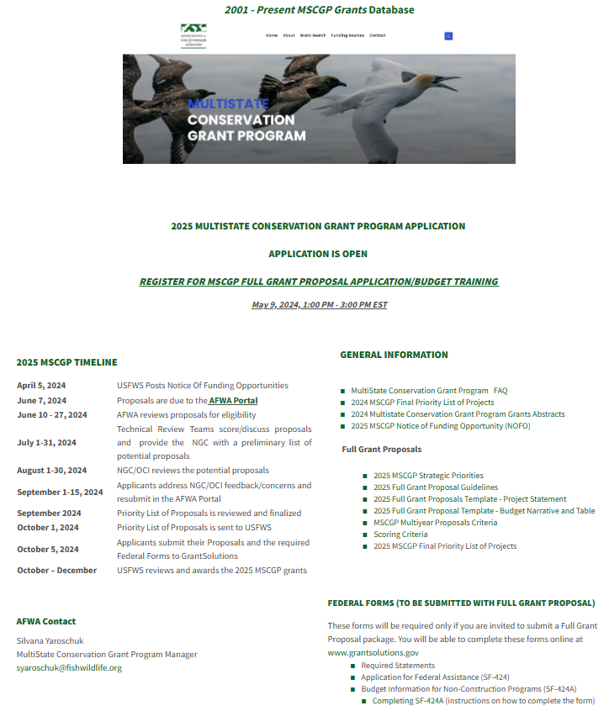
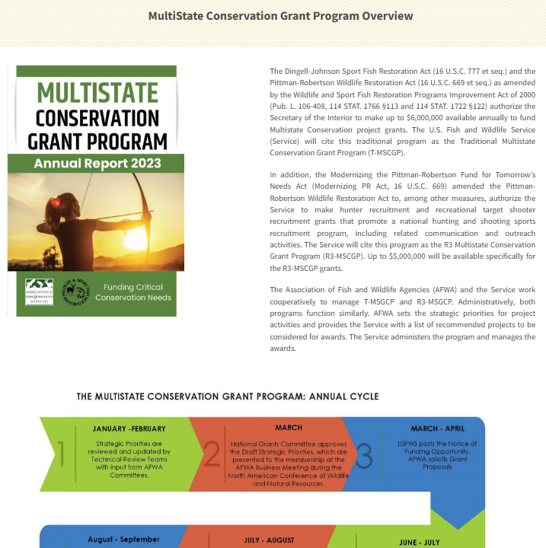
Resources
AFWA Website: Multistate Conservation Grant Program
Notes:
I can keep talking about this program forever, but I would rather show you some resources where to find all that info.

Slide 60
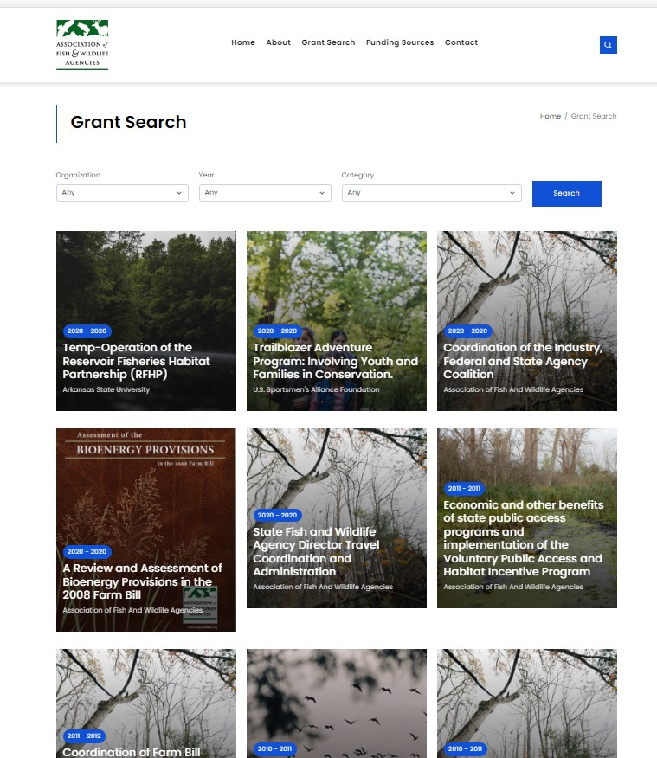
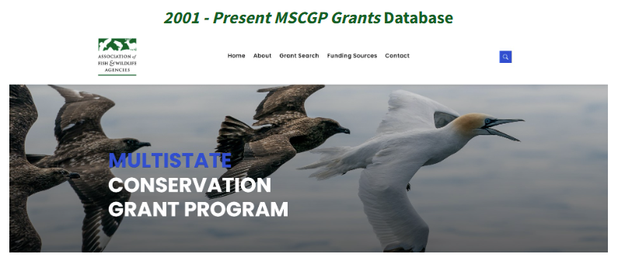
Resources MSCGP Grants Database www.fishwildlife.org/mscgp
Features Multistate Conservation Grants 2001 – Current Year.
Search options include:
Organization
Year
Priority
Key word (being added)
View abstracts and reports.

Slide 61
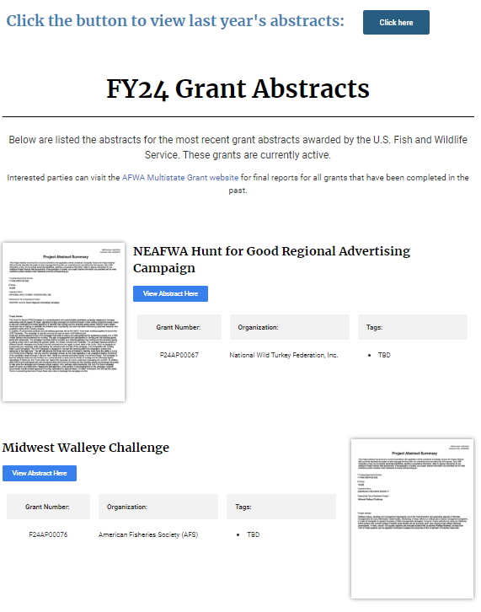
Partner with a Payer
Multistate Conservation Grant Program
Resources Partner with a Payer Website
Visit Partner with a Payer website provide abstracts for 2023 and 2024 grants.
Once final grant reports are accepted by the USFWS, AFWA will upload grant reports on the AFWA Multistate Dashboard.

Slide 62
Need Assistance?
Association of Fish and Wildlife Agencies (AFWA)
Silvana Yaroschuk, MSCGP Coordinator, syaroschuk@fishwildlife.org
John Lord, Director of Finance and Member Programs, jlord@fishwildlife.org
Office of Conservation Investment, USFWS:
Karen Bennett, Multistate Conservation Grant Coordinator, karen_bennett@fws.gov
Lori Bennett, Program Analyst, lori_bennett@fws.gov
Tom Decker, Branch Manager, Communications, Analysis and Partnerships, thomas_decker@fws.gov

Slide 63
Questions?
Thank you!

